Slide 1
UHS Internal Medical Examiners Group (IMEG) and Trust Mortality Reviews
Neil Pearce
Associate Medical Director for Safety
University Hospital Southampton

Slide 2
IMEG
All adult inpatient deaths
Child Death and Deterioration
Maternal and Perinatal Death
30 Day Post Discharge Deaths
ED and Major Trauma Centre Mortality

Slide 3
IMEG oversees all death certification
Inquest
Referral to HMC
Coroner’s PM
Part B
Death on Ward
IMEG Panel Review
Death
Registration
Part A
Approved MCCD
Bereavement Meeting
Concerns Raised
Internal Review / Investigation
(see next flowchart)

Slide 4
UHS IMEG/Mortality Review Flowchart
Speciality M&M
(with directed questions)
No adverse event but potential learning
IMEG REVIEW
No Care Concerns
No Further Action
Scoping Meeting
Potential serious adverse event / avoidable death
Care appears to be below expectations
TMRG (structured case note review)
Avoidability Rating
Avoidability Rating 1, 2, or 3
Action: Root Cause Analysis and action plan
Avoidability Rating
Avoidability Rating 4, 5, or 6
Action: feedback to clinicians, discussion at M&M
Avoidability Rating
1. Definitely avoidable
2. Strong evidence of avoidability
3. Probably avoidable (more than 50:50)
4. Possibly avoidable, but not likely (< 50:50)
5. Slight evidence of avoidability
6. Definitely not avoidable

Slide 5
IMEG Terms of Reference
The “hot” review of every adult inpatient death
Independent internal scrutiny by senior clinicians
Discussion with a member of the team prior to death certification or referral to the coroner
To assess the standard of care,
Review end-of-life care
To identify clinical concerns and adverse events
To identify potentially avoidable deaths
To improve the quality of death certification and reporting to HMC
Early identification of family concerns

Slide 7
End of life care

Slide 8
LD and mental
health reviews

Slide 9
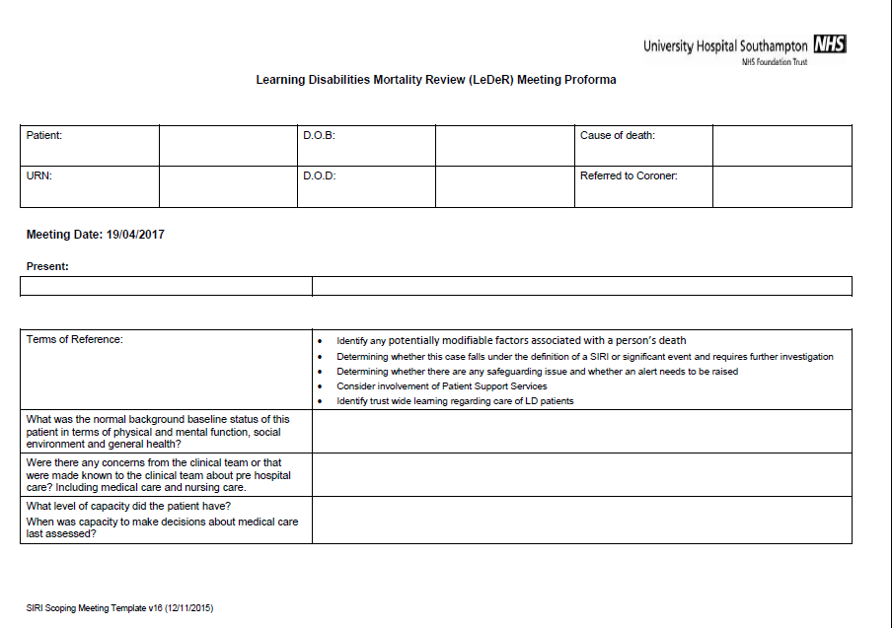

Slide 10
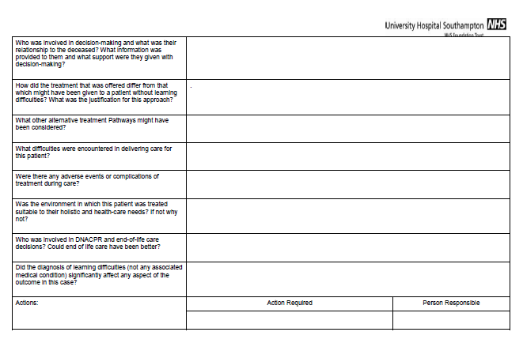

Slide 11
IMEG
Serious Adverse Event Case Review Meeting:
Identified areas of clinical concern which are thought to have directly contributed to death or other severe/ catastrophic harm
Trust Mortality Review Group (structured case note review)
Any case where there is not a clear serious adverse event but the reviewer has concerns that care could have been better and potentially ,may have adversely affected the outcome
Morbidity and Mortality:
Where elements of clinic care are felt may have been below normal expected standards, but which are unlikely to have contributed to death. Also highlight valuable learning and favourable events.
Family Concerns: Bereavement care and patient support services
Contact will be made with the family, usually directly through the bereavement care meeting, and a decision will be made with them about how best to resolve their concerns.

Slide 12
IMEG
Serious Adverse Event Case Review Meeting:
Identified areas of clinical concern which are thought to have directly contributed to death or other severe/ catastrophic harm
Trust Mortality Review Group (structured case note review)
Any case where there is not a clear serious adverse event but the reviewer has concerns that care could have been better and potentially ,may have adversely affected the outcome
Morbidity and Mortality:
Where elements of clinic care are felt may have been below normal expected standards, but which are unlikely to have contributed to death. Also highlight valuable learning and favourable events.
Family Concerns: Bereavement care and patient support services
Contact will be made with the family, usually directly through the bereavement care meeting, and a decision will be made with them about how best to resolve their concerns.

Slide 13
IMEG
Serious Adverse Event Case Review Meeting:
Identified areas of clinical concern which are thought to have directly contributed to death or other severe/ catastrophic harm
Trust Mortality Review Group (structured case note review)
Any case where there is not a clear serious adverse event but the reviewer has concerns that care could have been better and potentially ,may have adversely affected the outcome
Morbidity and Mortality:
Where elements of clinic care are felt may have been below normal expected standards, but which are unlikely to have contributed to death. Also highlight valuable learning and favourable events.
Family Concerns: Bereavement care and patient support services
Contact will be made with the family, usually directly through the bereavement care meeting, and a decision will be made with them about how best to resolve their concerns.

Slide 14
95% Of Doctors Think IMEG is a Positive Learning Experience
SA=Strongly agree, A = agree,
N = neither agree nor disagree,
D = disagree, SD= strongly disagree

Slide 15
91% Of Drs Find It A Good Opportunity To Reflect On Practice
SA=Strongly agree, A = agree,
N = neither agree nor disagree,
D = disagree, SD= strongly disagree

Slide 16
68% of junior doctors changed their practice following IMEG discussion

Slide 17
IMEG | 2016/2017
Deaths
Total Deaths in UHS | 2444
Non IMEG* | 225
Reviewed in IMEG | 2219 (91%)
Reviewed outside IMEG** | (32 +2 +19 +172)
Certificates Issued | 1994
Referred to HM Coroner | 966 (39%)
Coroner’s PM/Inquest | 225 (9%)
*= ED Deaths (MTC), maternal deaths, stillbirths, neonatal, paediatric
**= CDAD + Maternal + stillbirth/Intrapartum + ED / MTC

Slide 18
IMEG
Child Death and Deterioration
Maternal, Stillbirth and Intrapartium Death
30 Day Post Discharge Deaths
ED and Major Trauma Centre Mortality
The next big challenge!

Slide 19
IMEG | 2016/2017
Additional actions
Serious incident scoping Meeting | 60 (2.5%)
Incident Report | 42 (1.9%)
Falls Panel | 4
VTE Panel | 13
Total for adverse events | 119 (4.9%)
M & M / Clinical questions | 50 (2.2%)
TMRG Structured case notes review | 68 (3.1%)
Total additional actions | 237 (10.2%)

Slide 20
IMEG | 2016/2017
Additional Serious Family Concerns identified | 8
Learning disability case review | 16
End of Life Care
DNACPR | 1793 (73%)
Hospital Palliative Care Team | 908 (37%)
Hospital post mortem examination | 34 (1.5%)
Medical Certificate to Cause of Death
No Change / Clinical Decision | 1299 (53%)
Minor Change / Joint | 758 (31%)
Significant Change / Reviewer Modified | 374 (15%)
Change by HMC | 9 (<1%)
Cause of Death HMC | 2 (<1%)

Slide 21
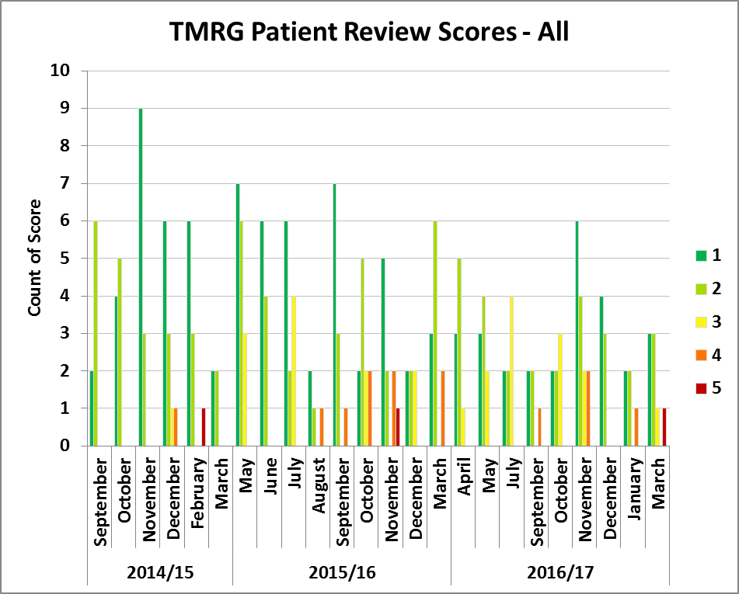
TMRG outcomes 2, Prior to RCP

Slide 22
IMEG Conclusions
Hot review of inpatient deaths, linked to a system of adverse event reporting and structured case notes review provides an effective means of assessing quality of care and avoidability
Improves the quality of bereavement care meetings
Facilitates discussion of end-of-life care
Ensures early scrutiny of mortality in vulnerable patient groups
IMEG has significant educational benefit for medical staff and changes practice

