Slide 1
Building capacity to support human factors in patient safety
Name of presenter
Organisation

Slide 2
Situation
80% of incidents are as a result of human factors.
Communication and team working are recognised to have significant impact on the quality of safe services for patients.
Cavendish Review specified standards for support workers (Bands 1 – 4) working in all NHS and social care settings.

Slide 3
Stephen’s Story
https://youtu.be/wO4bLRIjOtQ

Slide 4
Background
Health Education South West funded the West of England AHSN to develop an intervention using the SBAR tool (situation, background, assessment, recommendation) to support Human Factors training in patient safety focussing on support workers in community settings.
Curriculum developed in partnership with Sirona Care & Health and North Bristol NHS Trust.
Linked with Standard 6: Communication within The Care Certificate Standards.

Slide 5
Assessment – Human Factors
“Enhancing clinical performance through an understanding of the effects of teamwork, tasks, equipment, workspace, culture and organisation on human behaviour and abilities, and application of that knowledge in clinical settings.”
– Catchpole 2010

Slide 6
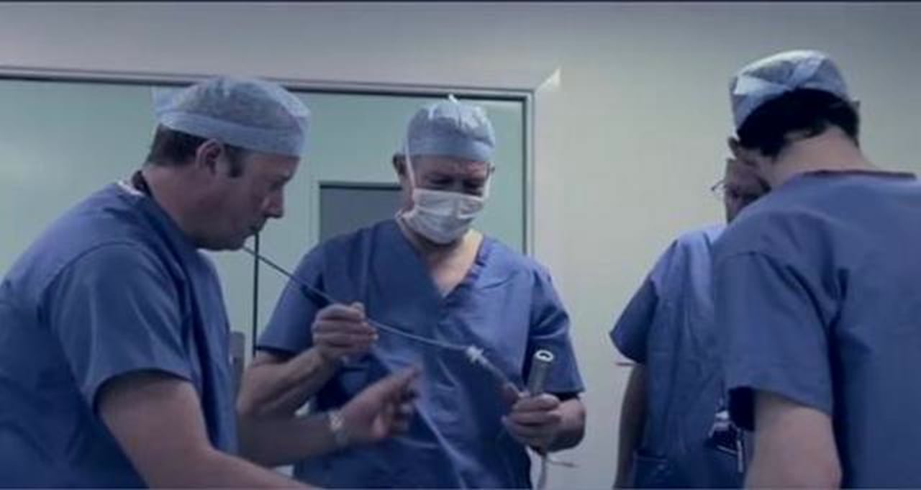
Human Factors
Just a Routine Operation
https://vimeo.com/970665

Slide 7
Recommendation – SBAR
Communication tools such as SBAR can greatly improve team communication by making conversations more succinct with greater clarity of information and expectations of action required. They have been found particularly helpful in communications where staff are expressing concerns about deterioration in patient condition but can be used to structure any conversations (clinical and non-clinical, verbal or written) to ensure adequate, useful communications are given and expectations of actions are clear.

Slide 8
S | Situation – patient’s /client’s details, identify reason for this communication, describe your concern
B | Background – relating to the patient/ client, significant history, this may include medications, investigations/ treatments
A | Assessment – what is your assessment of the patient/ client or situation, this can include clinical impression/ concerns, vital signs/ early warning score
R | Recommendations – be specific, explain what you need, make suggestions, clarify expectations, confirm actions to be taken

Slide 9
SBAR in practice
Handover – primary care
https://youtu.be/MVaOmoTuiVU
Escalation of unwell patient
https://youtu.be/26NadjAnnBc

Slide 10
Situation
Identify yourself the site/unit you are calling from
Identify the patient by name and the reason for your report
Describe your concern
Firstly, describe the specific situation about which you are calling, including the patient's name, consultant, patient location, resuscitation status, and vital signs.
For example:
"This is Lou, a registered nurse on Nightingale Ward. The reason I'm calling is that Mrs Taylor in room 225 has become suddenly short of breath, her oxygen saturation has dropped to 88 per cent on room air, her respiration rate is 24 per minute, her heart rate is 110 and her blood pressure is 85/50.”
© NHS Institute for Innovation and Improvement Safer Care
Notes:
The next slides outline the stages of SBAR (situation, background, assessment and recommendations)

Slide 11
Background
Give the patient's reason for admission
Explain significant medical history
Overview of the patient's background: admitting diagnosis, date of admission, prior procedures, current medications, allergies, pertinent laboratory results and other relevant diagnostic results. For this, you need to have collected information from the patient's chart, flow sheets and progress notes.
For example:
"Mrs. Taylor is a 69-year-old woman who was admitted from home three days ago with a community acquired chest infection. She has been on intravenous antibiotics and appeared, until now, to be doing well. She is normally fit and well and independent.”
© NHS Institute for Innovation and Improvement Safer Care
Notes:
What went well, what would you do differently and next steps

Slide 12
Assessment
Vital signs
Clinical impressions, concerns
For example:
You need to think critically when informing the doctor of your assessment of the situation. This means that you have considered what might be the underlying reason for your patient's condition.
If you do not have an assessment, you may say:
"Mrs. Taylor’s vital signs have been stable from admission but deteriorated suddenly. She is also complaining of chest pain and there appears to be blood in her sputum. She has not been receiving any venous thromboembolism prophylaxis.”
“I’m not sure what the problem is, but I am worried.”
© NHS Institute for Innovation and Improvement Safer Care
Notes:
What went well, what would you do differently and next steps

Slide 13
Recommendation
Explain what you need - be specific about request and time frame
Make suggestions
Clarify expectations
Finally, what is your recommendation? That is, what would you like to happen by the end of the conversation with the physician? Any order that is given on the phone needs to be repeated back to ensure accuracy.
"Would you like me get a stat CXR? and ABGs? Start an IV? I would like you to come immediately”
© NHS Institute for Innovation and Improvement Safer Care
Notes:
What went well, what would you do differently and next steps

Slide 14
Human Factors
Awareness of human factors can help you to:
Understand why healthcare staff make errors and in particular, which ‘systems factors’ threaten patient safety
Improve the safety culture of teams and organisations
Enhance teamwork and improve communication between healthcare staff
Improve the design of healthcare systems and equipment
Identify ‘what went wrong’ and predict ‘what could go wrong’
Appreciate how human factor tools can help to lessen the likelihood of patient/client/resident/tenant harm.

Slide 15
Implementing SBAR in our organisation
Available at http://www.weahsn.net/what-we-do/enhancing-patient-safety/patient-safety-priorities/human-factors/

Slide 16
Contacts
Local implementation lead contact
West of England AHSN project lead Nathalie Delaney nathalie.delaney@weahsn.net

