Slide 1
Start with SBAR
Template for local adaption

Slide 3
Overview of the session
9.30 Welcome and Introductions
Communication: What is it?
10.45 Break
11.00 Skills of communication
Structured communication approach
12.30 Lunch
13.15 Case studies using SBAR
14.45 Human factors and communication
15.30 Evaluation and Close

Slide 4
Good to know
Point for reflection
Group discussion

Slide 5
About this session
Commissioned by West of England Academic Health Science Network from Sirona Care and Health who developed and tested with public contributors.

Slide 6
“Taking it Personally” Sirona 2015
Slide for local
modification
CREWS
Caring
Reliable
Effective
Well-led
Safe

Slide 7
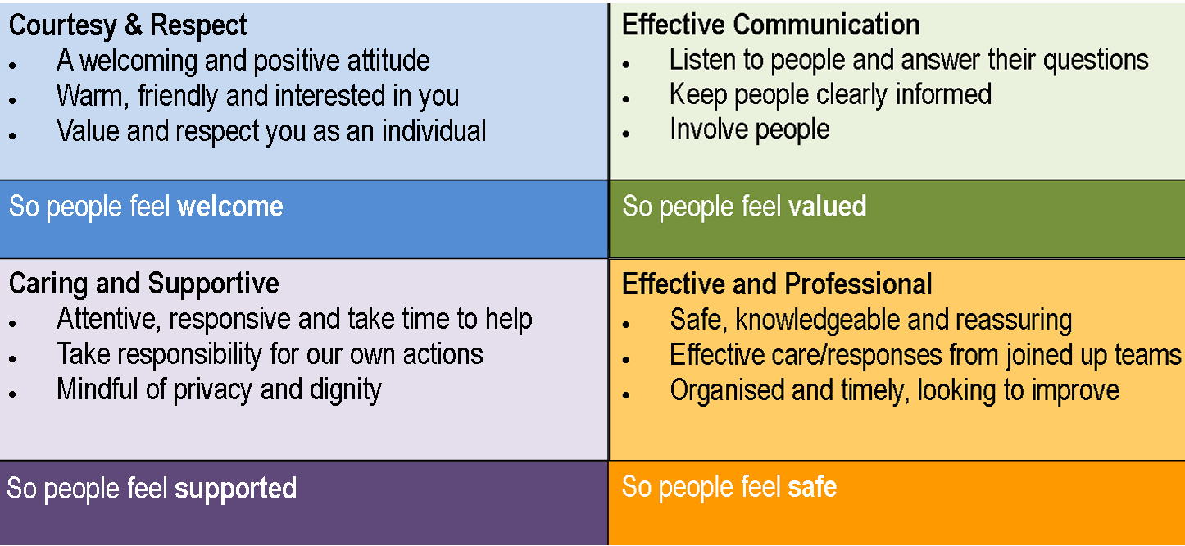
“Taking it Personally” Sirona 2015
Slide for local
modification

Slide 8
Learning Outcomes
Linked with Standard 6: Communication within The Care Certificate Standards

Slide 9
By the end of the workshop you will be able to:
Identify and explain the importance of effective communication at work.
Explore how to meet the communication and language needs, wishes and preferences of individuals.
Promote effective communication.
Identify and explain the principles and practices relating to confidentiality.
Use appropriate verbal and non-verbal communication.
Support the use of appropriate communication aids and technologies incorporating SBAR and the role of structured feedback approaches.

Slide 10
Ground rules
Confidentiality
Time keeping
Positive feedback
Respect for the opinions of others – space to have say without interruption
Take responsibility for learning

Slide 11
Housekeeping
Toilets
Fire alarms
Mobile phones/ bleeps

Slide 12
Learning to be Safer
http://www.heelearningtobesafer.org

Slide 13
“Enhancing clinical performance through an understanding of the effects of teamwork, tasks, equipment, workspace, culture and organisation on human behaviour and abilities, and application of that knowledge in clinical settings.”
– Catchpole 2010

Slide 14
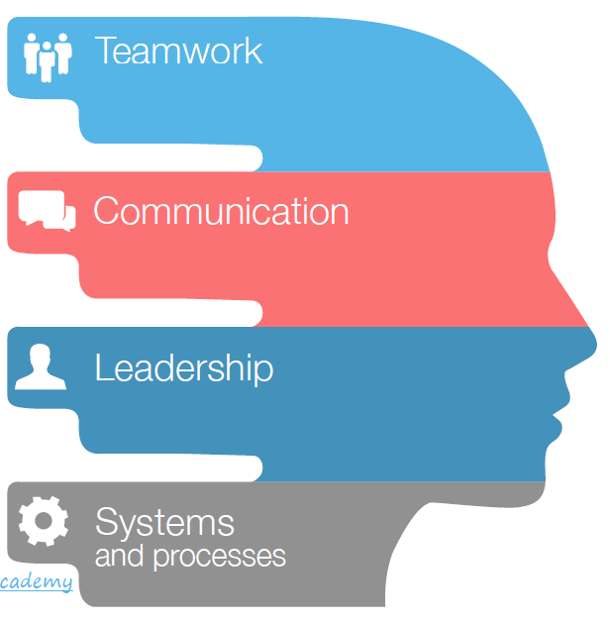

Slide 15
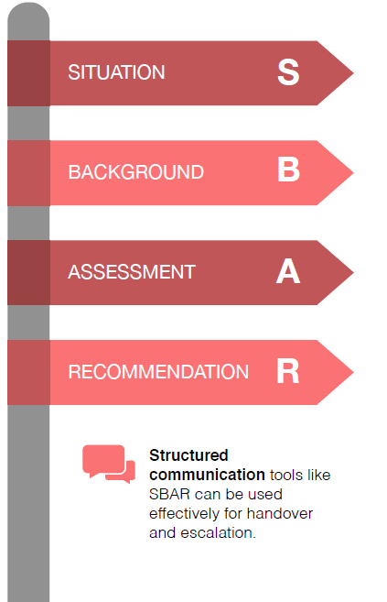

Slide 16
Aim
Slide for local
modification
The aim of this one day workshop is to provide Sirona Employed support workers with the knowledge, skills and attitude to support service users by communicating effectively within all aspects of interaction and operating as part of the dedicated team.

Slide 17
SBAR
SBAR is a structured method for communicating critical information that requires immediate attention and action contributing to effective escalation and increased patient safety (the priority).
SBAR can also be used to effectively enhance handovers between shifts or between staff in the same or different clinical or care areas.
We will use this tool later and apply it to some scenarios. So…

Slide 18
SBAR
S Situation Patient/ client’s details, identify reason for this communication, describe your concern.
B Background. Relating to the patient/ client/ service user/ resident significant history; this may include medications, investigations, treatments.
A Assessment. What is your assessment of the patient/ client or situation. This can include clinical impressions/ concerns, vital signs if relevant.
R Recommendation. Be specific, explain what you need, make recommendations, clarify expectations and confirm actions to be taken.

Slide 19
Communication, what is it?
Material facts: what are they?
Links with Confidentiality and Record Keeping later in the day

Slide 20
Communication, what is it?
Basic human right (what happens in a prison?)
Means of controlling the environment (TV, newspapers, internet?)
Making friends and building relationships
Gaining independence and choice making (growing up?)
Learning
Expressing feelings, thoughts and emotions (the language we use with family and friends is different than at work?)
Making sense of the world (avoid isolation)
2-way (and more) process between individuals and groups
Information exchange

Slide 21
Material facts are:
“Ones that, if they were withdrawn, would make a difference”
So, when communicating, part of your job is to give sufficient information for others to make decisions with.
You will also need Material Facts to do your job well.

Slide 22
How do we communicate?
Verbal
Non-verbal

Slide 23
How do we communicate?

Slide 24
How do we communicate?

Slide 25
How do we communicate?
Verbal
Speech
Content of speech
Noises
Vocalisation
Listening
Prosody – tone of voice, speech rate, intonation, volume, pitch
Clarity and fluency

Slide 26
How do we communicate?
Non-verbal
Body language/ movement Facial expression
Eye contact Posture/ gait
Gesture Sign language
Body proximity Touch
Appearance Smell
Pictures/ symbols Behaviour

Slide 27
Activity 1

Slide 28
Activity 1
How does communication affect relationships at work?
Who do you have work relationships with?
Reflect upon what you think good and bad communication skills do to your relationships at work.

Slide 29
Activity 1
How does communication affect relationships at work? Who do you have work relationships with?
Suggested answers:
Clients, service users, residents, tenants, friends and relatives…
Colleagues (your own, and others outside)
Managers
Yourself
Any others?

Slide 30
Activity 1
How does communication affect relationships at work? Reflect upon what you think good and bad communication skills do to your relationships at work.
Suggested answers:
Good:
Clear messages, good service provisions, safe, caring, getting help for people who need it
Any more?
Bad
Frustration, anger
Any more?

Slide 31
Effective working relationships…
Respect and value everyone’s contributions
Keep to any agreements made with colleagues
Be on time for any meetings
Take your fair share of the workload!
Ask and answer questions
Share your knowledge with others
Follow procedure to resolve disputes
Learn from the knowledge and skills of colleagues
Follow procedure for making decisions

Slide 32
Activity 2

Slide 33
Activity 2
Why do we need to know a person’s level of understanding?

Slide 34
Activity 2
Why do we need to know a person’s level of understanding?
Suggested answers:
Unrealistic expectations
Misinterpreted messages or partially understood may result in inappropriate behaviour
When someone does not respond appropriately they may be described as “uncooperative”
Confusion
Frustration at inconsistencies
Feel safer to withdraw

Slide 35
Break

Slide 36
Activity 3
In groups of 3

Slide 37
Activity 3
1. All of you, write the names of several emotions on pieces of paper.
Put the pieces of paper in the middle to pick out.

Slide 38
Activity 3
2. One of you pick out a piece of paper. Do not show it to your group! Communicate this emotion to the other two without speaking.
Non-verbal communication only.

Slide 39
Activity 3
3. The other two participants have to decide what and how you are communicating and decide what the emotion you are wanting to communicate to them. What makes up the emotion?

Slide 40
Activity 3
4. Try to list or note all the things that made you aware of the emotion being conveyed.
5. How easy was it to do this and guess the emotion?
6. Why is this aspect of communicating important to support workers?

Slide 41
Interpreting cues and messages
Why is it important to observe and be receptive to an individual’s reactions when communicating with them?

Slide 42
Interpreting cues and messages
Research shows that people pay far more attention to facial expressions and tone of voice than the spoken word.

Slide 43
Activity 4

Slide 44
Activity 4
See handout Proxemics Activity.
How did you feel?

Slide 45
Personal space
Research has shown that there are zones within which we are comfortable to communicate. Do you agree?
Intimate
Personal
Social
Public

Slide 46
Barriers to communication
What can they be?

Slide 47
Barriers to communication
Suggested answers:
Hearing impairment
Voice/ articulation/ speech e.g. dyspraxia, dysarthria, phonological, stammer, structural problems
Specific language impairments
Comprehensive / understanding difficulties of verbal and non-verbal communication
Expressive difficulties e.g. perserveration, echolalia
Autistic spectrum disorder
Poor non verbal/ social skills e.g. gesture, eye contact, turn taking, using language appropriately
Physical/ sensory impairment
Memory
Listening – locating, identifying sound, discriminating between sounds, attaching meaning
Attention
Motivation – can decrease if needs are always pre-empted/ routine
Having something to say

Slide 48
Important things to remember…
Families and carers can be a huge source of information about people with communication difficulties.
If you work with a new service user with new needs then consult with your manager and plan how their communication needs will be best met.
They will be able to offer specific advice
(e.g. communication tools, etc.)
Important to ask the service user first –
they may have thoughts and opinions
which differ to the person supporting them.

Slide 49
Revisit the learning outcomes
Identify and explain the importance of effective communication at work.
Explore how to meet the communication and language needs, wishes and preferences of individuals.
Promote effective communication.
Identify and explain the principles and practices relating to confidentiality.
Use appropriate verbal and non-verbal communication.
Support the use of appropriate communication aids and technologies incorporating SBAR and the role of structured feedback approaches.

Slide 50
Lunch

Slide 51
Learning outcomes for this afternoon…
Identify how SBAR can enhance communication exchanges.
Discuss examples of situations where communication can be improved, using a structured tool such as SBAR.
Identify a range of communication scenarios where SBAR can be used successfully.
Practice using the SBAR tool in a communications scenario.
Identify how SBAR can be used effectively within learners’ own practice areas.

Slide 52
SBAR
See hand outs for group work prompts and questions

Slide 53
SBAR
Handover – primary care
https://youtu.be/MVaOmoTuiVU
Handover – acute care
https://youtu.be/26NadjAnnBc

Slide 54
SBAR
Communication tools such as SBAR can greatly improve team communication by making conversations more succinct with greater clarity of information and expectations of action required. They have been found particularly helpful in communications where staff are expressing concerns about deterioration in patient condition but can be used to structure any conversations (clinical and non-clinical, verbal or written) to ensure adequate, useful communications are given and expectations of actions are clear.
For more information see: http://www.patientsafetyfirst.nhs.uk/ashx/Asset.ashx?path=/How-to-guides-2008-09-19/Deterioration%201.1_17Sept08.pdf

Slide 55
SBAR
What can you do to improve teamwork?

Slide 56
Activity 5

Slide 57
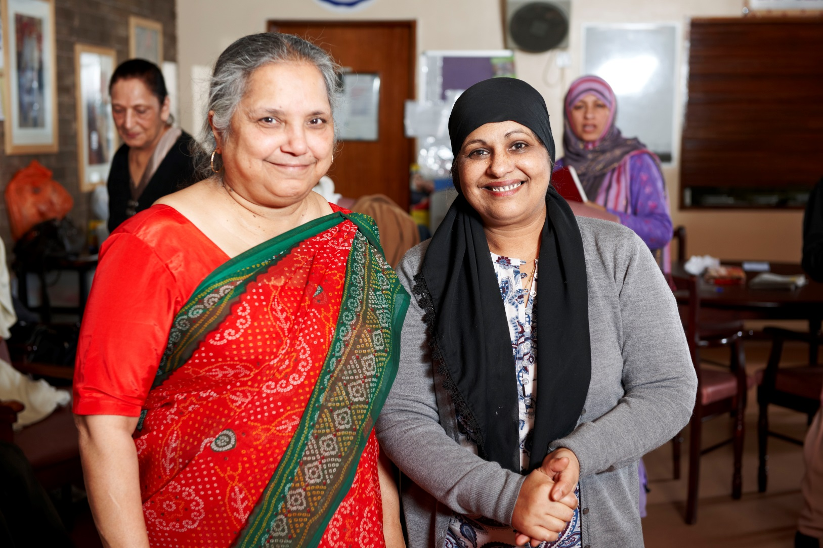
Case study 1 – Mrs Khan
Notes:
Photo source: NHS Photo Library

Slide 58
Case study 1 – Mrs Khan
Mrs Khan came to live in Britain about eight years ago. She came with her son and daughter-in-law from a small village in Afghanistan. She has always lived with her family, and has not needed to adapt her way of life to fit in with different ways of doing things in her adopted country. Mrs Khan speaks little English and can understand more than she speaks. She lives independently in her own rented flat about 1 kilometre from her family.
Her son an daughter-in-law work full time and are away from their home during the day and cannot always call in to see her during the week.
Now 86, Mrs Khan has mobility problems and a domiciliary care worker has recently begun to visit to help with daily tasks.
Mrs. Khan has recently had a fall, which has left her with a leg wound that needs regular dressing.

Slide 59
Case study 1 – Mrs Khan
Using SBAR:
S. What would you report about Mrs Khan’s condition?
B. What will you communicate about Mrs Khan’s history?
A. What observations will you report, including clinical vital signs?
R. What will you communicate in your suggestions and recommendations?

Slide 60
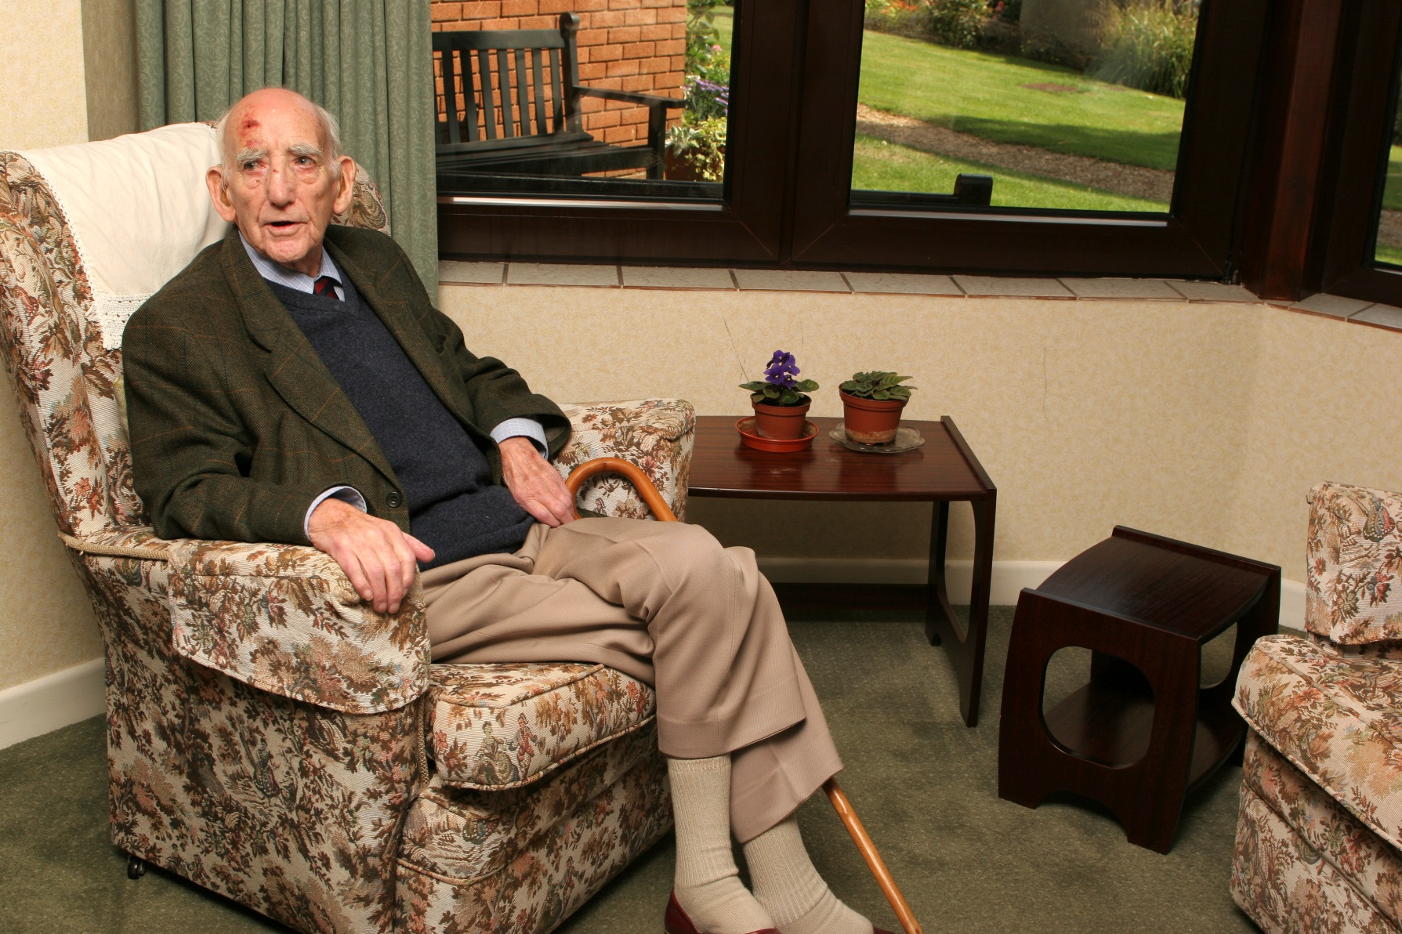
Case study 2 – Bert Smith
Notes:
Photo source: NHS Photo Library

Slide 61
Case study 2 – Bert Smith
Bert Smith is a 86 year old gentleman who lives in a supported living complex. He lives alone and maintains his independence with the help of support workers who visit three times a day.
Bert is usually very chatty when the support worker visits, however during the last two visits she has noticed he is a little confused when she talks to him.
Bert walks with a wheeled Zimmer frame and when the support worker helps him to mobile from the bedroom to the sitting area his movement is not as good as usual and he is shuffling rather than walking. She also notes a cut on his leg which he says he knocked on the coffee table. The area around the cut is hot to touch. The blood has dried but the wound looks inflamed and painful.
Bert says he does not want any breakfast prepared for him as he is not hungry and the support worker notices that yesterday’s tea time sandwich and cup of tea are where she left them. When chatting to Bert the support worker suggests a cup of tea and Bert says he only wants a small cup as he has to keep going to the toilet and cannot always get there in time.
When the support worker looks at Bert more closely she does notice that his skin is very dry and he says he feels unwell. He then asks her again who she is.

Slide 62
Case study 2 – Bert Smith
Using SBAR:
S. What would you report about Bert’s condition?
B. What will you communicate about Bert’s history?
A. What observations will you report, including clinical vital signs?
R. What will you communicate in your suggestions and recommendations?

Slide 63
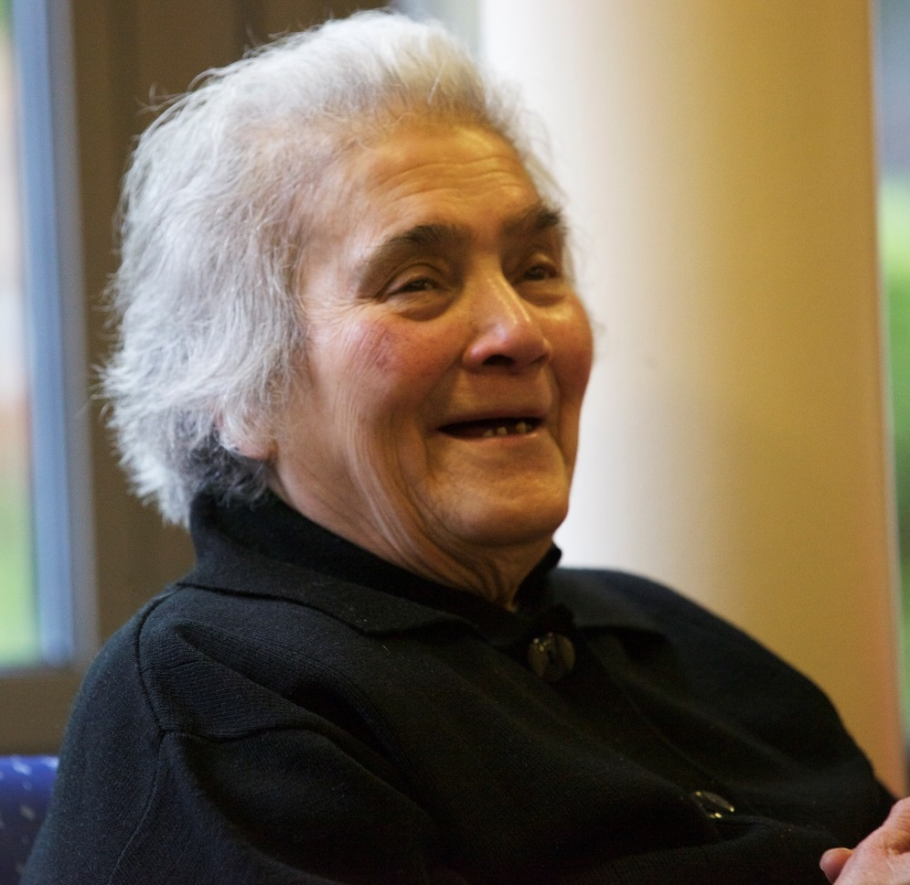
Case study 3 – Cynthia Flint
Notes:
Photo source: NHS Photo Library

Slide 64
Case study 3 – Cynthia Flint
Cynthia Flint is a 75 year old lady who lives on her own. She has a past medical history of a stroke which has left her with right sided weakness. The support worker visits daily to assist Cynthia to get dressed. Cynthia's daughter visits in the evening to help her into bed.
When you visit this morning you find Cynthia lying on the floor where she has been all night. As her daughter is away Cynthia thought she could manage on her own and has not told care staff what the plan is for the evenings.
Cynthia seems confused and is in pain when you try to move her.

Slide 65
Case study 3 – Cynthia Flint
Using SBAR:
S. What would you report about Cynthia’s condition?
B. What will you communicate about Cynthia’s history?
A. What observations will you report, including clinical vital signs?
R. What will you communicate in your suggestions and recommendations?

Slide 66
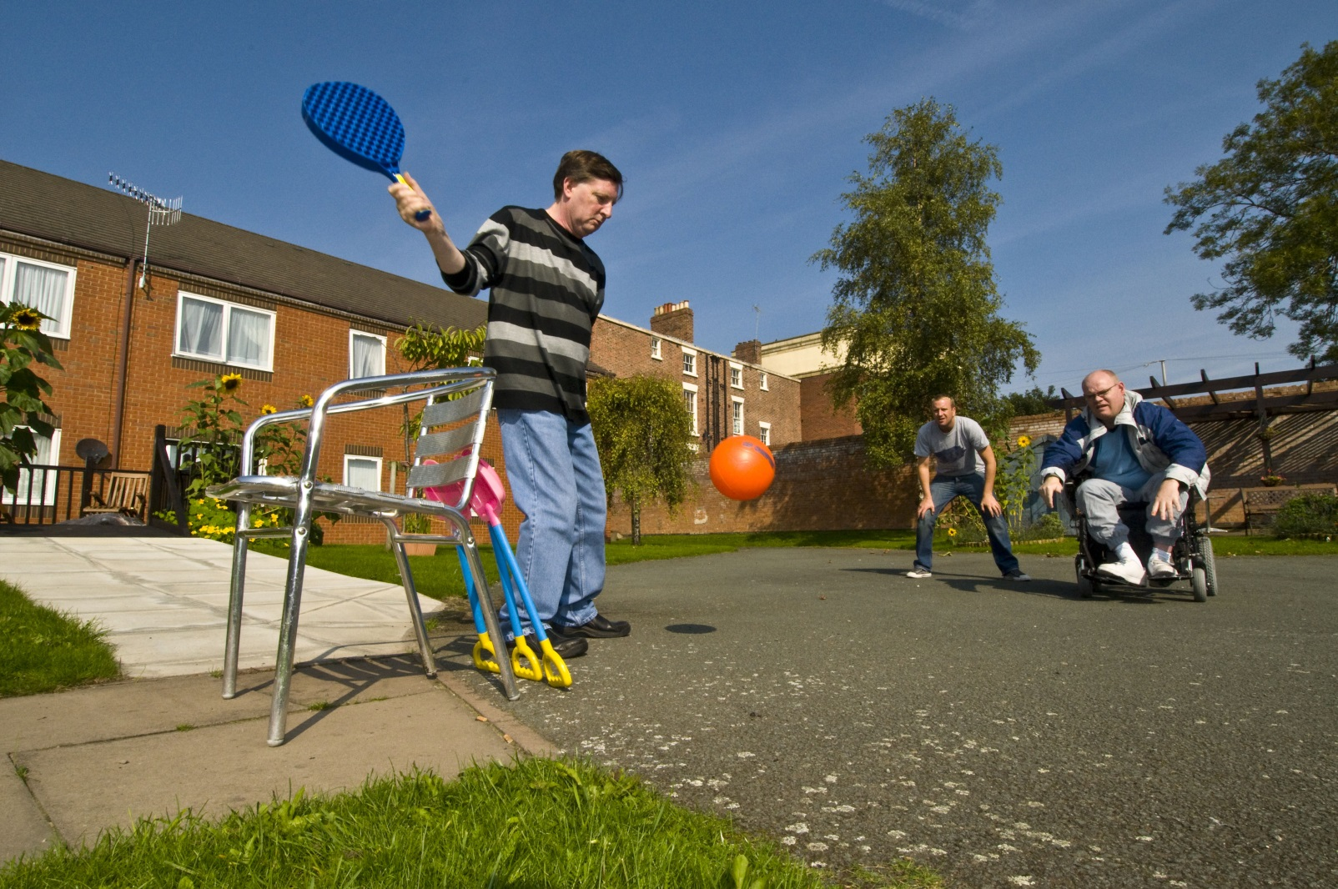
Case study 4 – John

Slide 67
Case study 4 – John
John is a 42 year old man who uses a wheelchair to mobilise. When he was 8 years old he fell from a bridge and suffered a brain injury. As a result he has some communication difficulties and is unable to use his lower limbs. John is very outgoing and sociable and enjoys sports. John lives with his parents in an independent flat in the basement. John very much enjoys the outdoors and is currently doing a numeracy course at college.
John requires help and support with personal care and supervision with medicines and going out into town and shopping.
One morning you find John on the floor of his flat. He is angry and frustrated and doesn’t seem to know how he got out of his chair and onto the floor.

Slide 68
Case study 4 – John
Using SBAR:
S. What would you report about John’s condition?
B. What will you communicate about John’s history?
A. What observations will you report, including clinical vital signs?
R. What will you communicate in your suggestions and recommendations?

Slide 69
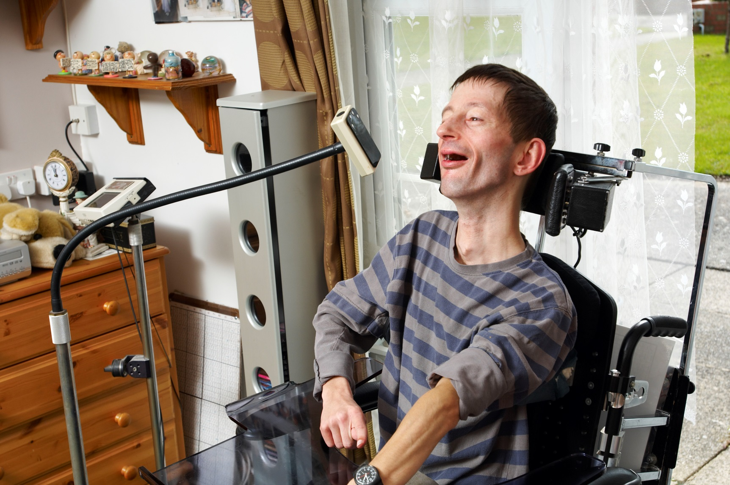
Case study 5 – Alfie

Slide 70
Case study 5 – Alfie
Alfie is a 32 year old man and has PMLD (profound multiple learning difficulties). Alfie needs 24/7 support and has epilepsy, a PEG tube in situ as well as posture and positioning issues. Alfie enjoys more “passive” activities although he does enjoy the occasional “rough and tumble”.
Alfie is supported at home and has a purpose-built annexe that he lives in attached to the family home.
One day after you enter Alfie’s home you notice that he appears to be struggling to breathe. His eyes are opened wide and his lips are looking a little blue. There is a half-eaten burger on his plate.

Slide 71
Case study 5 – Alfie
Using SBAR:
S. What would you report about Alfie’s condition?
B. What will you communicate about Alfie’s history?
A. What observations will you report, including clinical vital signs?
R. What will you communicate in your suggestions and recommendations?

Slide 72
Case study 6 – Ranjeeta

Slide 73
Case study 6 – Ranjeeta
Ranjeeta is a 28 year old woman and she lives at home with her family. Ranjeeta has a personal budget and is looking for 2 days per week day care.
Ranjeeta has epilepsy and hemiplegia. She tries really hard to be independent and would eventually like to live in her own flat with Supported Living Service.
Rajeeta likes dancing, swimming and the company of other people of similar age.
One day you attend Ranjeeta’s flat and find her lying on the floor. She is talking but is a little confused and doesn’t know how she got onto the floor.

Slide 74
Case study 6 – Ranjeeta
Using SBAR:
S. What would you report about Ranjeeta’s condition?
B. What will you communicate about Ranjeeta’s history?
A. What observations will you report, including clinical vital signs?
R. What will you communicate in your suggestions and recommendations?

Slide 75
Case study 7 – Jenny

Slide 76
Case study 7 – Jenny
Jenny is 19 years old and has mild Learning Disabilities. Jenny still lives at home at the moment but is hoping to move to a flat to live with her boyfriend.
Jenny likes meeting people of a similar age to her and also likes to play netball, going to discos, make up and going out with Jed, her boyfriend.
Jenny needs support with money and medications at present and it could be that she will need more support once living independently.
You meet Jenny at her house one day and find her dossett box half empty and it is only Monday. Jenny looks flushed and as though she is perspiring. Her parents are not at home this week and her boyfriend is not about either.

Slide 77
Case study 7 – Jenny
Using SBAR:
S. What would you report about Jenny’s condition?
B. What will you communicate about Jenny’s history?
A. What observations will you report, including clinical vital signs?
R. What will you communicate in your suggestions and recommendations?

Slide 78
Case study 8 – David

Slide 79
Case study 8 – David
David is 34 years old and has ASD (autistic spectrum disorder). David has no known family. David enjoys routine and has some communication issues. When his routine is disturbed he can become challenging with those around him.
David enjoys his own company and is reluctant to mix in with group activities and gatherings sometimes.
David lives in a residential home with 3 other people. David enjoys TV and computer games and cleaning the house.
Whilst in the house one day you suddenly hear a crash and lots of shouting. It is coming from the lounge.
On entering the room the TV is on the floor and Eric, a fellow housemate, is also on the floor with a nose bleed.
David is nowhere to be seen but you have just heard a door bang down the hallway.
You leave someone to tend to Eric and follow after David.

Slide 80
Case study 8 – David
Using SBAR:
S. What would you report about David’s condition?
B. What will you communicate about David’s history?
A. What observations will you report, including clinical vital signs?
R. What will you communicate in your suggestions and recommendations?

Slide 81
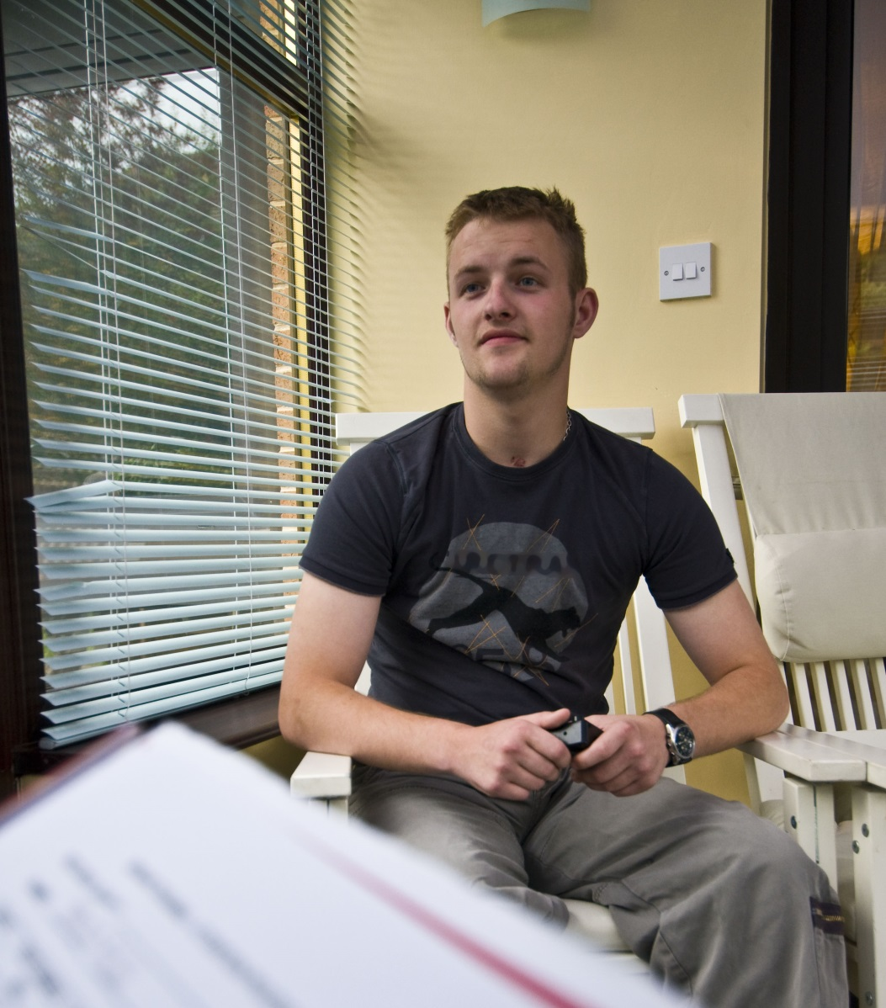
Case study 9 – Pat

Slide 82
Case study 9 – Pat
Pat is a 26 year old man who lives with his mother and her partner in a large converted house in Bath. Pat has physical disability as a result of a motorbike accident when he was 19. He is physically fit with a strong upper body but permanent injuries to his legs which give him pain on moving. He has limited physical mobility when walking slowly and cannot use stairs.
Pat also suffered a head injury during the accident and is liable to get frustrated and ‘challenging’ if his routines or wishes are not met sometimes.
Pat wishes to move out of his mother’s house and has been offered an independent scheme where you will provide support and some care. You have met with Pat to get to know him and help assess him for independent living.
Overall, this is a very positive move for Pat, he is really looking forward to his move and he hopes his girlfriend and other friends can stay with him and he can enjoy a new life. Pat wants to speak with you about his move and you have been asked to help him plan this.

Slide 83
Case study 9 – Pat
Using SBAR:
S. What would you report about Pat’s condition?
B. What will you communicate about Pat’s history?
A. What observations will you report, including clinical vital signs?
R. What will you communicate in your suggestions and recommendations?

Slide 84
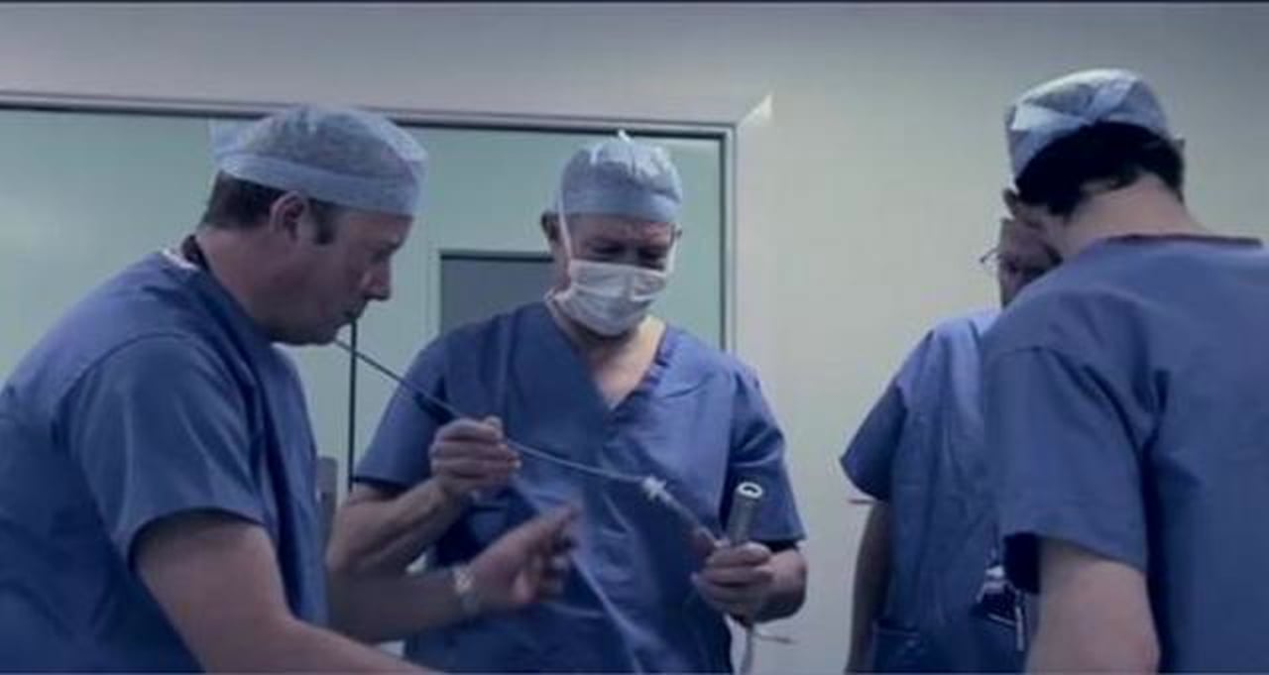
Human Factors
Just a Routine Operation
https://vimeo.com/970665

Slide 85
Human Factors
Stress is a recognised contributor in many such incidents/errors. People behave differently in high pressure situations and at such times, sensitivity to other human factors is heightened, in particular those most likely to affect perception and cognitive functions.
Some of the common human factors that can increase risk include:
mental workload
distractions
the physical environment
physical demands
device/product design
teamwork
process design

Slide 86
Human Factors
Awareness of human factors can help you to:
Understand why healthcare staff make errors and in particular, which ‘systems factors’ threaten patient safety
Improve the safety culture of teams and organisations
Enhance teamwork and improve communication between healthcare staff
Improve the design of healthcare systems and equipment
Identify ‘what went wrong’ and predict ‘what could go wrong’
Appreciate how human factor tools can help to lessen the likelihood of patient/client/resident/tenant harm.

Slide 87
Human Factors

Slide 88
Confidentiality
What does this mean in your role?
Suggestions…?

Slide 89
Confidentiality
Part of Information Governance (IG)
This is with regard to the ‘handling’ of information and refers to issues of information management:
*Confidentiality *Security *Processing
Service Users have a right (and we have a duty of care) to expect information to be protected and used only for the purposes it was supplied by them, or to us ‘about’ them.
Staff must maintain the confidentiality of information about service users, staff and other business at all times. Our work is of a confidential nature and information gained must not be communicated to other persons except in the recognised course of duty. Failure to do so may result in disciplinary action being taken.
Appropriate measures must be in place to handle and protect individuals, service user and their families

Slide 90
Confidentiality
Links with Material Facts mentioned earlier in the day
If a service user does not TRUST us then we are less likely to have a therapeutic and positive relationship with them
A service user (and any person owed a duty of care) can take legal action for damages and FINES can also be applied to the organisation
ALL staff have a duty of care with confidential information
ALL staff have a duty to seek to obtain truthful and meaningful information about a service user. This enables them to effectively care for service users. This then has to be ‘used’ appropriately.
Wherever information is stored or kept it must be ‘protected’. This can be in cars, public transport, clinics, ward areas, CRC’s and …
In whatever format i.e. letters, e mails, IT systems, diaries, care notes, etc.

Slide 91
Confidentiality
Links with Material Facts mentioned earlier in the day
If a service user does not TRUST us then we are less likely to have a therapeutic and positive relationship with them
A service user (and any person owed a duty of care) can take legal action for damages and FINES can also be applied to the organisation
ALL staff have a duty of care with confidential information
ALL staff have a duty to seek to obtain truthful and meaningful information about a service user. This enables them to effectively care for service users. This then has to be ‘used’ appropriately.
Wherever information is stored or kept it must be ‘protected’. This can be in cars, public transport, clinics, ward areas, CRC’s and …
In whatever format i.e. letters, e mails, IT systems, diaries, care notes, etc.

Slide 92
Confidentiality
Legislation
Data Protection Act (1998)
Caldicott Principles

Slide 93
Activity 6

Slide 94
Activity 6
See handout Information Governance.
Read the handout and comment on how this applies to you in your work.

Slide 95
Activity 6
Examples for consideration …
Ophthalmology Consultant
Duty to pass on confidential information but NEVER to BREAK a confidence
Tarrassoff V. Regents of University of California
Mental Health Psychiatrist and OWNERSHIP of confidential information

Slide 96
Confidentiality
Slide for local
modification
Situations where information, normally considered confidential, might need to be passed on:
With the service users permission
In the public interest
When ordered to do so by a court
Is it a duty or a right to pass on confidential information?
Linked with: Rights, Duties, Responsibilities, Best Interests and Least Worst Options
See Page 8 of Sirona Information Governance Staff Mandatory Training Handbook 2015 for Social Media Rules and Requirements

Slide 97
Confidentiality
Slide for local
modification
Advice and Support:
“The first ‘port of call’ should be your line manager. Confidentiality and information security is extremely important so do not be afraid to ask if you are unsure about something as it is likely that your issue is one that has come up before”
You can also contact Joe Tarring, Sirona’s IG Lead for advice by email Joe.tarring@sirona-cic.org.uk

Slide 98
Activity 7

Slide 99
Activity 7
Throughout the day you will have been communicating with others in the room and also observing others communicating with you.
So, to help you reflect upon this day…

Slide 100
Activity 7
Turn to a person near to you and tell them about the best holiday you have had OR time away from home you have ever had (working or travelling?) OR you can tell them about a hobby you have Consider
Verbal Tone and Volume
Non-Verbal
Position/Proximity
Eye Contact
Body Language
Touch
Signs
Symbols and Pictures
Writing
Objects of reference
Human and Technical aids

Slide 101
Knowledge check
Which form of communication uses signs and symbols to convey meaning?
Click to reveal answer
Makaton
Sign language
Braille
Eye contact
Notes:
Trainer should ask class why they chose the correct answer.
Feedback
A – Makaton is a form of language that uses a large collection of signs and symbols. It is often used with those who have learning and physical disabilities, or hearing impairment.
B – Sign language is a way of communicating which uses hand shapes and movements to get a message across.
C – Is a code of raised dots that are ‘read’ using touch. For people who are visually impaired or who are blind, the system supports reading and writing.
D – Maintaining good eye contact is an important way for a health and social care worker to show that they are engaged and listening.

Slide 102
Knowledge check
Which of the following is a result of poor communication?
Click to reveal answer
Understanding individual’s needs
Confusion
Effective team working
Clarity and trust
Notes:
Trainer should ask class why they chose the correct answer.
Feedback
A – Poor communication can lead to misunderstandings about an individual’s specific need and support. Understanding the individual's needs is more likely to result from good communication.
B – Poor communication can lead to mixed messages and confusion both between other workers who provide care and support and between the health and social care worker and the individual.
C – Poor communication can lead to misunderstandings and poor teamwork between teams of workers providing care. Effective team working of more likely to be a result of good communication.
D – Poor communication tends to lead to confusion and misunderstandings that can undermine trust. Clarity and trust are more commonly the result of good communication.

Slide 103
Knowledge check
A health and social care worker is talking to an individual about their needs. What is the best way to check that they have understood?
Click to reveal answer
Body language
Summarising
Touch
Stereo-typing
Notes:
Trainer should ask class why they chose the correct answer.
Feedback
A – The health and social care worker should be aware of body language and use it to get clues about how the individual is feeling but this is not the best way to check that you have understood what they have told you.
B – By summarising the key points of what have been discussed and repeating this back to the individual, the health and social care worker can check that they have fully understood what the individual has said. The individual has the opportunity to correct them if necessary.
C – Touch is a way of communicating with an individual who has a hearing impairment. It is unlikely that a health and social care worker would communicate through touch to confirm understanding if they had been having a verbal conversation.
D – Stereo-typing involves making assumptions about an individual based on their appearance or characteristics. This is not an effective way for a health and social care worker to check that they have understood what has been said.

Slide 104
Finally…
Support for the use of appropriate communication aids/technologies
Ensure they are:
Clean
Working properly
In good repair
Report to the appropriate person. This could be:
Senior member of staff
Carer or Family member

Slide 105
Our objectives for today:
Identify and explain the importance of effective communication at work.
Explore how to meet the communication and language needs, wishes and preferences of individuals.
Promote effective communication.
Identify and explain the principles and practices relating to confidentiality.
Use appropriate verbal and non-verbal communication.
Support the use of appropriate communication aids and technologies incorporating SBAR and the role of structured feedback approaches.

Slide 106
Any questions?

