Slide 1
Using Structured Mortality Reviews in Surgical Practice
Anne Pullyblank
Colorectal Surgeon North Bristol NHS Trust
Clinical Director WEAHSN
Kevin Hunter
Patient Safety Programme Manager WEAHSN
@APullyblank
@PSKevH

Slide 2
Mortality Review Context
National Programme in place to assist acute care hospitals in England and Scotland
Reviews safety and quality of care of adults who die in hospital
Evidence-based Structured Judgement Review [SJR]
Quantitative and qualitative information on care that goes well, or not so well
NHS Trusts expected to adopt and report number of reviews from Q3 onwards
Notes:
Context. A brief introductory overview of why, who and what.

Slide 3
What Is Special About SJR?
Examines both interventions and holistic care
Reviewers trained to give short explicit clinical judgements
Reviewers give phase of care scores and an overall care score
SJR is usually based on one reviewer’s judgement, with second stage review where cause for concern at first review
Allows units or organisations to ask ‘why’ questions
Results show good care as well as poor care

Slide 4
Where Does The WEAHSN Fit In?
Working with the RCP as a pilot area
First collaborative approach across the country
Sharing of learning and issues for implementation
Sharing of policies, screening tools and operational processes
Trained all trusts on the SJR process
Steering Group
Monthly telecon and quarterly face to face
GP and Mental Health colleagues
eLearning/Toolkit
Ability to collect thematic data at regional level
Collaborative best practice framework

Slide 5
Issues and Learning to date
Issues
Number of reviews and time to review
Avoidability question
Identifying patients with Learning difficulties & Mental health illness
No nationally available dashboard for data collection
Accessing patient records and poor quality notes
Feeding back to families where issues in care identified
Learning
Not as many reviews or issues in care as expected
Defining those for automatic inclusion for reviews/out of scope
Reviews to be completed within 6 weeks
Not just looking at clinical care i.e. number/times of internal bed moves
Screening tool useful for high volume specialties
Using Patient Liaison teams and where family have raised concerns
Case studies for training and structured judgement examples

Slide 6
Issues and Learning to date
Issues
Number of reviews for Staff to undertake and time to review
Avoidability question
Identifying patients with Learning difficulties & Mental health illness
No nationally available dashboard for data collection
Accessing patient records and poor quality notes
Feeding back to families where issues in care identified
Learning
Not as many reviews or issues in care as expected
Defining those for automatic inclusion for reviews/out of scope
Reviews to be completed within 6 weeks
Not just looking at clinical care i.e. number/times of internal bed moves
Screening tool useful for high volume specialties
Using Patient Liaison teams and where family have raised concerns
Case studies for training and structured judgement examples

Slide 7
Recurring themes
No more than 2 reviews per consultant per month
No ‘marking own homework’
Feeding back to colleagues
This is a ‘learning’ tool and not to punish
Making this more than just a ‘tick-box’ exercise

Slide 8
Phases of care
Admission and Initial care – first 24 hours approx.
On-going care up to end of life or discharge of the patient (may cover a prolonged period)
Care during a procedure
Perioperative/procedure care
End of Life care or Discharge care
Overall care

Slide 9
The 1-5 phase of care score
1 Very poor care
2 Poor care
3 Adequate care
4 Good care
5 Excellent care

Slide 10
When good data goes bad

Slide 11
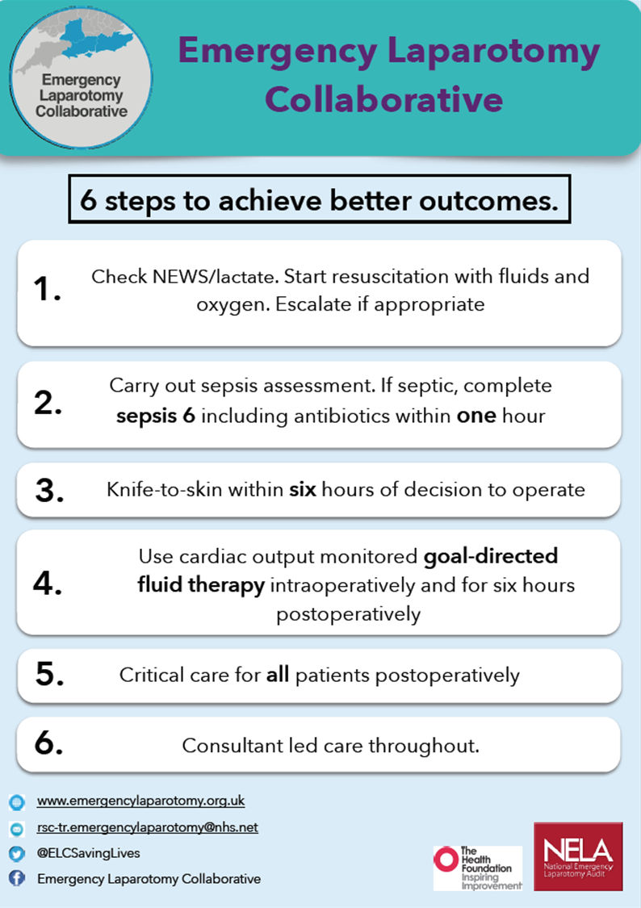

Slide 12
Adaptions for ELC
Have added sepsis screening
Components of care bundle
Applying to emergency laparotomy deaths

Slide 13
Phase of care: Admission and initial management
(approximately the first 24 hours)
Full care to be reviewed, but the following should be specifically considered and answered in this box:
What was the time of first review by Consultant Surgeon
Was there a NEWScore calculated? (Or recognition of deterioration/illness?)
Timely recognition of Sepsis (if applicable)
Was the Sepsis 6 carried out?
Were antibiotics administered?

Slide 14
Phase of care: Ongoing care
Full care to be reviewed, but the following should be specifically considered and answered in this box. The box above relates to the first 24hrs of care – this is ongoing care past 24hrs.
Was there a NEWScore calculated? (Or a recognition of deterioration/illness?)
Timely recognition of Sepsis (if applicable)
Was the Sepsis 6 carried out?
Were antibiotics administered?

Slide 15
Phase of care: Care during a procedure
Full care to be reviewed, but the following should be specifically considered and answered in this box:
Was a Lactate performed and recorded?
What was the Pre Op P-POSSUM score?
What was the patient’s time to theatre – planned and actual?
Was there a Consultant Surgeon in theatre?
Was there a Consultant Anesthetist in theatre?
What was the ASA Score?
Did the patient undergoing cardiac output monitoring?

Slide 16
Phase of care: Perioperative
Full care to be reviewed, but the following should be specifically considered and answered in this box:
Did the patient go to ITU post Op?
If no which ward did they go to?
Was there a care of the elderly review? (mark N/A where not appropriate)

Slide 17
Case Example
96 year old female admitted on 15th April 2016
#NOF following a fall
Hemiarthroplasty 16th April 2016
Diagnosed with norovirus 23rd April 2016
Died 24th April 2016

Slide 18
Task
Examine notes
Page 1-5 Initial admission
Page 6-9 Peri-operative care
Identify any good practice
Any areas that could be improved or below standard
Consider what score you would give episode of care

Slide 19
Admission and Initial Care

Slide 20
Admission and Initial care
Good assessment and management
Prompt surgery within 24 hours
Good multidisciplinary team input
No collateral Hx about fall

Slide 21
What should a judgement comment look like?
Needs to be explicit
Score needs to reflect the comment
You can have a good comment but still have a bad score for the whole phase of care

Slide 22
The 1-5 phase of care score
1 Very poor care
2 Poor care
3 Adequate care
4 Good care
5 Excellent care

Slide 23
Perioperative/procedure care

Slide 24
Perioperative/procedure care
Surgical site not marked
Consent form not completed
No orthopaedic consultant review

Slide 25
The 1-5 phase of care score
1 Very poor care
2 Poor care
3 Adequate care
4 Good care
5 Excellent care

Slide 26
On-going care (up to end of life or discharge of the patient)
Medication errors
Lack of senior support to junior doctors
Poor fluid and sepsis management
Patient gradually deteriorated despite treatment

Slide 27
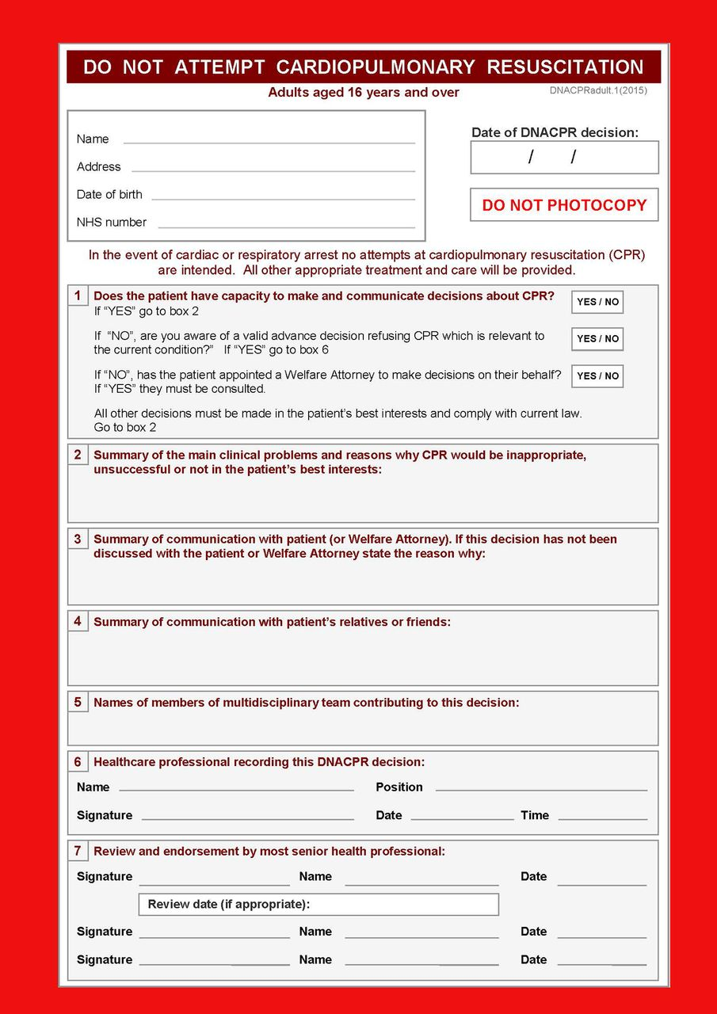
End of Life Care (or Discharge care)
Delay in DNACPR form
Not completed until 23rd April despite community DNACPR in place

Slide 28
Assessment of problems in healthcare
In this section reviewers comment on whether specific types of problems were identified and if so, whether harm was caused e.g. – no, or if yes, please identify problem type(s) from selected list and indicate whether any led to harm
The are 8 problem categories eg:
Problem related to treatment and management plan. Yes [ ]
Did the problem lead to harm?
No [ ] Probably [ ] Yes [ ]
Adapted from PRISM 2 study documents, with permission 2016

Slide 29
Avoidability Score
Definitely avoidable
Strong evidence of avoidability
Probably avoidable (>50:50)
Possibly avoidable but not very likely (<50:50)
Slight evidence of avoidability
Definitely not avoidable

Slide 30
Using the reviews
In scope/out of scope needs to be agreed at senior trust level
A few done well is better than many done badly
Feeding back (good and bad) to staff through trust mortality surveillance groups – remember it’s to learn!
Feed up to trust board and then into national reporting requirements
Regional QI Programmes based on the themes

Slide 31
Early Findings
Data from across 2 of our early implementers May to beginning Sept
Trust 1 - 466 deaths, 72 SJR, 1 avoidable (already identified through SI process)
Trust 2 - 313 deaths 50 SJR, 0 avoidable

Slide 32
Early Findings
End of Life Care – early discussion with palliative care
in hospital recognition
out of hospital recognition and DNACPR
Timely senior reviews
#NOF pathway
Poor documentation – both content and availability for reviews
Screening process still to be refined

