Slide 1
READ ME FIRST
This slide deck has been designed as a template for promoting the Improving NIV care project and the NIV 5 care bundle.
It will need to be edited to suit your local implementation strategy.
Key edits to note:
Delete slide with either bundle A4 or sticker as appropriate
Add localised timeframes for phased implementation to timeline (as appropriate)
Amend text currently in red – and then change it to black.
**Delete this slide ahead of presenting**

Slide 2
INSERT NAME
INSERT DATE
#NIVcare
INSERT TRUST LOGO

Slide 3
Drivers for change
The British Thoracic Society (BTS) has conducted regular audits of acute non-invasive ventilation for over 10 years, which have highlighted persistently poor patient outcomes.
These results prompted a National Confidential Enquiry into the care of patients treated with NIV (NCEPOD 2017).
As a consequence the BTS developed quality standards for acute NIV (2018).
The 2019 BTS NIV audit showed improved results but rates remain higher than in other comparable countries at 26%.
Locally, the BTS NIV audits across [insert trust] demonstrated a [insert result] mortality rate.
The collaborative have agreed on a standardised care bundle to be used across the West of England, based on the NCEPOD review – NIV 5

Slide 4
Project aims
Through Improving NIV care and implementing the NIV 5 care bundle, the project aims to:
Reduce mortality rates to 10% or lower for patients who require acute NIV for Type II Respiratory Failure
Improve staff knowledge of NIV care
Improve the patient experience through improved communication

Slide 5
Who is involved in improving NIV care?

Slide 6
What are the ?
NIV to be started within 60 minutes of decision to treat
Inspiratory pressure of 20 cm H₂O achieved within 60 minutes
Appropriate case selection
NIV is only recommended in acute Type 2 Respiratory Failure where it is proven to be effective
Treatment Escalation Plan in place
ReSPECT to be completed with specific reference to suitability for invasive ventilation or NIV as ceiling of treatment
Arterial or capillary blood gas to
be repeated within 2 hours of
starting NIV

Slide 7
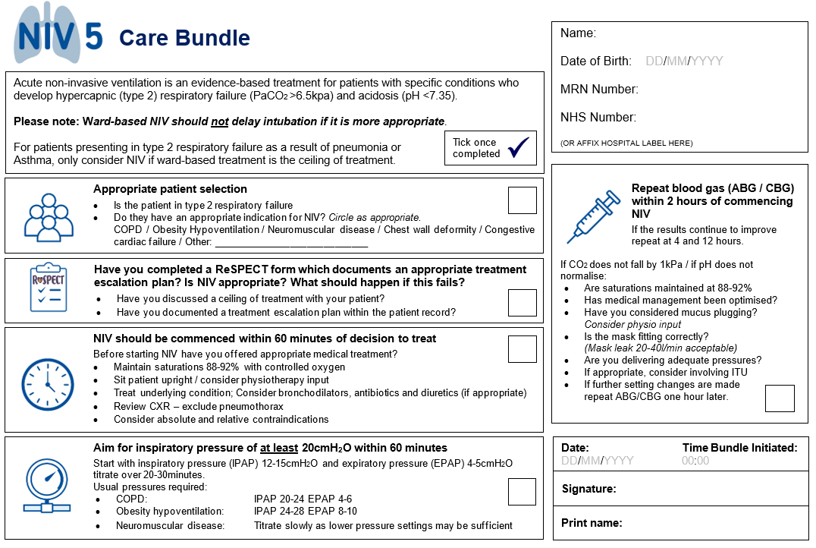
Notes:
A4 version – addition of NIV 5 logo
Addition of time of initiation.

Slide 8
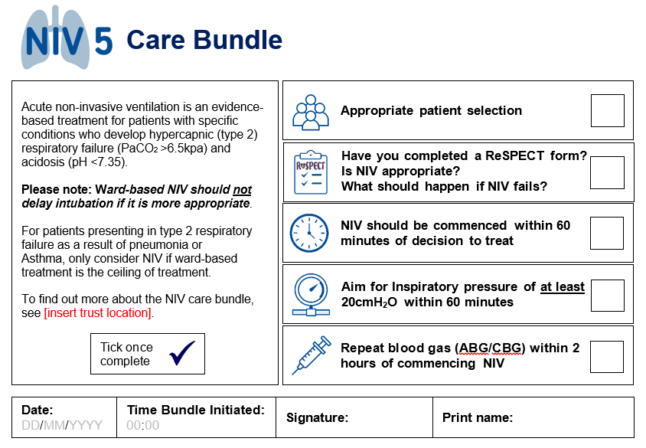
Notes:
Sticker version – you may wish to add your trust location and put copy in the final version here.

Slide 9
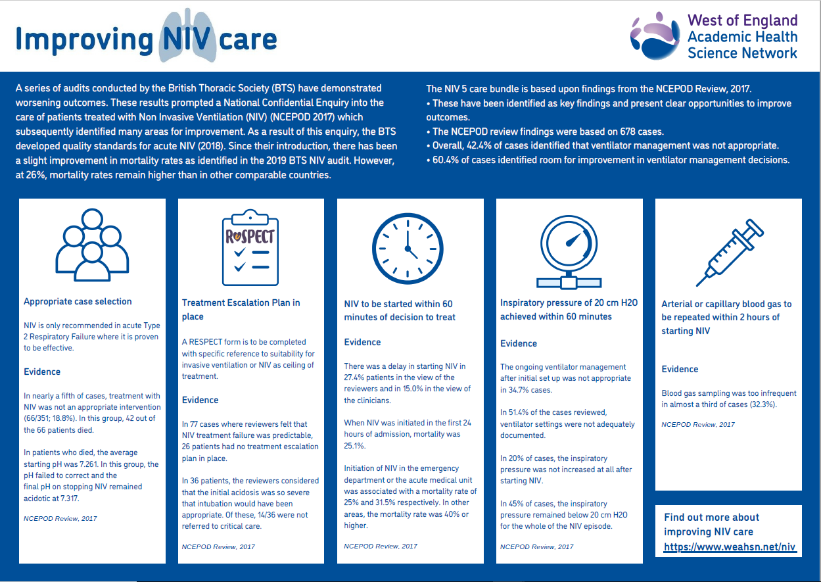
Notes:
Evidence for the bundle elements
Available as a download here: https://www.weahsn.net/niv

Slide 10
project timeline
Implementation of NIV 5
01/02/2023
End of Improving NIV care project
30/09/2023
Ongoing data collection
Until 29/02/2024
Project Evaluation
31/03/2024
Jan
Feb
Mar
Apr
May
Jun
Jul
Aug
Sep
Oct
Nov
Dec
Jan
Feb
Mar
2023
2024
Notes:
Add any additional localised timeframes that you would like to include – e.g. phased implementation in different departments

Slide 11
Project Driver Diagram
To reduce mortality rates to 10% or lower for patients who require acute NIV for Type II Respiratory Failure
NIV is only recommended in acute Type 2 Respiratory Failure where it is proven to be effective
Appropriate case selection
Improve staff knowledge of NIV care
NIV to be started within 60 minutes of decision to treat
Inspiratory pressure of 20 cm H2O to be achieved within 60 minutes
Reliable care delivery
Arterial or capillary blood gas to be repeated within 2 hours of
starting NIV
Treatment Escalation Plan in place.
RESPECT to be completed with specific reference to suitability for invasive ventilation or NIV as ceiling of treatment
Improve patient experience through improving knowledge and communication

Slide 12
Project evaluation
The project evaluation will be completed by Spring 2024.
The evaluation will aim to explore 4 key themes:
To demonstrate whether mortality rates improve through the implementation of the NIV 5 care bundle.
To understand whether staff confidence and competence improves as being part of the Improving NIV care project.
To learn from patient experience in order to improve NIV care.
To create standardisation of how NIV care is delivered by using a bundle and to investigate which elements of the bundle work most effectively.

Slide 13
To find out more about…
The Improving NIV care project
Visit: https://www.weahsn.net/niv/
Contact the Improving NIV care project manager: megan.kirbyshire@nhs.net
Follow #NIVcare and @weahsn on Twitter
The implementation of NIV care in [insert trust]
Contact the project clinical lead: [insert name]
[Add any other locations where resources are stored]
ReSPECT and Treatment Escalation Plans
https://www.resus.org.uk/respect/respect-healthcare-professionals

