Slide 1
Opioid harm reduction ‘guide’ Improvement ideas for GP practices / PCNs

Slide 2
About this guide
Guide produced as a ‘framework’ for activity to support work to help people live well with pain – for individuals and practices
Produced in collaboration with primary care clinicians and allied health professional input, with patient input for tips and tricks
It’s not a tested approach but has been reviewed by experienced clinicians
Aims to give ideas about how to support patients living with pain through tips and tricks to take into your practice immediately
Promotes a culture change around management of long term pain to rely less of potentially harmful medications

Slide 3
How to use this guide
Give yourself 1 hour to review the guide and consider your actions – Individually and/or as a group
Slide links and hyperlinks are embedded – click on the blue underlined text to follow
The guide is split into sections – Click on the side panel to open the different sections:
- Ideas for action you can take in your practices and resources to support processes
- Tips and tricks for consultations
- Example from practices that have worked to reduce opioid prescribing
- How you can identify the at risk patients in your practices
- Training and support
- Core competencies for pain management
Share and discuss with your colleagues and work together to create a practice based approach
Carry out using continuous learning approach – i.e Small steps / small changes / review and learn
Consider one patient at a time and learn from each one
This workbook could help you plan how your actions - QI_workbook_final-version-18-Aug-22.pptx

Slide 4
There are no primary care competency frameworks in the UK for the management of pain
The Faculty of Pain Medicine of the Royal College of Anaesthetist core standards laid out for pain management service, including for GPs / Pharmacist – see here
Fishman et al, 2013 published ‘Core Competencies for pain management: results of an interprofessional consensus summit’ in the Pain Medicine Journal, part of the American Academy of Pain Medicine
- Domain 1: Multidimensional Nature of Pain: What is Pain?
- Domain 2: Pain Assessment and Measurement: How is Pain Recognized?
- Domain 3: Management of Pain: How is Pain Relieved?
- Domain 4: Clinical Conditions: How Does Context Influence Pain Management?
Using the above as a self assessment guide will help understand your level of competency and understanding for working with people living with pain – eLearning course are detailed here
Knowing your level of competency will allow you to seek support – pain management is complex. It’s difficult to know everything

Slide 5
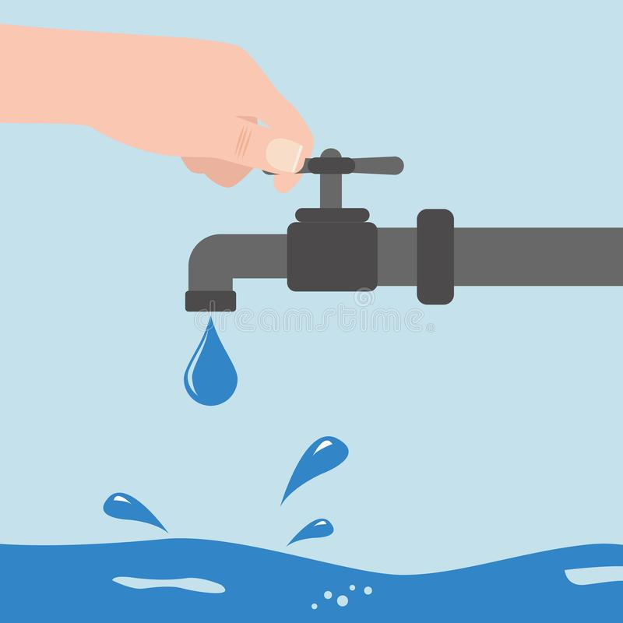
Framework idea towards QoF / IIF - “Turn the taps off” –
Step 1 – Identify patients in ‘at risk’ group who have recently been prescribed Opioids using NHS Opioids Dashboard (More than 3 months, less than 6 months) - (See slide 23 for access)
Step 2 – Request list of patient NHS numbers from NHS BSA
Step 3 – Triage list of patients, removing those prescribed Opioids for cancer or end of life pain management
Step 4 – Contact appropriate patient using text system to inform them you would like to discuss options for them to manage their pain given evidence about efficacy of long term Opioid use. Include link to Opioid patient information letter/leaflet (See next slide for examples)
Step 5 – Have a process for recording patients who respond to the surgery and who is allocated to review the patient, and book these in for a review. Re-contact those who do not reply within an agreed timescale. (consider alternative method of contact)
Step 6 – Review patient. Agree tapering plan. Provide information about pain, opioid tapering including withdrawal symptoms, pain management and resources to support understanding, including social groups/community assets. A double appointment time may be appropriate.
Step 7 – Set follow up date to check patients tapering, understanding and management of pain.
Turning the taps off of the problem - Aiming to prevent Opioid dependence ‘at source’

Slide 6
Patient letter / leaflet examples – Use or tweak
An example letter inviting patients for a review of their opioids
A short patient information sheet about Opioids and their effect on chronic pain, includes links to key information webpage and short video explaining pain
A short patient information sheet explaining about the laws and risks with driving when taking high dose Opioids
Double or right click on ‘word’ graphic to access documents
For further examples and resources - Medicines Safety Improvement Programme - FutureNHS Collaboration Platform

Slide 7
Potential benefits of approach
You:
Gain confidence with having conversations with patients about pain
Understand the biopsychosocial support available in your area to patients in the management of pain
Work together with your colleagues
Try your own Quality Improvement Project, and learn along the way
Provides opportunities to present your project externally to help shape future practice
Surgery/PCN
Create a surgery/PCN focus on reducing harm from Opioids
Compare and monitor your surgery/PCNs progress against others in your region
Improve collaborative learning and working within the surgery/PCN
Reduced demand on appointments (in time) with less people developing opioid dependency
Increased understanding of local ‘community assets’ to be used in the management of other long term conditions
Meet and achieve your QoF and IIF targets
Patients/Public
Reduce the risk of harm form Opioids
Reduced hospital admissions
Patients gain empowerment and take more ownership of condition
Test and learn as a team with each patient. Get your colleagues involved. Use the Opioid dashboard data to monitor your progress. Gain confidence with treating people with pain. Reduce the burden of Opioids. Improve the lives of people living with pain

Slide 8
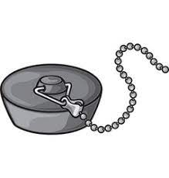
“Turn the taps off’ and then ‘pull out the plug’??
&
We’ve got to start some where. Addressing the problem ‘at source’ could help with talking the wider issues

Slide 9
Framework idea of the dashboard – 2 – Pull the plug out
Step 1 – Identify patients on high dose Opioids using NHS Opioids Dashboard (More than 120mg Morphine equivalent)
Step 2 – Request list of patients from NHS BSA
Step 3 – Triage list of patients, removing those prescribed Opioids for cancer or end of life pain management
Step 4 – (Optional) – Discuss patients at MDT. Consider who would be best to see patient
Step 5 – Contact appropriate patient using text system to inform them you would like to discuss their pain management treatment. Include link to Opioid patient information letter/Leaflet (See slide 6 for examples)
Step 6 – Record patients who contact surgery and book in for review, re-contact those who do not (consider alternative method of contact)
Step 7 – Double appointment length for patient. Discuss patients pain experience. Consider tapering plan and set functional goals. Provide information about pain management and resources to support understanding, including social groups/community assets
Step 8 – Set follow up date to check patients tapering, understanding and management of pain.
Step 9 - (Optional) Consider patient support group(s) / Coffee mornings
Removing the bath plug on the problem - Aiming to tackle the broader problem by reducing the numbers of people who currently take high dose Opioids

Slide 10
Consultation top tips from clinicians
Be aware of your posture – sit at eye level and face the patient – not the computer
Prepare by reading notes; your opening question/statement can help set the tone for the appointment
- “We invited you to come in to see me today, Can you tell me what you understand about why we wanted to see you?”
- “I understand you’ve been struggling with pain. Can you tell me about it?”
Use open questions (i.e not ones with ‘Yes’ or ‘No’ responses only)
Use silence and pauses. HOLD the space to allow patient to speak.
Listen to their words and phrases – repeat these back to the patient to acknowledge and normalise their responses
Don’t expect to tackle all the issues at once – Listening to their issues and building trust is important
Explore fears and what does their pain stop them doing that they want to do
Move the conversation to a forward thinking approach – coaching questioning can help this
Explore the small changes or improvements they can make around biopsychosocial / self care treatment
Consider their readiness to reduce opioids – Not everyone will be ready for this immediately
Invite them to bring a family member / partner / trusted individual with them if they wish

Slide 11
Top tips from clinicians
Change the narrative away from what it prevents the patient from doing Identify what the patient has found helpful i.e Heat, tens, distraction, socialising
Identify the things the patient can do despite their pain, build on these things
Use a Symptom Impact Questionnaire (SIQR) to understand the impact of the condition on daily living
Set expectations, be honest and realistic about their pain
Seek to understand the patients ‘acceptance’ of their pain – Is their condition currently controlling them, or are they wanting to be in control of their condition?
Restore hope by discussing a realistic plan and staged plan: This will/can take time.
- Sleep important to address initially if pain prevents them getting adequate rest
- Mood also important to address to help them look forward
- Address pain at rest to allow an increase in function and movement
- Then address their pain when moving
- Help them set ‘small’ and SMART goals – looking forward & remind patient about pacing
- Conclude: Would they benefit from input from other healthcare professionals (physiotherapists/Occupational therapists/Social prescribers/psychologists)
– The Faculty of Pain Medicine – Conducting Quality Consultations in Pain Medicine can help

Slide 12
3 important questions you could ask a patient in pain
What does your pain prevent you from doing that you would love to do? What steps could you take to work towards doing this again?
What impact does your pain have on those around you?
If taking pain meds - are you still in pain? If yes - then they aren't working & we should discuss stopping gradually & the alternatives
For further conversation tips – see
Shifting the conversation - Live Well With Pain

Slide 13
A biopsychosocial approach to pain management is recommended by evidence and best practice; therefore ask and consider…
Is the patient doing regular activity and activity that is meaningful to themselves?
What is the patient doing to for their mental wellbeing and to have a healthy mind?
Does the patient have support, social connections, and involvement in their community?

Slide 14
Find out what is in your local area
Does your practice have a social prescriber? Health Coach? Health trainer? Health Navigators? They could help you with finding support for patients
Community groups
Pain groups
Activity classes – pottery, drawing, Tai Chi, walking groups, dancing groups
Book clubs
Local charity organisations
Does your region have an ‘physical health’ referral programme?

Slide 15
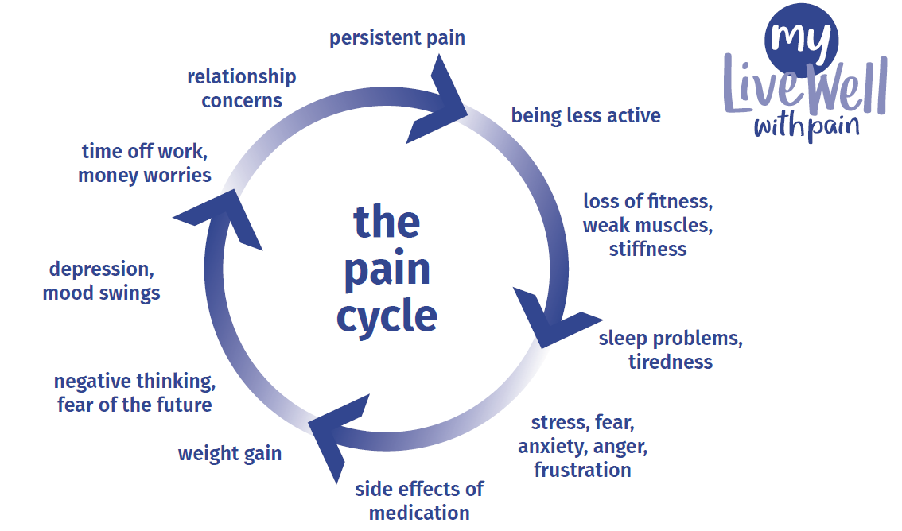
Does the patient recognise themselves within the pain cycle?
Download patient resource aid here

Slide 16
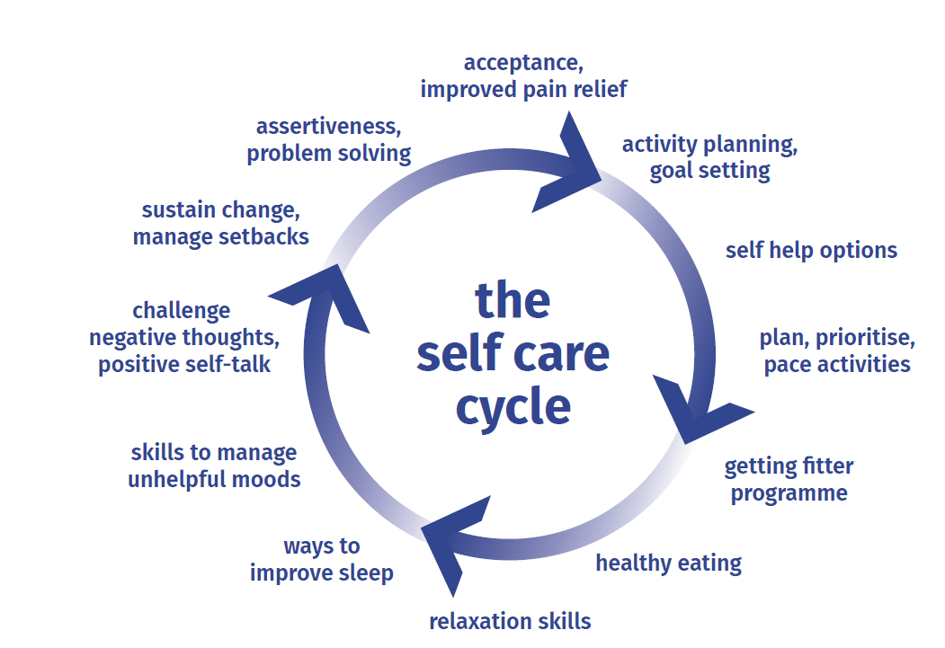
Does the patient consistently do any of these for themselves?
Download patient resource aid here

Slide 17
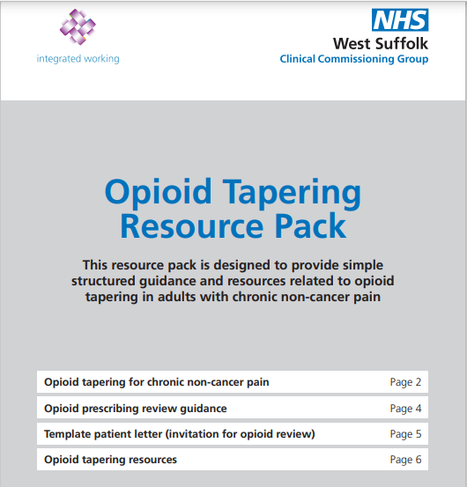
Tapering guide to support clinicians
Click link below to access:
https://www.westsuffolkccg.nhs.uk/Opioid-Tapering-Resource-Pack.pdf
Spend some time reviewing this guide and use it within your consultations – it’s quite comprehensive

Slide 18
Make your self a tea or coffee and enjoy this for 10 minutes
Dr Sarah Alderson - How practices reduced opioid prescribing.mp4 (dropbox.com)
It describes the steps Sarah and colleagues took in their practice, and across West Yorkshire ICS, to reduce the number of people prescribed opioids for chronic pain by 15,000 people over a 12 month period (a reduction of 0.65 per 1000 patients).
Including:
What practices did to reduce their opioid prescribing
Searches and alerts
Practice protocol for prescribing opioids
Delivering consistent messages to patients
Discussing limitations of opioids with patients

Slide 19
Opioid Prescribing Comparators Dashboard
NHS BSA ePACT2 Opioids Dashboard, developed by clinicians alongside Wessex AHSN
It allows GP Practices, PCNs and ICSs to complete searches to;
understand the size of their Opioid prescribing issues,
identify any particular areas where they may have significantly higher prescribing,
help to identify how many patients are taking Opioids in combination with other medicines known to increase the risk of harm from Opioids
Data can be split by ICS/PCN/Practice and gender and age
and find the NHS numbers of the patients within these data sets to help with the prioritisation of those deemed to be at the greatest risk from harm – See slide 21
They are also the first comparators to make use of the electronic prescribing system (EPS) data, therefore more ‘live’ data.
Highlight patients who have been taking Opioids for over 3 months, but less than 6 months. presenting opportunities to reduce risk of Opioid dependence at source and Quality Improvement based projects

Slide 20
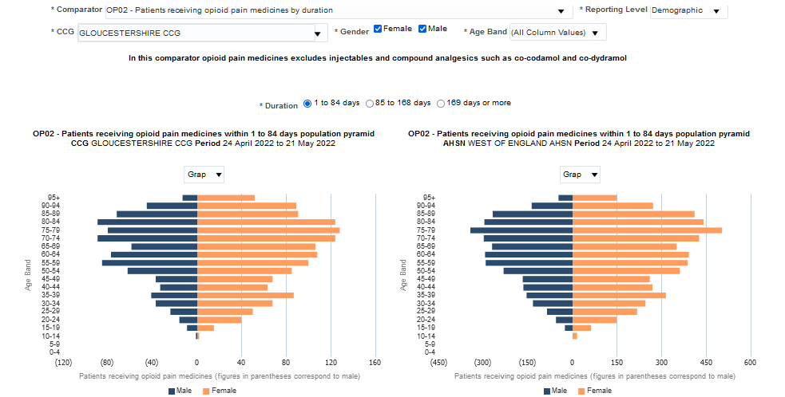
Breakdown by age groups
Breakdown by gender

Slide 21
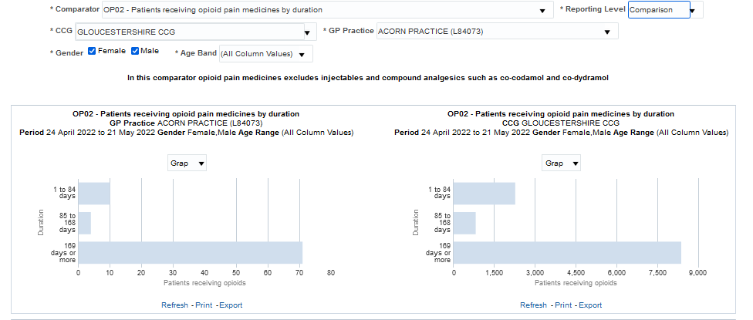
Each practice is different; it could be as few patients as this
In this practice, 13 patients could be stopped from developing opioid dependency
If all practices in ISC region focused on patients prescribed Opioids less than 6 months, over 600 patients may not become dependent in 1 month.
NHS numbers of patients available to practices through NHS BSA

Slide 22
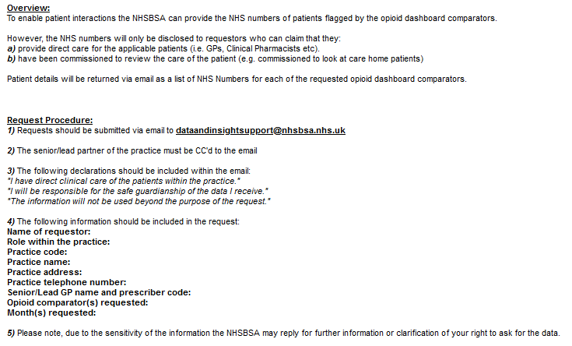
Requesting NHS numbers of those identified by the Opioid Dashboard

Slide 23
Assess and training for the Opioid Prescribing Comparators Dashboard – NHS BSA
Further information and for recorded training sessions and how to book - ePACT2 training web page.
Registration for access has been opened to allow broader access. More information can be found at the NHS BSA website . To register for ePACT2, email registration@nhsbsa.nhs.uk.
Webinars to help colleagues make best use of the dashboard are being delivered – See embedded video - NHSBSA Opioid Comparators Dashboard Phase 2 Release - Overview and demo - YouTube

Slide 24
Pain Management - eLearning options
RCGP – Educates healthcare professionals about the physiology of pain, and how pain can become persistent. In summarising the 2021 NICE guideline it provides practical advice about how the guideline can be applied to patient care. 30minutes. https://elearning.rcgp.org.uk/course/info.php?id=588
e-PAIN from elearning for healthcare is the place to start for anyone working in the NHS who wishes to better understand and manage pain. 12 modules. https://www.e-lfh.org.uk/programmes/pain-management/
CPPE Pain management - earning programme is to provide healthcare professionals with the knowledge and expertise to assess, treat and manage pain effectively. Up to 8 hours of learning. https://www.cppe.ac.uk/programmes/l/pain-e-01/
CPPE Deprescribing opioids in people with chronic pain - develop skills and confidence to support people living with chronic pain. You will consider the safe and effective use of medicines, focusing on opioids, and how to use a person-centred approach to empower people to live well with pain. Up to 7 hours of learning. https://www.cppe.ac.uk/programmes/l/pain-ew-01

Slide 25
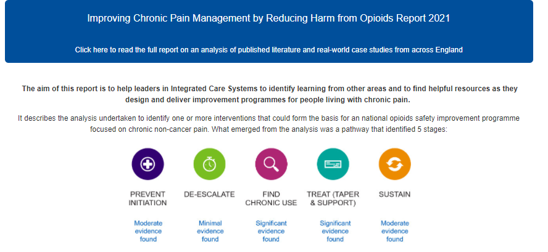
Join the FutureNHS workspace to support you in your work – A community of supportive colleagues and resources aiming reduce the burden of Opioid harm nationally
Resources to support each of the 5 above elements can be found on the FutureNHS page
Improving Chronic Pain Management by Reducing Harm from Opioids - Medicines Safety Improvement Programme - FutureNHS Collaboration Platform

Slide 26
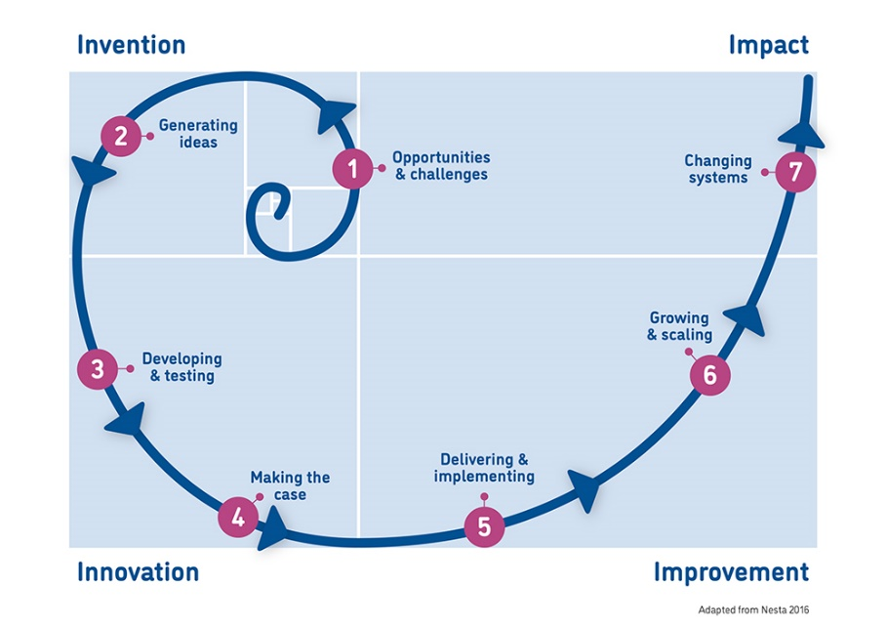
The West of England Academy provides a range of free resources to help you gain knowledge and develop essential skills for innovative thinking and working..
We promote the use of quality improvement methodologies to support delivery of better patient care. The Academy is for all health and care professionals, front line, support services and commissioners, plus innovators living, working or planning to work in the West of England.
We run free learning events as well as bespoke support for those needing specialist advice on our services. In 2020/21 we have delivered 28 improvement and innovation learning events for over 900 attendees.
Online resources and events: www.weahsn.net/Academy
Sign up for our newsletter:
https://www.weahsn.net/news-views/newsletter-sign-up/
Contact us: weahsn.academy@nhs.net
Twitter: @weahsn #WEAHSNAcademy
Take things further by joining Q to access national Special Interest Groups and learning events: https://q.health.org.uk/join-q/
100% of delegates who provided feedback would recommend the event to a colleague, and 97% could use the new learning in their role.

Slide 27
Domain 1 - Multidimensional nature of pain: What is pain?
This domain focuses on the fundamental concepts of pain including the science, nomenclature, and experience of pain, and pain's impact on the individual and society.
Explain the complex, multidimensional, and individual-specific nature of pain.
Present theories and science for understanding pain.
Define terminology for describing pain and associated conditions.
Describe the impact of pain on society.
Explain how cultural, institutional, societal, and regulatory influences affect assessment and management of pain.

Slide 28
Domain 2 - Pain assessment and measurement: How is pain recognized?
This domain relates to how pain is assessed, quantified, and communicated, in addition to how the individual, the health system, and society affect these activities.
Use valid and reliable tools for measuring pain and associated symptoms to assess and reassess related outcomes as appropriate for the clinical context and population.
Describe patient, provider, and system factors that can facilitate or interfere with effective pain assessment and management.
Assess patient preferences and values to determine pain-related goals and priorities.
Demonstrate empathic and compassionate communication during pain assessment.

Slide 29
Domain 3 - Management of pain: How is pain relieved?
This domain focuses on collaborative approaches to decision-making, diversity of treatment options, the importance of patient agency, risk management, flexibility in care, and treatment based on appropriate understanding of the clinical condition.
Demonstrate the inclusion of patient and others, as appropriate, in the education and shared decision-making process for pain care.
Identify pain treatment options that can be accessed in a comprehensive pain management plan.
Explain how health promotion and self-management strategies are important to the management of pain.
Develop a pain treatment plan based on benefits and risks of available treatments.
Monitor effects of pain management approaches to adjust the plan of care as needed.
Differentiate physical dependence, substance use disorder, misuse, tolerance, addiction, and nonadherence.
Develop a treatment plan that takes into account the differences between acute pain, acute-on-chronic pain, chronic/persistent pain, and pain at the end of life

Slide 30
Domain 4 -Clinical conditions: How does context influence pain management?
This domain focuses on the role of the clinician in the application of the competencies developed in domains 1–3 and in the context of varied patient populations, settings, and care teams.
Describe the unique pain assessment and management needs of special populations.
Explain how to assess and manage pain across settings and transitions of care.
Describe the role, scope of practice, and contribution of the different professions within a pain management care team.
Implement an individualized pain management plan that integrates the perspectives of patients, their social support systems, and health care providers in the context of available resources.
Describe the role of the clinician as an advocate in assisting patients to meet treatment goals.

Slide 31
For more information, please contact:
weahsn.transformation@nhs.net
Website:
https://www.weahsn.net/medicines-safety-improvement-programme/

