Slide 1
Quality improvement (QI) journey workbook
www.weahsn.net/academy #WEAHSNAcademy
v 2.3 August 2022

Slide 2
What is the workbook?
The workbook is a collection of worksheets that can be used to help structure and guide a simple quality improvement (QI) project. We recommend you start at the beginning and work your way through each activity or use the contents page to navigate your journey.
Who is the workbook for?
The workbook has been designed to help people that are running a QI project in a healthcare setting. If you are new to QI then do check out our on-demand QI training.
Some worksheets can be completed by one person, but the majority will need completing as part of a team-based activity with a mix of people involved in your project work. Involving your stakeholders (people impacted by the changes you’ll be making) in these activities will significantly help your project to be a success.
Why would I want to use the workbook?
We know that running a QI project can sometimes be complicated and confusing. We hope that this workbook will provide practical, simple support to guide you through the process. Watch this video to understand how QI tools can be used in a real healthcare improvement project.
This workbook is structured and colour-coded to help you design a QI poster or write an improvement report to share the learning from your project.
Check out our guide to creating a QI poster for more information and once you have created your poster please share it with others on our Evidence Repository.
The West of England Academy offers a wide range of free resources to healthcare professionals and innovators across the region. To find out more, visit our website or email weahsn.academy@nhs.net

Slide 3
Contents
 | Stage | QI Tools | Poster sections | Page
1 | Understand the challenge | 5 Whys Stakeholder analysis Project mapping | Background / Problem/ Issues | 5-11
2 | Set a SMART target | SMART target | Aim | 12-14
3 | Identify your measures | Sources of data collection Outcome, Process and Balancing measures Operational definitions | Results/ data | 15-18
4 | Create and select change ideas | Greenhousing TRIZ MOSCOW |  | 19-24
5 | Plan the project | Driver Diagram Communication Plan Project check-in | Method/Strategy for Change | 25-30
6 | Test change ideas | PDSA Learning Log | Conclusions/ Lessons Learned | 31-33
 | Sharing your learning |  | Poster template SQUIRE template | 34-38
What are we trying to accomplish?
How will we know that a change is an improvement?
What changes can we make that will result in improvement?
Model for improvement
Plan
Do
Study
Act

Slide 4
Project Title People involved
The table below uses colour to show the different sections of the QI Poster Template and how they relate to the stages of your QI journey through this workbook.
Background/Problem/Issue | Results/Data
Aim | Image/Chart
Method/Strategy for Change | Conclusions/Lessons Learned

Slide 5
Stage 1: Understand the challenge
It is important to take the time to fully understand the problem you are trying to solve.
Complete 5 Whys, stakeholder mapping and process mapping.
If you skip this stage, you might waste time making a solution that doesn’t solve your issue.
At the end of this stage you will have the information you need for your poster on the Background/ Problem/ Issue.
About the tools:
5 Whys is a simple tool to help you start to identify the root cause of a problem. Use the 5 Whys facilitator slides to help facilitate this as a team activity. For more detail on this tool, please visit the relevant page in the toolkit
Stakeholders are everyone involved, interested in and benefiting from your project work. Understanding and engaging with your stakeholders is crucial to the success of your project as they can be champions of your work or create barriers.
Use the stakeholder facilitator slides to help facilitate mapping as a team activity. For more detail on the tool, please visit the relevant page in the toolkit
Process mapping can be used to demonstrate the:
Current way of working to identify areas for improvement, for example where the same activity is repeated unnecessarily or where there is a ‘bottle neck’.
A new ‘improved’ process, for example you can map what the process would look like if you changed it in some way.
Use the process mapping facilitator slides to help facilitate this as a team activity. For more detail on the tool, please visit the relevant page in the toolkit.
Background/Problem/Issue | Results/Data
Aim | Image/Chart
Method/Strategy for Change | Conclusions/Lessons Learned

Slide 6
Quality improvement tool: 5 Whys
Step 1: What do you think the problem is?
Step 2: Ask someone else, or yourself, why?
Why is that happening?
Why is that?
Why is that?
Why is that?
Step 3: Can you redefine the problem? What do you think the problem is?
Example:

Slide 7
5 Whys Template
What do you think the problem is?
Why?
Why is that happening?
Why is that?
Why is that?
Why is that?
Can you redefine the problem? What do you think the problem is?

Slide 8
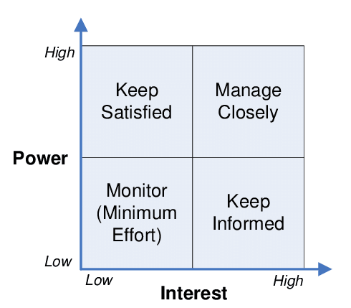
Quality improvement tool: Stakeholder mapping
Step 1: Who are your stakeholders?
Make a list of the obvious people
Refine your list by using the following (QSIR NHS E/I):
Commissioners
Customers
Collaborators
Contributors
Channels
Commentators
Consumers
Champions
Competitors
Step 2: What type of stakeholder are they?
Step 3: Create a user persona for key stakeholders
What do you know about them?
How do they interact with the service/product?
How do they communicate?
Map your stakeholders on to the chart (see next slide).
Now that you understand who your stakeholders are you can appropriately involve them in your QI project at the relevant stages.
When you know your project objective and the changes you’ll be testing, you’ll need to think about how you will communicate with your stakeholders throughout the project. We’ll look later at creating a communications plan.
It is really important to think about how you can involve patients and families in your project right at the start.

Slide 9
Stakeholder mapping template
 | Low interest | High interest
High power | Keep satisfied | Manage closely
Low power | Monitor (minimum effort) | Keep informed

Slide 10
Quality improvement tool: Process mapping
Questions to consider with your team before starting:
What is the aim for this process mapping exercise?
What is the start and the end of the process you are mapping?
Do you have everyone involved in the process taking part?
Can you map this process in one session, or should you chunk it?
Use these symbols to plot the process:
Box: shows the activities of the process.
Diamond: represents the stage in the process where a question is asked, or a decision is required.
Oval: shows the start of a process and the inputs required and the end of the process with the outputs.
Arrows: show the direction of the process.
If you are drawing a process map in PowerPoint look for the green anchor points when attaching arrows, as these will connect things up and keep the arrows with the right boxes when you move things around.

Slide 11
Process mapping template
Draw your process map here…

Slide 12
Stage 2: Set a SMART Target
A SMART target will help everyone involved in your project understand and agree what your objective is, it doesn’t leave any room for confusion or misunderstanding. Using a SMART target will help define the scope of your project and make your project measurable.
Use the SMART Target facilitator slides to help facilitate this as a team activity. For more detail on the tool visit the relevant page in the toolkit.
Consider your general aims for the project.
e.g. Improve community rehabilitation rates
...and refine the sentence so it’s SMART
e.g. Ensure that all patients are seen within 4 weeks of referral for community rehabilitation by October 2022.
At the end of this stage you will have the information you need for your poster on the Aim.
Background/Problem/Issue | Results/Data
Aim | Image/Chart
Method/Strategy for Change | Conclusions/Lessons Learned

Slide 13
Quality improvement tool: SMART Target
Step 1: What is your general aim for the project?
Step 2: Discuss these questions with your team:
Key terms: Are the key terms defined clearly?
Scope: What is the scope of the improvement? Which patients, services, locations etc. are included or excluded?
Timescales: How good, by when? When is the improvement intended to happen by? What is the scale of the improvement?
Constraints: What are the constraints on how the improvement is undertaken? What don’t you want to accidentally make worse?
Measurement: How will the improvement be measured?
No solution: Does the aim include the solution? (It shouldn’t)
Step 3: Rewrite your target, using the SMART acronym below as a guide
Specific – have you been specific about what you want to improve?
Measurable – have you included a numerical target?
Achievable – is it achievable?
Relevant – does it relate to patient outcomes? can you link it to the strategic aims of your organisation?
Time-bound – have you included a timeframe for the project?
The SMART target for the QI project is:

Slide 14
SMART Target template
What is your general aim for the project?
Specific – have you been specific about what you want to improve?
Measurable – have you included a numerical target?
Achievable – is it achievable?
Relevant – does it relate to patient outcomes? can you link it to the strategic aims of your organisation?
Time-bound – have you included a timeframe for the project?
The SMART target for the QI project is:

Slide 15
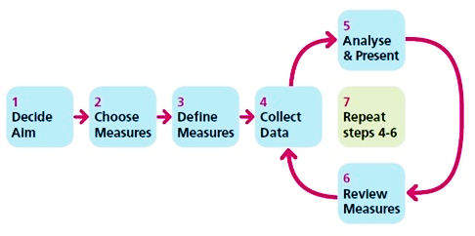
Stage 3: Identify your measures
To ensure the changes you are making are improving the situation, you will need to collect some data. If you have evidence that your QI project has worked then you will be more likely to secure funding to sustain the changes. The data doesn’t need to be complicated, keep it simple and easy to collect.
Remember to “seek usefulness, not perfection, in the measurement” (Nelson et al, 1998).
Use the sources of data collection, operational definitions and outcome, process and balancing measures facilitator slides to help facilitate these activities with your team. For more details on these activities, please visit the relevant page in the toolkit.
At the end of this stage you will have a plan for collecting the data for your results section of your poster and you may have some idea of how you will present your data as an image or chart.
This stage can be a bit iterative, and it make take a few tests of change to get the measures right so don’t worry if you don’t get it right first time.
Also ask yourself:
Where will you review and discuss your data as a team?
How will you share and celebrate success?
Background/Problem/Issue | Results/Data
Aim | Image/Chart
Method/Strategy for Change | Conclusions/Lessons Learned

Slide 16
Identifying your measures
Step 1: Your project objective:
Step 2: What are your initial ideas on the data that might help with your project? e.g., how to understand the problem and how to measure improvement.
Step 3: Use these prompts to consider more sources and types of data: Qualitative, quantitative, patient level, service level, organisational level, population health level, routinely collected data
Step 4: In your data above identify measures for your project.
Outcome (x1) linked explicitly to the aim of the work:
Process (x2+) linked to the changes you are going to work on to achieve your aim:
Balancing (x2+) unintended consequences, good/bad:
Step 5: Use the prompts below to consider if your measures are clearly defined:
Be aware of areas of subjectivity, could someone else misunderstand them?
Always define what is correct and what is incorrect.
If a visual check of pass/fail is required, your operational definition could include photographs.
Test the operational definition to make sure it produces consistency.
Step 6: As you collect the data consider how to present and share it.
Can you improve the definitions in Step 4?

Slide 17
Defining your measures template
 | Outcome | Process | Balancing | Qualitative
What is being measured?
Who does it measure?
When does it measure it?
How often is it measured?
Who collects it?
Does it measure absolute numbers or proportions?
Where does the data actually come from?
How accurate and complete will the data be?
Are there any caveats/ warnings/ problems?
Comments/ notes

Slide 18
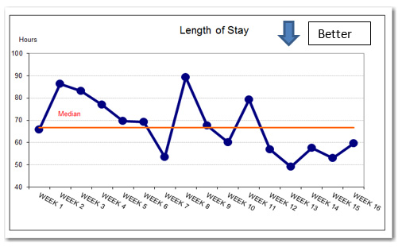
Representing data on charts
As you collect the data consider how to present and share it.
You could use a run chart for example:
Ref: https://www.iecodesign.com/blog/2015/2/2/run-charts-in-quality-improvement-work
There is a section for adding images and charts on the poster template:
Or an infographic, for example:
Find out more about making infographics by watching our short video.
Our QI on-demand training includes bonus sessions on how to collect and present data.
Plot the Dots/Making Data Count from NHS England are really useful guides and include templates to make charts from your data.
Background/Problem/Issue | Results/Data
Aim | Image/Chart
Method/Strategy for Change | Conclusions/Lessons Learned

Slide 19
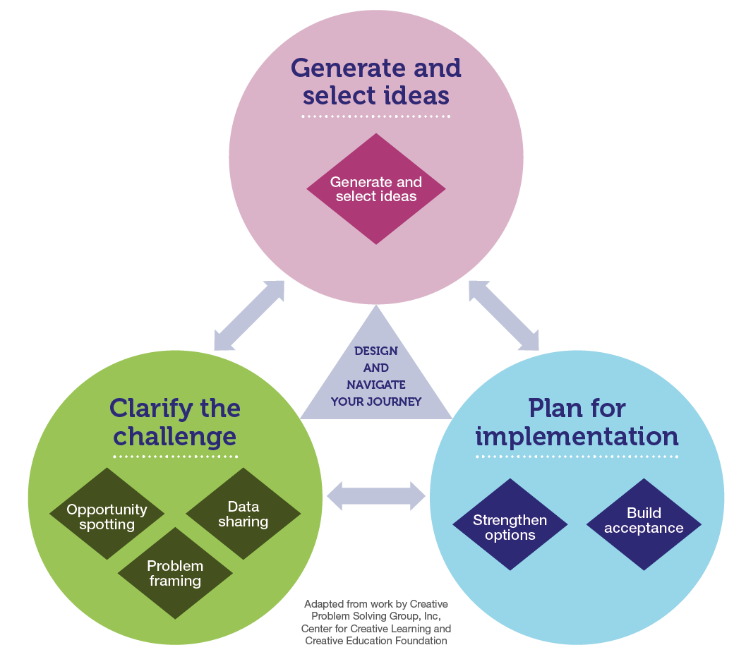
Stage 4: Create and select change ideas
Don’t jump to the obvious ideas to test, take some time with your team to think creatively about ways to reach your project objective.
Use the greenhousing and TRIZ facilitator slides to help facilitate these activities with your team. or more details on these activities, please visit the relevant pages in the toolkit.
If you need to prioritise your ideas, you can use MOSCOW to separate them into the things you must do, should do, could do, or won’t do.
At the end of this stage you will have some ideas for how you can plan your approach to change and this will help you put together your Method/ Strategy for Change in the next stage.
Our Creative Problem Solving Toolkit has lots of other tools to help you through the creative problem solving process.
Background/Problem/Issue | Results/Data
Aim | Image/Chart
Method/Strategy for Change | Conclusions/Lessons Learned

Slide 20
Quality improvement tool: Greenhousing
Greenhousing techniques can be used to create the ideal conditions for sharing and developing new ideas. When new ideas are shared, they can be fragile and need growing and developing in a safe space.
In your creativity session use phrases such as:
“Tell me more…” “let me understand…” “I’m just going to have think about that”
“What’s the big idea behind this idea” “How else could we do this?”
“Maybe we could take that idea and do this…” “I like that, we could do that and then…”
To support ideas being created:
Suspend your judgement
Understand what’s in front of you
Nurture the idea
To prevent ideas being created:
React straight away
Assume you know everything about the idea
INsist you are right
The SUN and RAIN model is from the book Sticky Wisdom.

Slide 21
Change ideas template
Write your ideas here…

Slide 22
Quality improvement tool: TRIZ
Use TRIZ, a Liberating Structure, with greenhousing techniques to help your team be creative. Follow these steps and complete the template.
If you enjoyed TRIZ, you might like to try other Liberating Structures: https://www.liberatingstructures.com/
Step 1. Write down your project objective
Step 2. Flip the project objective on its head to make it the worst-case scenario objective
Step 3. Describe what would happen if this worst-case scenario came true.
Step 4. Make a list of all the things you can do to ensure you achieve the worst-case scenario.
Step 5. Highlight the items on this list that are currently being done. Be honest!
Step 6. Think creatively for how you can reduce/stop these unwanted activities or behaviours. Nurture these ideas using the ‘SUNny’ language.

Slide 23
TRIZ Template
Project objective
TRIZ objective
Describe the worst case scenario
What things can you do to ensure the worst case scenario? | Tick if this happens | Ideas for stopping unwanted activities (let the SUN in!)

Slide 24
MOSCOW template
Must do
Could do
Should do
Won’t do

Slide 25
Stage 5: Plan the project
It is important to take the time to plan your improvement project, this allows you to consider the impact of your project — and it’s helpful having documentation to share with people who are interested in your work. Planning can be a relatively quick exercise as a lot of the elements will already be thought through.
At the end of this stage you will have the information you need for your poster on the Method/ Strategy for Change.
About the tools:
A driver diagram is used to plan and map out your improvement project, it is beneficial to see your project on one page and to understand how your change ideas connect to your project objective. Work with the project multi-disciplinary team to complete the driver diagram template on page 20.
Use the driver diagram facilitator slides to help facilitate this team activity. For more detail on the tool, please visit the relevant page in the toolkit.
A simple communications plan maps out your key messages and how you will share these with your different stakeholder groups.
There is also a quick project check-in template to discuss with your team to help you finalise your plans.
Background/Problem/Issue | Results/Data
Aim | Image/Chart
Method/Strategy for Change | Conclusions/Lessons Learned

Slide 26
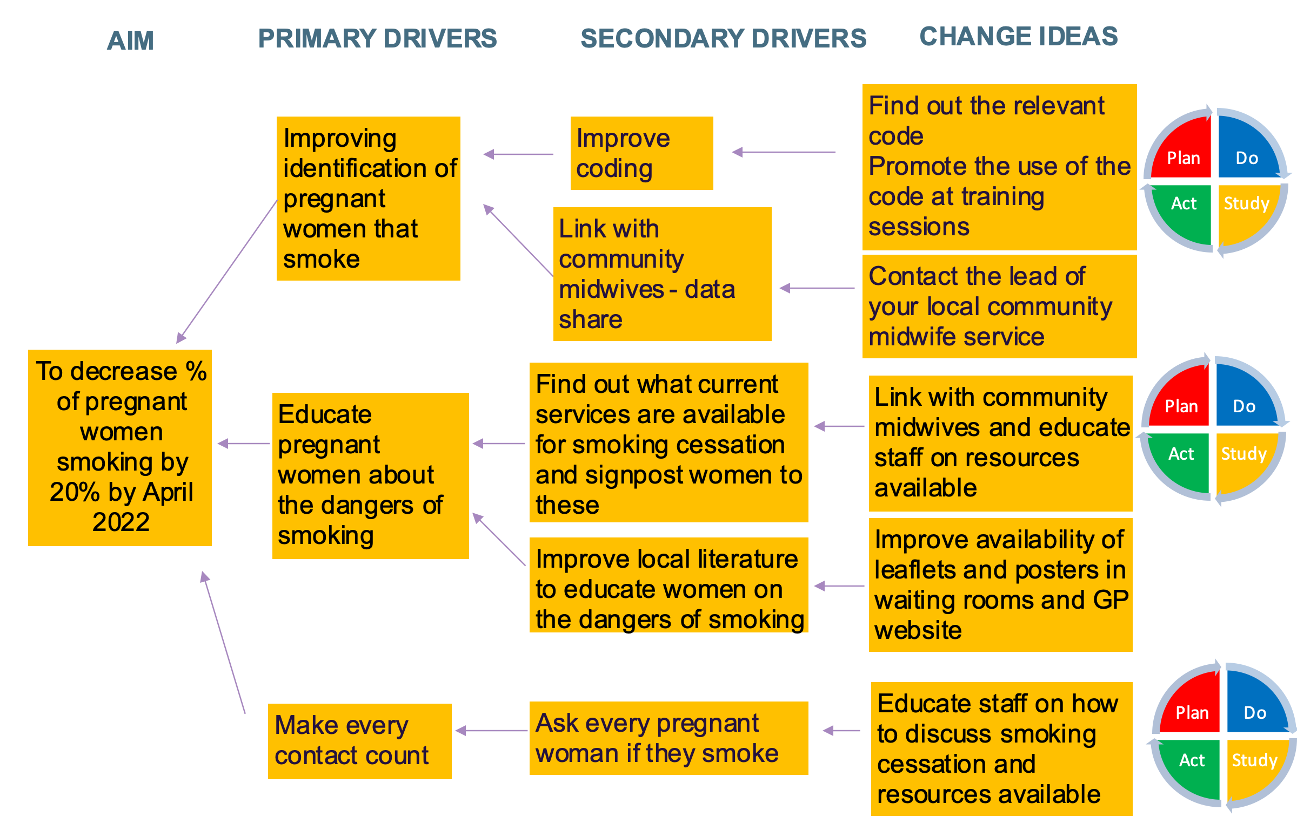
Quality improvement tool: Driver diagram
Questions to consider before starting:
What is your project objective?
What are the overarching primary drivers that will help you meet the objective?
Can these primary drivers be broken down further into secondary drivers?
What are your measures?

Slide 27
Driver diagram template
Primary Drivers: System components which will contribute to meeting the project objective­ | Secondary Drivers: Elements of the associated primary driver. They can be used to create projects or change packages that will affect the primary driver | Change ideas
P
D
A
S
SMART Objective
P
D
A
S
P
D
A
S
Measures:
Process measure(s):
Outcome measure(s):
Balancing measure(s):
P
D
A
S

Slide 28
Quality improvement tool: Communications plan
Knowing who your stakeholders are and including them in your project work is crucial for the success of your QI project. You will want to keep them updated/involved/engaged as the project progresses.
Use this simple communications plan to map out your key messages and how you will share these with your different stakeholder groups.
Creating a ‘brand’ for your project can help get people involved and excited about your work.
Communications plan
Objectives (for the comms plan)
Key Messages (to be communicated out)
Target Audiences and Channels
Branding
Project name/logo (get creative!): Remember to talk to your comms team about this
Organisation logos to include in comms:
Some example project logos:
PreciSSIon (Preventing Surgical Site Infection across a region)
Black Maternity Matters

Slide 29
Communications plan template
Stakeholder group | Role in your project | Communication channel and regularity (e.g., monthly direct email and weekly department briefings) | Key messages

Slide 30
Project check in template
 | Where are you now? | What are your plans? | What are your challenges?
Change Ideas | Which change ideas are you planning to test? Why have you selected them? How have you assigned the testing of change ideas? What has gone well in relation to change ideas? | What change ideas will you test next? | What’s difficult about selecting and testing change ideas? How might you overcome these barriers?
PDSA | Which PDSAs have you tested? Have you learnt anything from testing? How did you record your PDSA? Who has been involved in your testing? Have you used measurement to inform your PDSAs? How do you share your learning/outcomes from PDSA? What has been good about doing PDSA? | What PDSAs are you planning to do? Who will test for you? Where will the tests happen? | What’s been challenging about PDSA? How might you overcome these barriers?
Measurement | What measures from your measurement plan are you using at project level? Consider; Outcome, Process, Balancing, Qualitative. How do you collect your measures? How are you presenting and sharing your measures? What is your data telling you so far? What has been positive about using measures? | What are your plans related to measurement? | What has been challenging about measurement? How might you overcome these barriers?
Involving patients | How have you involved patients and families in your project? What strategies/approaches have you used? What have you learnt from involving patients and families? How will you be evaluating patient and family experience? | What are your plans for involving patient and families in the future? | What has been challenging about involving patients and families? How might you overcome these barriers?

Slide 31
Stage 6: Test change ideas
A Plan Do Study Act (PDSA) cycle is the recommended model for testing changes from the Institute for Healthcare Improvement. The PDSA cycle guides you to make safe changes and facilitates a ‘test and learn’ approach.
About the tool
Use the PDSA facilitator slides to help facilitate this as a team activity. For more detail on the tool, please visit the relevant page on the toolkit.
Before you start a PDSA cycle you need to:
Understand the problem and have set a SMART target
Agree how to measure the impact of your project work
Get creative and think f improvement ideas and record these ideas in your driver diagram.
Once you have worked through these three steps, you are ready to start using the Plan Do Study Act cycle. Use the learning log template to record your PDSA cycles.
At the end of this stage you will have the information you need for to write the section on Conclusions/ Lessons Learned for your poster.
Background/Problem/Issue | Results/Data
Aim | Image/Chart
Method/Strategy for Change | Conclusions/Lessons Learned

Slide 32
Learning Log template
Plan
Do
Study
Act
Plan | What will your test be? How could the issue be resolved? What could be introduced to make an improvement? Who is a useful contact to support you with this improvement? What data will you collect? Can you work with others to shape your improvement? What is your baseline measurement? What do you think will happen as a result of your test?
Do | What happened when you carried out your test? What did the data show?
Study | How did the results of your test compare with predictions? Has the change been an improvement? Is there variation in the data? What have you noticed during the study period? What have you learnt from making this change? Do you have any tips for other improvers?
Act | Do you think there is still room for improvement? What will you do next? Will you adopt this change (keep it), adapt it for another cycle or abandon it (stop it).

Slide 33
Learning Log template
Plan
Do
Study
Act
Plan
Do
Study
Act

Slide 34
Sharing your learning
Using the information you have entered into this workbook, you now have most of the important information needed to put together a poster!
You can use the colour-coding below to know what information goes where:
Check out our guide to creating a QI poster for more information and to download editable poster templates.
Once you have created your poster please complete a cover sheet and share it with others on our Evidence Repository.
Project Title People involved
Background/Problem/Issue | Results/Data
Aim | Image/Chart
Method/Strategy for Change | Conclusions/Lessons Learned
Another way to share your findings is with a more detailed improvement report. The SQUIRE guidelines set out best practice in writing up quality improvement projects and the template on the next page shows how SQUIRE maps to the sections in this workbook.
Before you start you might find it helpful to read some existing projects published in BMJ Quality Improvement Reports to understand how others have documented and structured their work.
If you are a member of the Q community this comes with opportunities to publish your work.

Slide 35
Project title
People involved
Background/Problem/Issue
ENTER TEXT HERE
Results/Data
ENTER TEXT HERE
Aim
ENTER TEXT HERE
Image/Chart
ENTER TEXT HERE
Method/Strategy for Change
ENTER TEXT HERE
Conclusions/Lessons Learned
ENTER TEXT HERE

Slide 36
SQUIRE template mapped to the sections of this workbook
Title | Indicate that the article concerns an initiative to improve healthcare
Abstract | This is a summary of your work and is the most important section to attract a reader's attention. Please ensure you include a brief background to the problem, the method for your quality improvement project, the overall results and conclusion. Keep it succinct and factual.
Problem | In this section you will need to summarise your problem and the focus of your project. You will need to outline your SMART aim for your project (for example; the aim was to reduce medication errors from 15% to 5% across six elderly care wards in three months). Give some details about your local context including; the type of organisation you work in, the size of your organisation, details about the staff members who work there and perhaps a little bit about your local patient population. It might be useful for others to include how you got started with this project and what drove you to tackle this problem.
Background | This section gives the reader background information about the problem and provides up-to-date, research and knowledge from the literature. Summarise the literature you have found on the background t your problem here. What existing evidence is there that this problem exists? What evidence is there that other people have tried to solve this problem in the past? Is there any evidence for what works and what doesn't to solve your problem?
Measurement | Describe which measures you selected for studying processes and the outcomes of the intervention(s), including rationale for choosing them, their operational definitions, and their validity and reliability. Describe how you planned to collect this data throughout your project and how frequently. Outline how you planned to establish if the observed outcomes were due to your interventions. You must also include here, the results of your baseline measurement.
Design | Describe the intervention (or series of interventions) that you planned to implement to improve the quality of care you deliver. Describe any reasons or assumptions that were used to develop the intervention(s) and reasons why you expected them to work. Outline how you consulted/engaged with your team members or organisations. Who was in your project team? Did you anticipate/predict any problems at this stage? Describe how you planned to make your intervention sustainable. This step is critical for others to understand the thinking behind the development of your intervention.
Strategy | In this section you should explain your strategy for improvement to the reader and discuss how you implemented your improvement cycles. In most cases you will have tried a number of progressive improvement cycles, some of which will not have been successful. It is important that you also share these to help others avoid similar difficulties. Remember that data should be collected continuously throughout your project. This is a difficult section to document and will contain a lot of information. For each PDSA cycle you should describe your aim, your change hypothesis and strategy for change. Describe how you implemented the change and the data you collected. Describe your key learning from each cycle of change, and discuss how this learning impacted on your change process. How well did your predictions of what change was needed match your outcomes? What worked more effectively than anticipated and what had less effect than predicted?

Slide 37
SQUIRE template mapped to the sections of this workbook
Results | Provide a summary of what your results and run-chart/control chart showed. Describe the variation in your data. Were the interventions you made responsible for any improvements? Describe how contextual elements interacted with the intervention(s) and affected your results. Compare your results to your baseline measurement. Comment on how you assessed whether the data was complete and accurate- was there any missing data? Please comment on whether there were any unintended consequences such as unexpected benefits, problems, failures or costs associated with the intervention(s).
Lessons and limitations | In this section, discuss the lessons you learnt from the project and its limitations. Comment on the strengths of the project. Describe any problems you faced and how you navigated these. If you were to undertake this project again, what would you do differently? Reflect on your project's limitations. For example, did you realise as the project was implemented that your results would be affected by unforeseen factors such as a small sample size or the turnaround of patients or staff? Comment on the limits of generalisability. Describe whether chance, bias, or confounding have affected your results and whether there was any imprecision in the design or analysis of the project. Are more data points required? Were efforts made to minimise/adjust for any limitations? Although we accept publications using different improvement approaches, we would expect you to have modified your intervention as it was implemented and undergone a process of continuous improvement, measurement and learning. If your project does not fit with this approach then we would like to see reflections and learning here about how you could have incorporated continuous improvement and measurement approaches in your project.
Conclusion | You should reflect on your background research, noting what is already known on this topic and what your project adds. You should refer back to your aims statement – did your project achieve its aims? Did you adjust your aims as you went along? Was it a useful project? Were your measures appropriate and did you use balancing measures? Think about what your senior sponsor would like to see as an output of your work and what can help others to make the case for undertaking a similar piece of work – or for doing something differently if your project was not successful. Please describe your cost analysis here, were there any financial savings that your project made? Being able to demonstrate that your intervention delivered savings really helps to add value. Give an assessment of whether you think your project is sustainable- do you have enough data? What have you done to try to ensure that your work continues? Comment on how you would spread your project and whether it could be replicated elsewhere. Discuss what your next steps will be and whether further study in the field is required. The point of the conclusion is not to rewrite the whole project, but to give an overview of how the whole project was conducted, what it achieved, and some personal reflections.
References | In this section you should record any references to published material that you refer to elsewhere in your project. This is particularly likely to include material from background reading or from your conclusions.
Acknowledgements | Please include here the names of anyone who is not on the author list but whose input you wish to acknowledge.

Slide 38
We hope this workbook has been helpful to facilitate your QI Journey. We’d love to hear your questions or suggestions to make improvements. Contact us at weahsn.academy@nhs.net
The West of England Academy offers a wide range of free resources to healthcare professionals and innovators across the region. To find out more, visit our website or follow our hashtag #WEAHSNAcademy on Twitter.
Thank you.
West of England Academy team.
Created February 2022
Version 2.3 August 2022

