Slide 1
A collaborative initiative to reduce incidence of SSI after elective colorectal surgery

Slide 2
The PreciSSIon Collaborative
Notes:
Seven hospitals over five trusts

Slide 3
Introduction
Surgical site infections (SSI) are common after colorectal surgery¹. Rates are reported to be as high at 30%
Patient morbidity & cost to NHS – GIRFT estimates £35.2m over 5 years on SSI related medical negligence claims
However, SSI reporting not mandatory for colorectal surgery
1) Newton L, Dewi F, McNair A, Gane D, Rogers J, Dean H, Pullyblank A. The community burden of surgical site infection following elective colorectal resection. Colorectal Disease. 2020 Nov 1.
Notes:
Surgical Site infections are a common occurrence following colorectal surgery, with multiple sources reporting rates as high as 30% - this is associated with morbidity for patients and cost to the NHS (GIRFT estimates that English NHS trusts have spent 35.2mil over 5 years on SSI-related medical negligence claims)
In spite of this, collecting SSI incidence data is not mandatory for large bowel surgery – recent PHE report (2019/20) of SSI showed that only 20/195 NHS hospitals surveyed were surveilling SSI. And the majority therein were monitoring for SSI occurring as inpatients and as a reason for re-admission, not for those in the community who do not present to hospital – evidence suggests that 50% of SSI occur after DC. Largely to due to influence of ERAS and community management with antibiotics.

Slide 4
Introduction
North Bristol NHS Trust had reduced 30-day patient reported SSI rates by 50%² and sustained this change over 8 years
Using evidence based bundle of care, alongside existing WHO SSI bundle
The bundle was then adopted by 6 other local hospitals
2) Dean HF, King E, Gane D, Hocking D, Rogers J, Pullyblank A. Introduction of a care bundle effectively and sustainably reduces patient-reported surgical site infection in patients undergoing colorectal surgery. Journal of Hospital Infection. 2020 Jun 1;105(2):156-61
Notes:
One of our local hospitals has been looking into this since 2013. They have measured 30 day patient reported SSI rates in the community using questionnaires and have been able to show that by implementing a 4 item care bundle, alongside the existing WHO SSI bundle , they have reduced SSI rates by 50% in this patient group.
Dean HF, King E, Gane D, Hocking D, Rogers J, Pullyblank A. Introduction of a care bundle effectively and sustainably reduces patient-reported surgical site infection in patients undergoing colorectal surgery. Journal of Hospital Infection. 2020 Jun 1;105(2):156-61.

Slide 5
Project objectives Nov 2019 – March 2021
To reliably measure SSI rates following elective colorectal surgery
Reduce patient reported SSI across a region by 50%, using an evidence based bundle of care

Slide 6
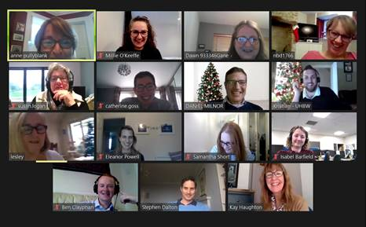
Materials & Methods
Collaborative Quality Improvement Project
MDT
Quarterly meetings, moved online due to COIVD
QI coaching, sharing data and experiences
Notes:
How did we go about this:
PreciSSIon is a collaborative quality improvement project, based on the IHI breakthrough series collaborative model, involving quarterly meeting where we can share data and experiences. These unfortunately had to be moved online due to COVID, one of the many challenges we came across as a team throughout the pandemic.
24s
Supported by the WEAHSN provided educational multimedia (videos, poster templates) as well as implementation toolkit
Based on IHI Breakthrough Series collaborative model, consisting of quarterly learning a sharing events. The first of which (Nov19) was held in person but due to COVID these had to be moved onto a virtual platform
Large multidisciplinary team comprised of Doctors, Nurses, QI experts and others.

Slide 7
Materials & Methods
Measuring 30-day patient reported SSI
PHE questionnaire
Evidence based SSI reduction bundle
2% Chlorhexidine
Antibacterial sutures
Antibiotics after 4hrs
Wound protector
Notes:
Patient would be mailed a questionnaire/rang 30d after surgery to ascertain if they have had an SSI. Validated questionnaire for use in all types or surgery and is mandatory for hip and knee procedures.
4 item SSI reduction bundle for use in combination existing WHO bundle.
2%chlorhexidine skin prep
A second dose of intraoperative antibiotics if the procedure lasts longer than 4hrs
Antibacterial sutures for superficial and deep closure
Dual-ring wound protector

Slide 8
Results – Bundle Compliance up to March 2021
(anonymised)
Hospital | Chlorhexidine | Antibacterial sutures | 2nd dose antibiotics after 4hrs | Wound protector
1 | 75% | 60% | 50% | 35%
2 | 70% | 52% | 25% | 39%
3 | 99% | 78% | 90% | 94%
4 | 80% | 86% | 100% | 86%
5 | 100% | 100% | 67% | 60%
6 | 100% | 100% | 100% | 91%
7
Mean | 87% | 79% | 72% | 68%

Slide 9
Results – SSI rates – all trusts
(anonymised)
Hospital | Baseline SSI rate (no. patients) | Post bundle SSI rate (no. patients) | Response rate
1 | 15%(198) | 7% (220) | 79%
2 | 8% (128) | 9% (210) | 68%
3 | 22% (74) | 7% (172) | 98%
4 | 12% (44) | 8% (220) | 86%
5 | 30% (208) | 14% (195) | N/A
6 | 20% (197) | 9.5% (253) | 93%
7 | 20% (54) | 7% (42) (data to Apr 2020) | 68%
Mean | 18% (903) | 9.5% (1270) | 80%
18%

Slide 10
Results – Bundle Compliance up to March 2021
Hospital | Chlorhexidine | Antibacterial sutures | 2nd dose antibiotics after 4hrs | Wound protector
GRH | 75% | 60% | 50% | 35%
CGH | 70% | 52% | 25% | 39%
RUH | 99% | 78% | 90% | 94%
GWH | 80% | 86% | 100% | 86%
UBHT | 100% | 100% | 67% | 60%
NBT | 100% | 100% | 100% | 91%
WGH
Mean | 87% | 79% | 72% | 68%

Slide 11
Results – SSI rates – all trusts
Hospital | Baseline SSI rate (no. patients) | Post bundle SSI rate (no. patients) | Response rate
GRH | 15%(198) | 7% (220) | 79%
CGH | 8% (128) | 9% (210) | 68%
RUH | 22% (74) | 7% (172) | 98%
GWH | 12% (44) | 8% (220) | 86%
UBHT | 30% (208) | 14% (195) | N/A
NBT | 20% (197) | 9.5% (253) | 93%
WGH | 20% (54) | 7% (42) (data to Apr 2020) | 68%
Mean | 18% (903) | 9.5% (1270) | 80%
18%

Slide 12
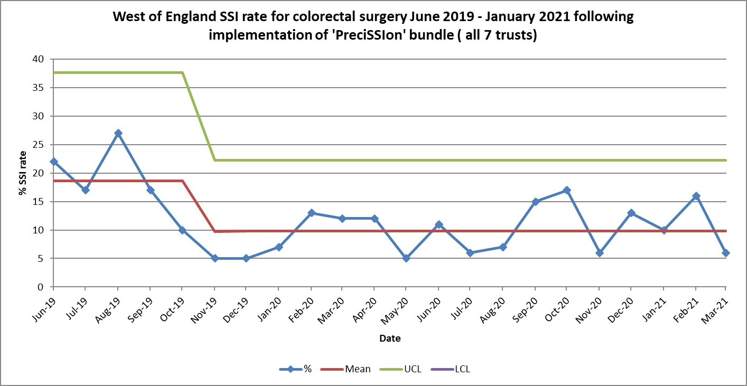
SPC chart: significant reduction SSI across region

Slide 13
Celebrating our success
All hospitals reliably measured SSI rate
50% reduction in SSI rate for elective colorectal surgery
Estimated saving of £566,720
115 patients saved from SSI
Article on celebrating the success of PreciSSIon
Notes:
In conclusion,
We have achieved our two aims: Each participating hospital is reliably measuring SSI rate following elective colorectal surgery and we have managed to reduce that rate by 50% with the use of our bundle
This amounts to an estimated savings (over the course of the project) of over 500k
But more importantly we have saved 103 patients from SSI

Slide 15
Awards entries
Quality Improvement Team of the Year
Peri-operative Care
Infection Prevention and Control
Shortlisted in both categories
Results September 2021
Awaiting results

Slide 16
Publications and Presentations
Paper submitted for publication by the British Medical Journal

Slide 17
Your trust data and run chart

Slide 18
Your team, your story, your plan for sustainability

