Slide 1
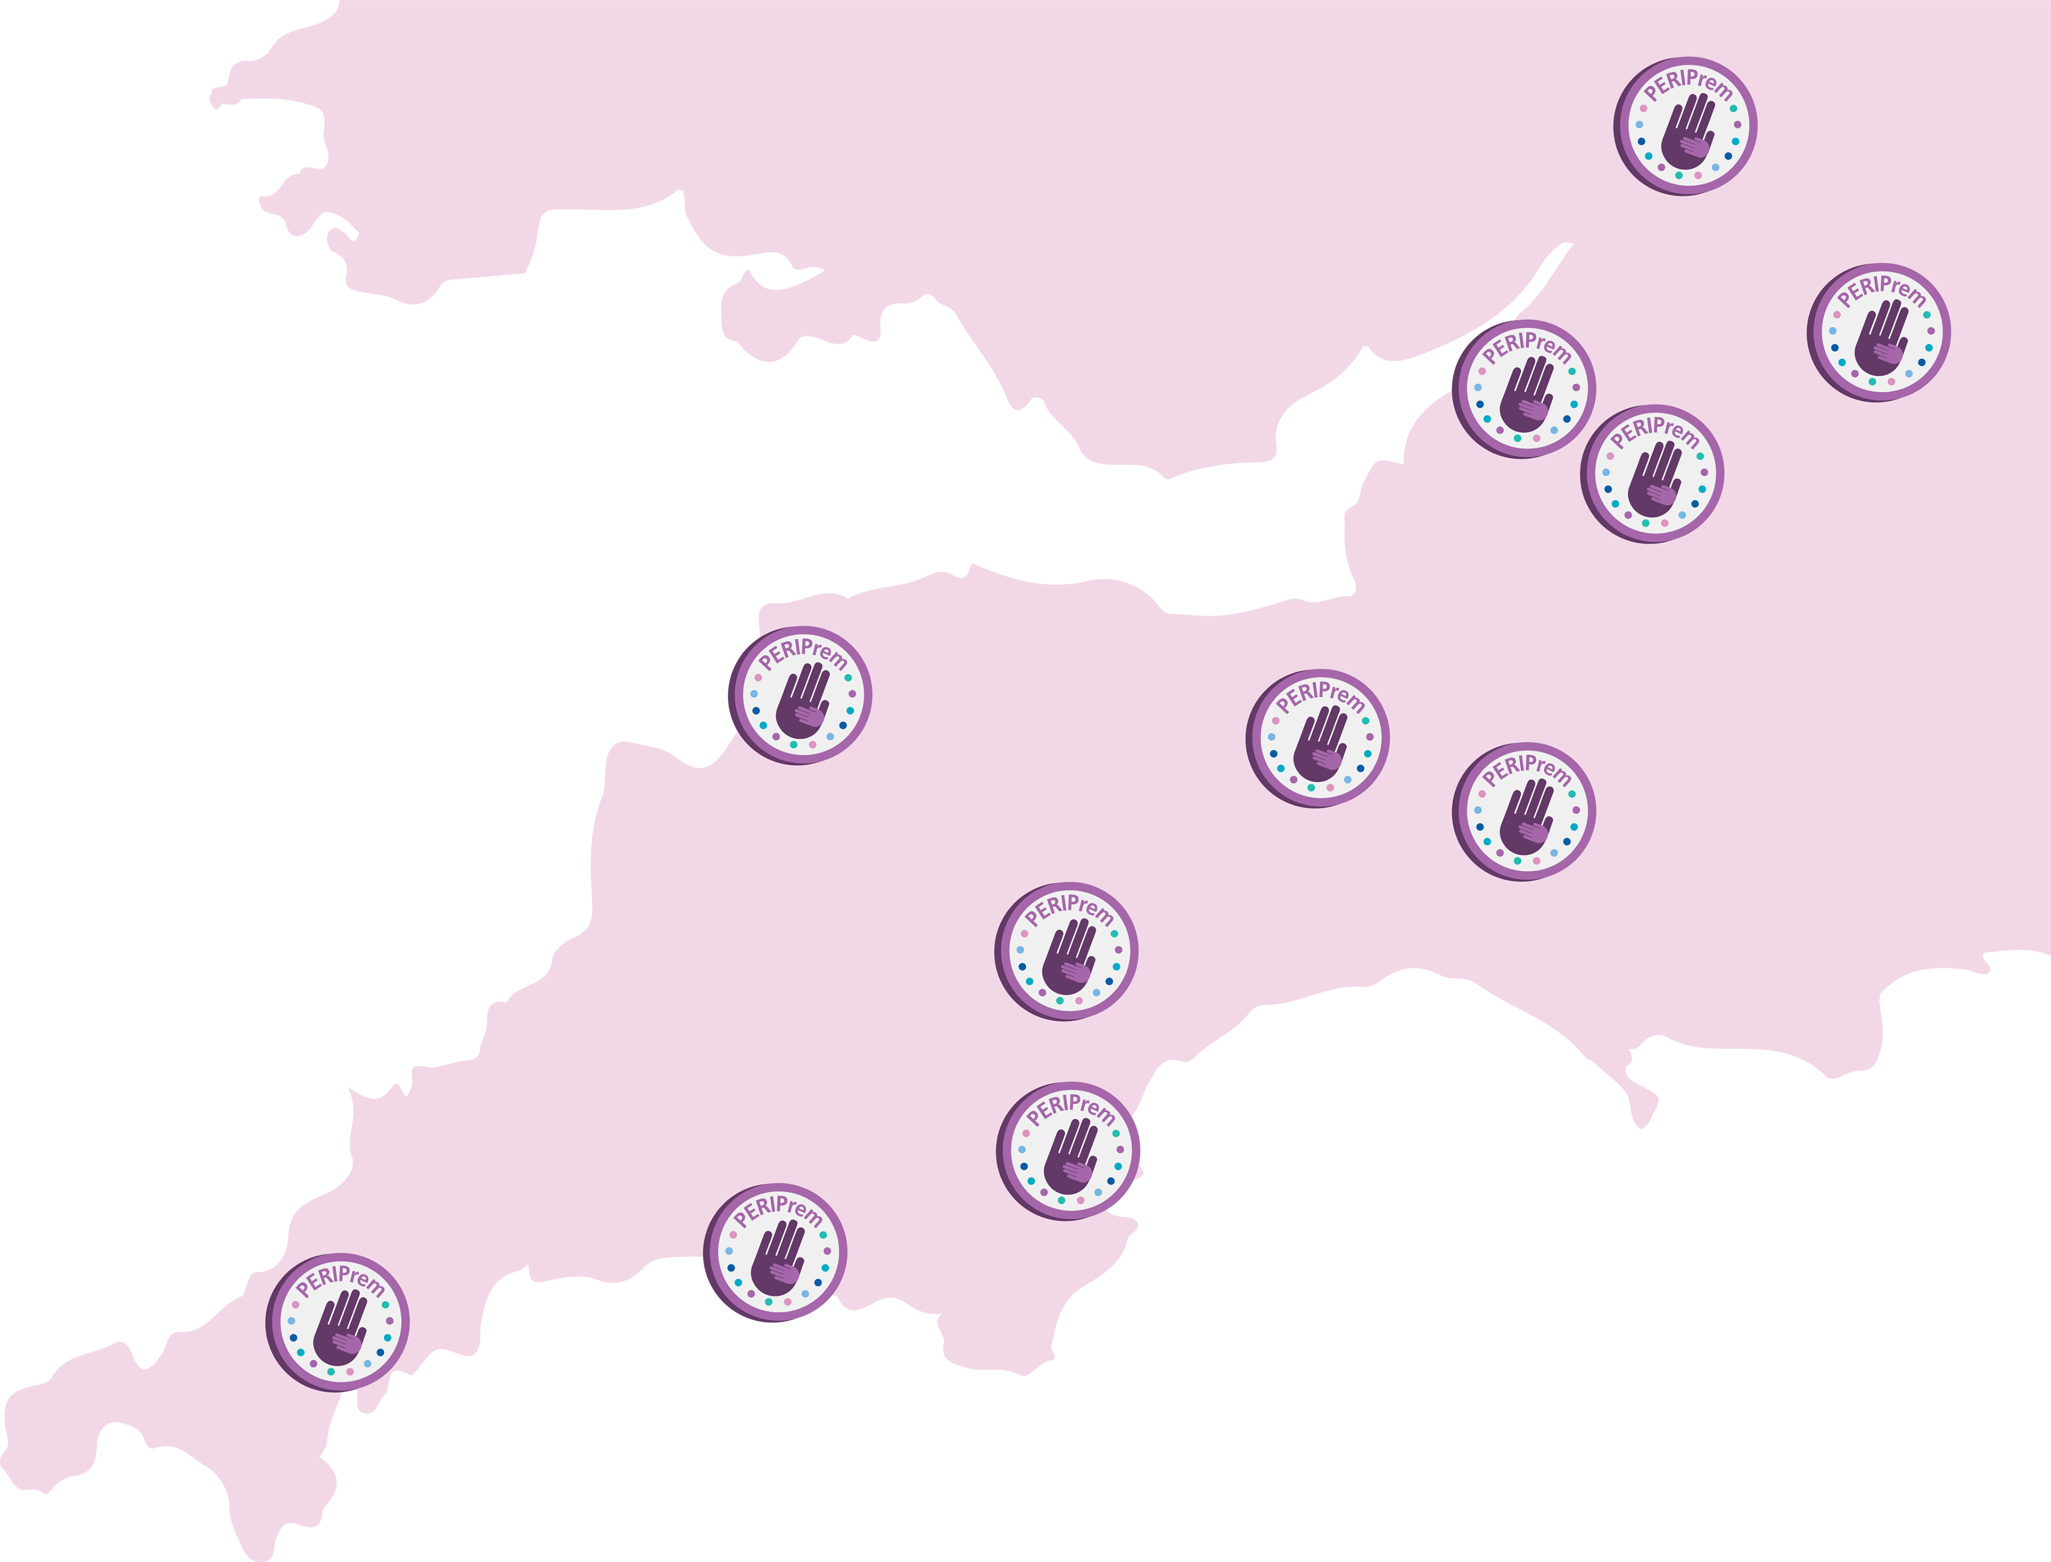
Debrief
What went well and what were the barriers to achieving bundle elements?
Place of Birth:
2. Antenatal Steroids:
3. Magnesium Sulphate:
4. Maternal Early Breast Milk:
5. Optimal Cord Management:
6. Thermal Care:

Slide 2
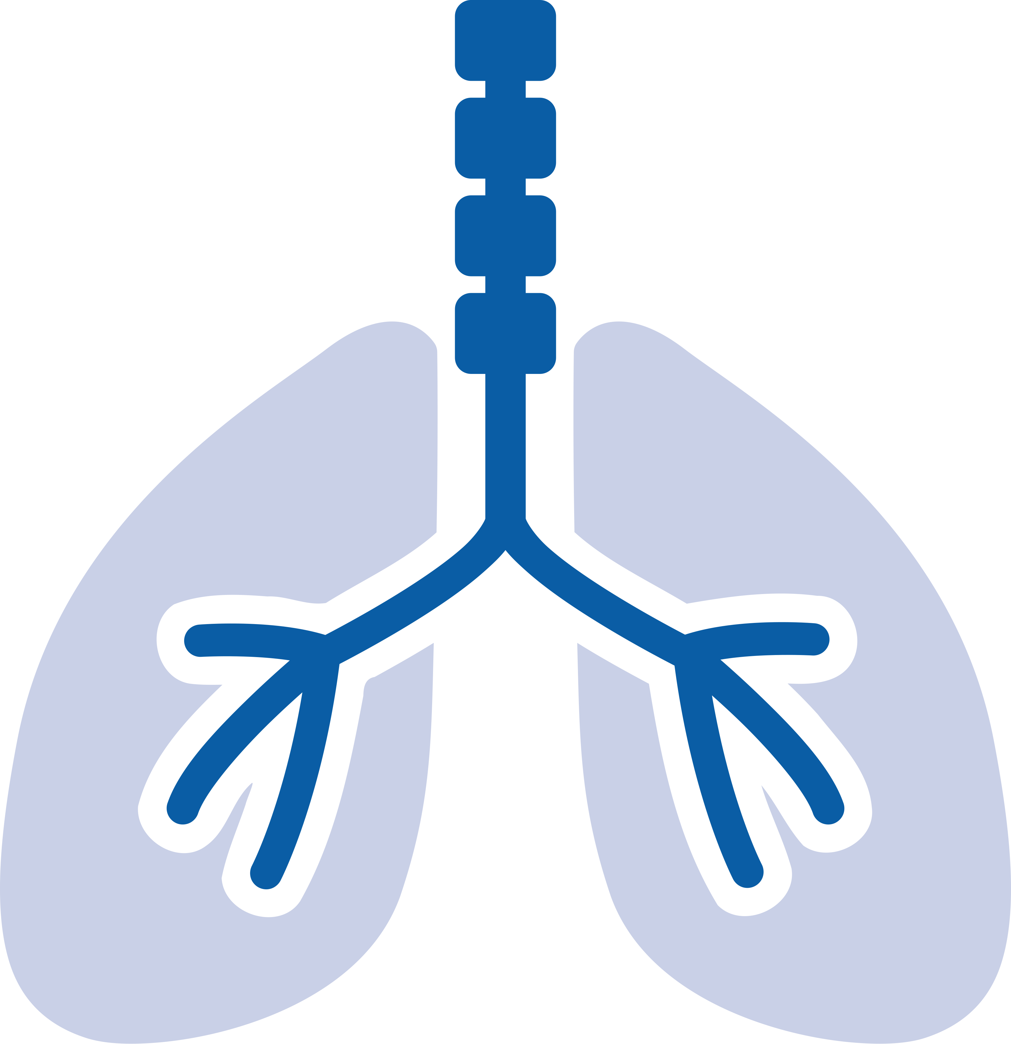
7. Respiratory
Management:
8. Caffeine:
4. Maternal Early Breast
Milk: (b)
9. Probiotics:
10. Prophylactic
Hydrocortisone:
11. Intrapartum Antibiotic Prophylaxis:
Improvement suggestions:

