Slide 1
What it takes to change Neonatal Care in the NHS
Dr. Eleri Adams
Notes:
Overview of main drivers for transformational change in neonatology
Key organisations involved in transformation of neonatal services
NCCR and GIRFT
Change so far

Slide 2

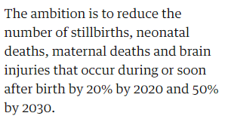
Background
November 2015
November 2017
“Through the Long Term Plan, the NHS will accelerate action to achieve 50% reductions in stillbirth, maternal mortality, neonatal mortality and serious brain injury by 2025”.

Slide 3




2016
GIRFT
Neonatology
National Report
2017
Jan 2019
Dec 2019
Sept 2021

Slide 4


Better Births – Feb 2016
Local Maternity Systems formed in March 2017 to deliver the maternity objectives within Better Births
Neonatal issues highlighted in Better Births:
  Medical and Nursing staffing issues, including Nurse training
  Support Staff ( AHP)
  Capacity
  Safety & Sustainability with reference to remote/rural settings
4.56………Maternity services cannot be considered in isolation and are inextricably linked to neonatal services, which are key in delivering optimal outcomes for babies.
4.58………In the time frame in which the National Maternity Review was conducted, it was not possible to review neonatal services concurrently. A dedicated review should be taken forward, in light of the findings of this review and its consequences for neonatal services.
The NCCR commissioned by NHS England SC W&C PoC Board led by Prof. Neil Marlow and Neonatal Critical Care Clinical Reference Group

Slide 5
Neonatal Critical Care Transformation Review ( NCCR) 2016-2019
Phase 1: Datapack to support local maternity transformation (Sept 2017 )
Neonatal Capacity & Transfers
    Reduction in Term Admissions- ATAIN
    Workforce planning
    Mortality
Phase 2: Development of Action plans Oct 17-Nov 18
  Models of Care Group
  Data Sub Group
  Workforce and Education Sub Group
  Pricing Group
Implementing NCCR – December 2019

Slide 6
NCCR Action plan Jan 2020 onwards
ODN to lead reviews locally with providers
  To meet NCCR activity requirements within five years
  Neonatal plans included in Regional LTP Implementation
  ODNs will work with LMS
Transport
  Review KPIs and address gaps in service
Develop the nursing workforce & AHP Plan
  CNST nursing criterion to ensure priority
  Nurse and AHP funding in LTP from 2021/22
  Education
Optimise medical staffing
  Gap analysis
  CNST criterion to ensure priority

Slide 7
NCCR Action Plan
Develop and invest in support for parents
  Funds for care coordinators across all networks 2020/21
  Encourage Trusts to support BFI neonatal and Bliss Charter
  Accommodation fitting out funds available
6. Develop local implemental plans
  5 year commissioning plan for each ODN
  Include in LMS submission and describe collaborative working
  GIRFT review
Ensure integration into Maternity Planning
  Nursing plan
  Birth in the right setting
  Neonatal Safety Champions and CNST criteria
8. National Infrastructure to oversee implementation
  NIB, Oversight and Assurance

Slide 9
What is GIRFT?
“National clinically led QI program to tackle unwarranted variation to improve quality of patient care”
Development of a benchmarking data pack to support peer to peer discussions
Sharing good practise & identifying changes to improve care &/or efficiencies
Design & implementation of changes derived from GIRFT recommendations lies with trusts and networks supported by GIRFT

Slide 10
Scope of GIRFT Neonatology
England only
Networks (10 networks)
Neonatal Transport Services (11 services)
Trusts (156 trusts – 43 NICUs, 75 LNUs, 38 SCUs)
To support the NCCR Action Plan including
    providing information to the NIB to support NHS LTP funding allocation
    provide detailed information to ODNs at the time of their GIRFT visits to support
      Capacity and demand planning,
      Workforce information
      Parent facilities

Slide 11
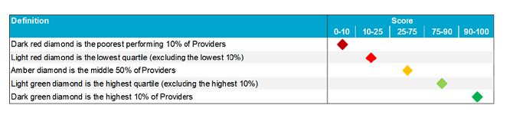
Datapacks
Network and Unit Designation Level Benchmarking Data
Data Sources
  Badgernet data
  NNAP/ MBRRACE- UK
  Questionnaires
    Networks
    Transport Services
    Trusts
    Workforce Snapshot ( UK-wide) in conjunction RCPCH
  NTG data
  HES/DIDS/Blueteq/ SC QST/ Reference cost data

Slide 12
GIRFT “Visits”
All held on VC
Wide representation
Datapack aids discussion
What’s is/isn’t going well and why?
Permission to share good ideas
Suggested action plan specific to trust
Common themes requiring action reported at national level

Slide 13
Datapack Content
Network Arrangements
Activity and Capacity
Network Pathways and Patient Flow
Transport Services
Clinical Processes and Outcomes
Governance and Research
Parents and Families
Workforce
  Medical
  Nursing
  AHPs
Reference Costs

Slide 14
Clinical Measures
Optimal Start metrics
Respiratory Management
Infection, infection control, prescribing
NEC and NEC prevention
PN, standardisation, procurement
Radiology access
Haematology
PDA
ROP
HIE
Mortality and End of Life Care

Slide 15
Clinical Processes and Outcomes
Optimal Start
  NNAP data and additional network pathway data
  3 year rolling averages and performance for combined metrics
  Split data for different gestations
  Caffeine, Early Milk, DCC,
  cardiac compressions/adrenaline at delivery
Respiratory Management
  Intubation in Delivery Suite at different gestations
  Elective surfactant/LISA
  Infants receiving 0-1 day ventilation in first week
  Median ventilation over first month
  Primary mode ventilation/ Use of morphine
  BPD data NNAP
  Home Oxygen
  Palivizumab

Slide 16
QI Support – Early Care
Mat-Neo Safety Improvement Program
  Preterm stabilisation & optimisation
  Detection and Management Neonatal Hypoglycaemia
MCQIC Program
BAPM QI Toolkits
  Antenatal optimisation
  Cord Management
  Normothermia
  Maternal Breast Milk
SW Periprem Care-bundle

Slide 17
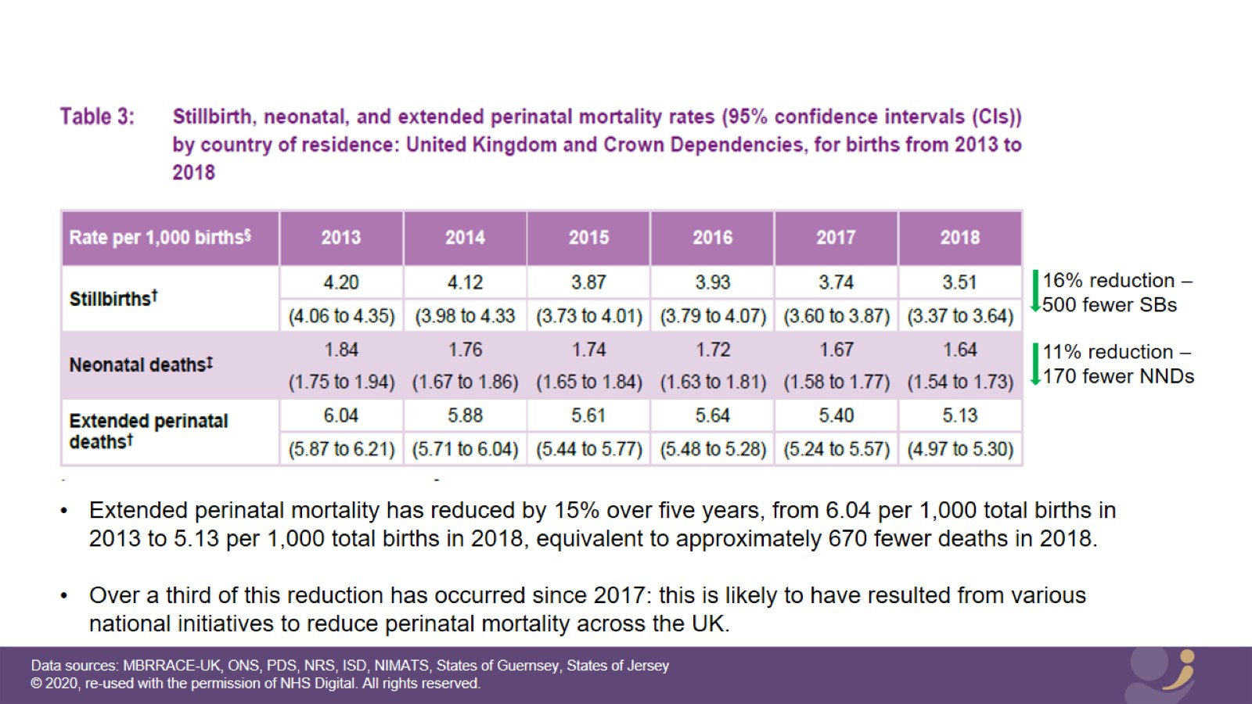
MBRRACE-UK 2018

Slide 18
Progress against NHSE Targets
Stillbirths on track for 20% reduction by 2020
Neonatal deaths are not on track for 20% reduction
Revised target 50% reduction by 2025 will be extremely challenging

Slide 19
What it takes to change
Practice in the NHS
A vision
Winning hearts and minds
System wide resource and collaboration
Sometimes funding or financial incentive eg. CNST
Helps if it costs less
Regional and national support structures
QI support structures
People with enthusiasm and understanding of QI on the ground

