Slide 1
Concept testing and writing a business case
Date:
Presenter:

Slide 2
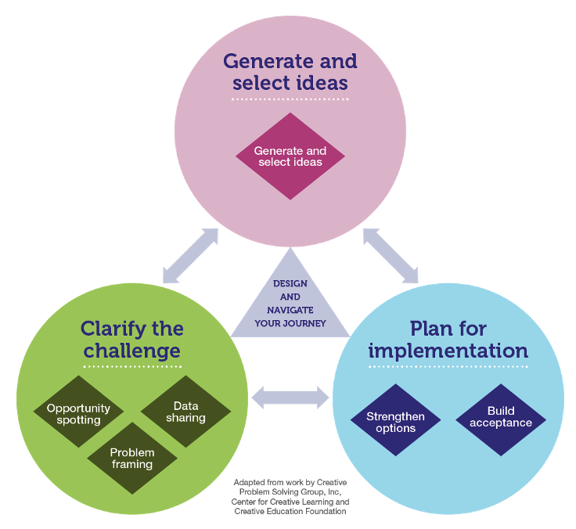

Slide 4
Qualitative Research Methods
Key considerations:
honest views from people
ongoing access to people for repeat cycles
depth of insight
listen to emotions, not just words
Higher
Cost
Focus groups - F2F - more costly;
- online - less
Video diaries and written diaries with test / target audience
1:1 interviews with lead users, or influencers. (Their time costs more.)
Observations of people as they use/make sense of the concept
1:1 interviews with target customers. (Useful to avoid group bias.)
Brief qualitative surveys – where do your target people gather?
Lower Cost

Slide 5
Quantitative and qualitative feedback

Slide 6
Brand compatibility
https://www.consumerreports.org/consumerist/17-commercial-failures-from-brands-with-spectacularly-bad-ideas/

Slide 7
Whatever Method(s) You Use…
Bring it to life quickly – the sooner the target audience can relate to something tangible the better
Think of this as a co-creation process. Consider customer, consumers, lead users, experts and other groups. Work with these to help you turn the idea into a concept and then further shape and improve
Test individual components of a concept as well as the full mix to understand specific strengths and weaknesses and potential log jams for the consumer. Be adaptable.
Introduce additional stimulus over and above the written concept e.g. low-fi prototypes
Take the time needed to improve the quality of the output – more haste, less speed

Slide 8
Build Persuasive Claims Into The Concept
Emotional: creates an emotional connection between consumers and your brand
Functional:
it helps consumers solve a problem - better than the competitors
Adoption: it’s easy for consumers to adopt
Notes:
Equally important is Being able to write concepts that cover all three of these type of core innovation claims the better your concept will be
Rob – please also reference the Claims Expert Plan verbally… And that there is a resource link below the video in this step of the Expert Plan that goes into much more detail around claims development – for existing products and services and new innovations.

Slide 9
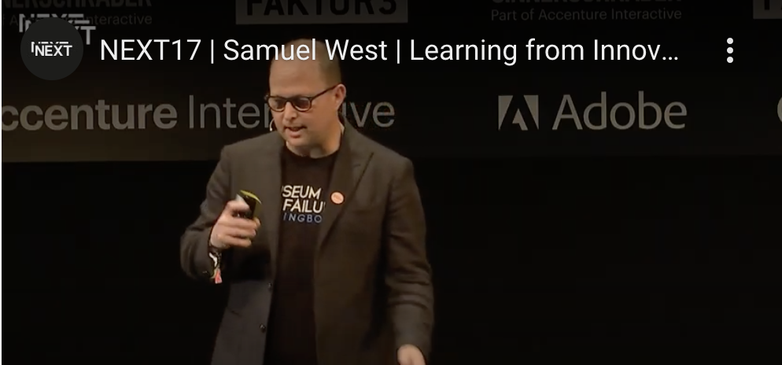
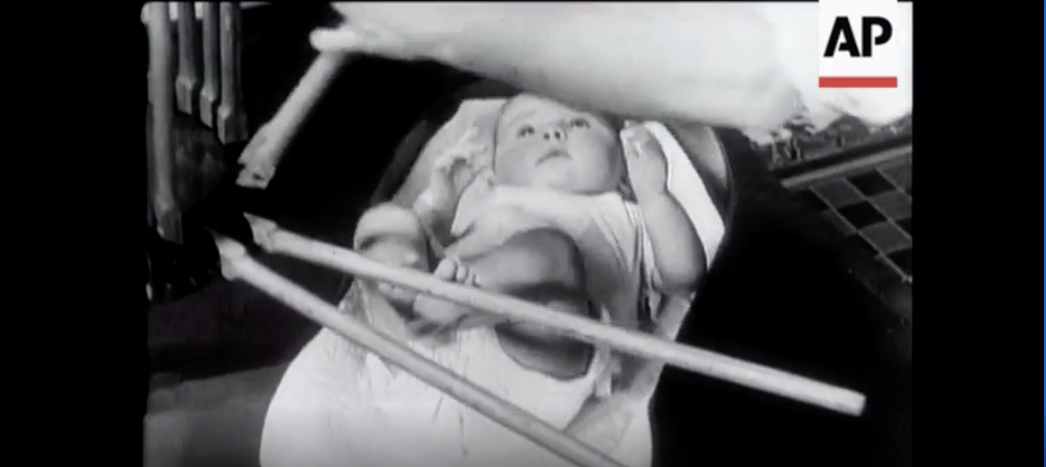
Testing, learning and failing

Slide 10
Writing a mini-business case
Feasible
(We can do this.)
Viable
(The idea will bring value.)
Desirable (The target group wants it.)
Start here

Slide 11
Structure of the MNBC
1. This is the customer friction
2. This is our new concept
What is the customer friction?
Situation
Need
Friction
Target group
Description of the new concept
New to us, - market, or - world?
New concept existing/new market?
6. We will continue in this way
3. This is the benefit for the customer
Why proceed?
What are the uncertainties?
Next steps
Team
Planning
Costs
mini new business case
Why will the customer choose it ?
Who are our competitors?
What’s our positioning?
Rating of the concept in the test?
5. This is what we get
4. We can produce it
Potential turnover
Potential margin and profits
Further costs for development
Feasibility
Potential partners for co-creation
Next steps in the process
Toolkit | Home Coming | MNBC |
11

Slide 12
This is the customer friction
I am
[picture of a customer from the target group, who struggles with his/her friction]
I need
But
Toolkit | Home Coming | MNBC |
12

Slide 13
This is our new concept
Our new concept
[picture/cartoon of the new concept]
Our target group
EVOLUTIONARY
REVOLUTIONARY
New for our company
New for our market
New for the world
Toolkit | Home Coming | MNBC |
13

Slide 14
This is the benefit for the customer
Competition
Be visual!
1 picture says more than a 1000 words.
1 minute says more than a 1000 photos.
Competitor 1 and their offer
Competitor 2 and their offer
Competitor 3 and their offer
Our main benefit for the customer
[Describe is the main benefit of our concept for the customer compared to the competition. Cheaper? Better? Faster? Easier?]
Our positioning in the market
[Describe our positioning in the market in a “sexy” advertising slogan].
Toolkit | Home Coming | MNBC |
14

Slide 15
We can produce it
Feasibility
Be visual!
1 picture says more than a 1000 words.
1 minute says more than a 1000 photos.
[Describe how production, logistics, service and sales of the new concept will be feasible. Use an appendix to explain further]
Potential partners
Partner 1 and how it may contribute
Partner 1 and how it may contribute
Partner 1 and how it may contribute
Critical aspects to feasibility
[Describe critical aspects concerning the feasibility].
Possible launch date:
Toolkit | Home Coming | MNBC |
15

Slide 16
This is what we get
Potential turnover and profit
Be visual!
1 picture says more than a 1000 words.
1 minute says more than a 1000 photos.
[Show your estimation of the projected potential turnover and profit in year three after the launch of the new concept. Use an appendix to show the assumptions and detailed calculations further].
Expected costs for development
[Show your estimation of the R&D costs to develop the new concept up to the launch date Use an appendix to show the assumptions and detailed calculations further].
Toolkit | Home Coming | MNBC |
16

Slide 17
We will continue this way
Uncertainties to be checked further
Be visual!
1 picture says more than a 1000 words.
1 minute says more than a 1000 photos.
[Describe the main uncertainties to be checked further in the concept development process.]
The main reasons to say YES to the concepts
…
…
…
Our next steps
Team
[Describe the team for the next steps]
Activity
[Describe the activity in the next steps]
Deliverable
[Describe the deliverable of the next step and delivery date]
Toolkit | Home Coming | MNBC |
17

Slide 18
Facilitating creative problem solving

