Slide 1






A collaborative initiative to reduce incidence of SSI after elective colorectal surgery
Dr Ben Clayphan: presenting on behalf of the PreciSSIon collaborative
Notes:
Good Afternoon, I am presenting to you today the PreciSSIon project. A collaboration between 7 hospitals in the west of england supported by the west of England academic health science network,
Looking at reducing SSI following elective colorectal surgery

Slide 2
Introduction
Surgical site infections (SSI) are common after colorectal surgery¹
Patient morbidity & cost to NHS
SSI reporting not mandatory for colorectal surgery
1) Newton L, Dewi F, McNair A, Gane D, Rogers J, Dean H, Pullyblank A. The community burden of surgical site infection following elective colorectal resection. Colorectal Disease. 2020 Nov 1.
Notes:
Surgical Site infections are a common occurrence following colorectal surgery, with multiple sources reporting rates as high as 30% - this is associated with morbidity for patients and cost to the NHS (GIRFT estimates that English NHS trusts have spent 35.2mil over 5 years on SSI-related medical negligence claims)
In spite of this, collecting SSI incidence data is not mandatory for large bowel surgery – recent PHE report (2019/20) of SSI showed that only 20/195 NHS hospitals surveyed were surveilling SSI. And the majority therein were monitoring for SSI occurring as inpatients and as a reason for re-admission, not for those in the community who do not present to hospital – evidence suggests that 50% of SSI occur after DC. Largely to due to influence of ERAS and community management with antibiotics.

Slide 3
Introduction
A local hospital has reduced 30-day patient reported SSI rates by 50%²
Sustained change over 8 years
Using evidence based bundle of care, alongside existing WHO SSI bundle
2) Dean HF, King E, Gane D, Hocking D, Rogers J, Pullyblank A. Introduction of a care bundle effectively and sustainably reduces patient-reported surgical site infection in patients undergoing colorectal surgery. Journal of Hospital Infection. 2020 Jun 1;105(2):156-61
Notes:
One of our local hospitals has been looking into this since 2013. They have measured 30 day patient reported SSI rates in the community using questionnaires and have been able to show that by implementing a 4 item care bundle, alongside the existing WHO SSI bundle , they have reduced SSI rates by 50% in this patient group.
Dean HF, King E, Gane D, Hocking D, Rogers J, Pullyblank A. Introduction of a care bundle effectively and sustainably reduces patient-reported surgical site infection in patients undergoing colorectal surgery. Journal of Hospital Infection. 2020 Jun 1;105(2):156-61.

Slide 4
Objectives
To reliably measure SSI rates following elective colorectal surgery
Reduce patient reported SSI across a region by 50%, using an evidence based bundle of care
Notes:
Which brings us on to the objectives of the PreciSSIon project,
Starting in Nov 2019 and ending in March 2021,
to have all 7 participating hospitals reliably measuring SSI rates 30 days after elective colorectal surgery and have halved SSI rates by implementing a new evidence based bundle of care

Slide 5
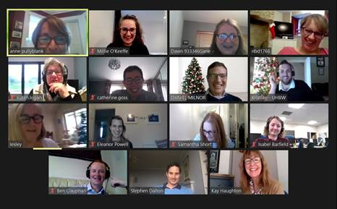
Materials & Methods
Collaborative Quality Improvement Project
  MDT
  Quarterly meetings, moved online due to COIVD
  QI coaching, sharing data and experiences
Notes:
How did we go about this:
PreciSSIon is a collaborative quality improvement project, based on the IHI breakthrough series collaborative model, involving quarterly meeting where we can share data and experiences. These unfortunately had to be moved online due to COVID, one of the many challenges we came across as a team throughout the pandemic.
24s
Supported by the WEAHSN provided educational multimedia (videos, poster templates) as well as implementation toolkit
Based on IHI Breakthrough Series collaborative model, consisting of quarterly learning a sharing events. The first of which (Nov19) was held in person but due to COVID these had to be moved onto a virtual platform
Large multidisciplinary team comprised of Doctors, Nurses, QI experts and others.

Slide 6




Materials & Methods
Measuring 30-day patient reported SSI
  PHE questionnaire
Evidence based SSI reduction bundle
2% Chlorhexidine
Antibacterial sutures
Antibiotics after 4hrs
Wound protector
Notes:
Patient would be mailed a questionnaire/rang 30d after surgery to ascertain if they have had an SSI. Validated questionnaire for use in all types or surgery and is mandatory for hip and knee procedures.
4 item SSI reduction bundle for use in combination existing WHO bundle.
2%chlorhexidine skin prep
A second dose of intraoperative antibiotics if the procedure lasts longer than 4hrs
Antibacterial sutures for superficial and deep closure
Dual-ring wound protector

Slide 7
Results – Bundle Compliance
Hospital | Chlorhexidine | Antibacterial sutures | 2nd dose antibiotics after 4hrs | Wound protector
1 | 89% | 58% | 32% | 34%
2 | 91% | 68% | 34% | 33%
3 | 100% | 90% | 85% | 90%
4 | 84% | 86% | 98% | 83%
5 | 100% | 100% | 67% | 61%
6 | 100% | 100% | 100% | 91%
7 | 100% | 71% | 100% | 100%
Mean | 95% | 82% | 73% | 70%
Notes:
How did we get on:
Firstly this slide shows the each hospitals compliance with elements of the bundle, expressed as a percentage of the cases in which they were used.
All trusts had implemented all elements of the bundle by Feb 2020
Some easier to measure and some easier to implement
For example not always possible to use a WP
But overall, Average compliance has been excellent. Across region between 70 and 95% for each element

Slide 8
Results - SSI
Hospital | Baseline SSI (no. patients) | Post bundle SSI (no. patients) | Response rate
1 | 15%(198) | 7% (187) | 74%
2 | 8% (128) | 8.6% (197) | 63%
3 | 22% (74) | 6% (136) | 100%
4 | 12% (44) | 8.5% (193) | 86%
5 | 30% (208) | 15% (175) | N/A
6 | 20% (197) | 11% (217) | 93%
7 | 20% (54) | 7% (42) | 68%
Mean | 18% (903) | 9% (1147) | 80%
18%
Notes:
This slide shows the SSI rates at each hospital, pre- and post bundle introduction
6/7 hospitals reduced SSI
On average = 18% baseline to 9%
Constituting a 50% reduction in SSI rate
Hospital 2 = 4% since Aug 20

Slide 9
Conclusion
All hospitals reliably measured SSI rate
50% reduction in SSI rate for elective colorectal surgery
Estimated saving of £22,660 - £309,000
103 patients saved from SSI
What next?
Notes:
In conclusion,
We have achieved our two aims: Each participating hospital is reliably measuring SSI rate following elective colorectal surgery and we have managed to reduce that rate by 50% with the use of our bundle
This amounts to an estimated savings (over the course of the project) of between 119-234,000
But more importantly we have saved 103 patients from SSI
Next steps: Already spread to emergency surgery, has the possibility to be trialled in other regions or specialities
3 hospitals reduced from Average combined Baseline SSI rate 23.5% ( 13- 32 %) decreased to 10% ( 7-12%)Easily spread to other specialties
Testing other ways of measuring
ePROMS
Data linkage

Slide 10
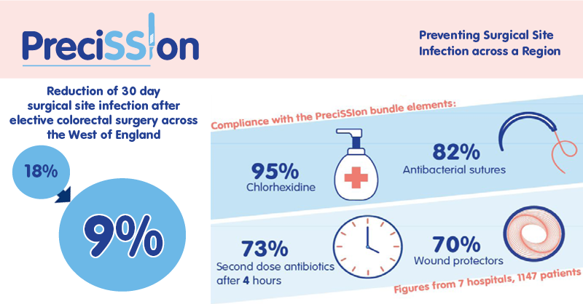
Notes:
In Summary
Using a Collaborative, multidisciplinary team approach to QI. With a focus on patient involvement, we have been able to reduce SSI by 50% following colorectal surgery across the west of England
Thank you for listening

