Slide 1
PERIPRem Share & Learn Session
“Optimising Deferred Cord Clamping”

Slide 2
Aims of the session:
Who are we?
Why Deferred Cord Clamping?
Share innovation
Promote collaboration and community
Identify barriers and facilitators to improvement
Trouble shoot / offer solutions
Getting started

Slide 3
Share and Learn Session Etiquette
When not speaking please go on mute to minimise background noise; click on the microphone icon to mute / unmute.
Introduce yourself before speaking to the group.
Use the chat function if you are unable to speak.
Raise your hand to indicate you would like to speak.
Use of the video is optional; turn the camera off if you do not wish to have your camera on.

Slide 4
The Swindon DCC Journey:

Slide 5
Attitudes & Team Culture
Neonatal Concerns
Obstetric Concerns
Environmental & Practical Challenges
Notes:
In 2015, we performed structured interviews with obstetric, neonatal, midwifery and anaesthetic colleagues about DCC, to try to ascertain what the barriers were to implementation. All team members were clearly aware of the benefits of DCC,

Slide 6
Attitudes
Neonatal Concerns
Is it a ‘compromised’ baby?
“I need to get the baby from the obstetrician to the resuscitaire”
Airway support & Lung inflation prior to cord clamping matters…
Obstetric Concerns
Environmental Challenges
“admission temperature was inversely related to mortality (28% increase per 1°C decrease)”
“I need to get the baby to the neonatologist”
Sterile surgical conditions,
Notes:
The first, linking in with the concerns about ‘the compromised baby’, was the importance of being able to support the airway during DCC, and provide respiratory support, with PEEP, and inflation breaths if needed. Evidence from animal studies, (and increasingly from human studies), suggests the changes in the physiology as the pulmonary vascular bed opens with lung inflation seem to be very key in the efficacy of DCC.
The second is about provision of thermal care during DCC. Hypothermia is detrimental to preterm infants, in terms of morbidity and mortality.
It was clear to me that, when we were going to implement delayed cord clamping to preterm infants, we must be able to provide good thermal care, airway support, and respiratory support, along side our obstetric and midwifery colleagues, as a perinatal team. This is fairly simple to do at a vaginal delivery…

Slide 7
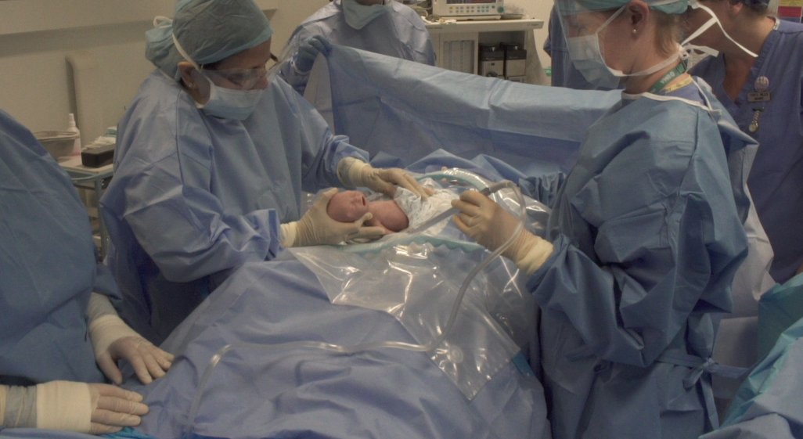
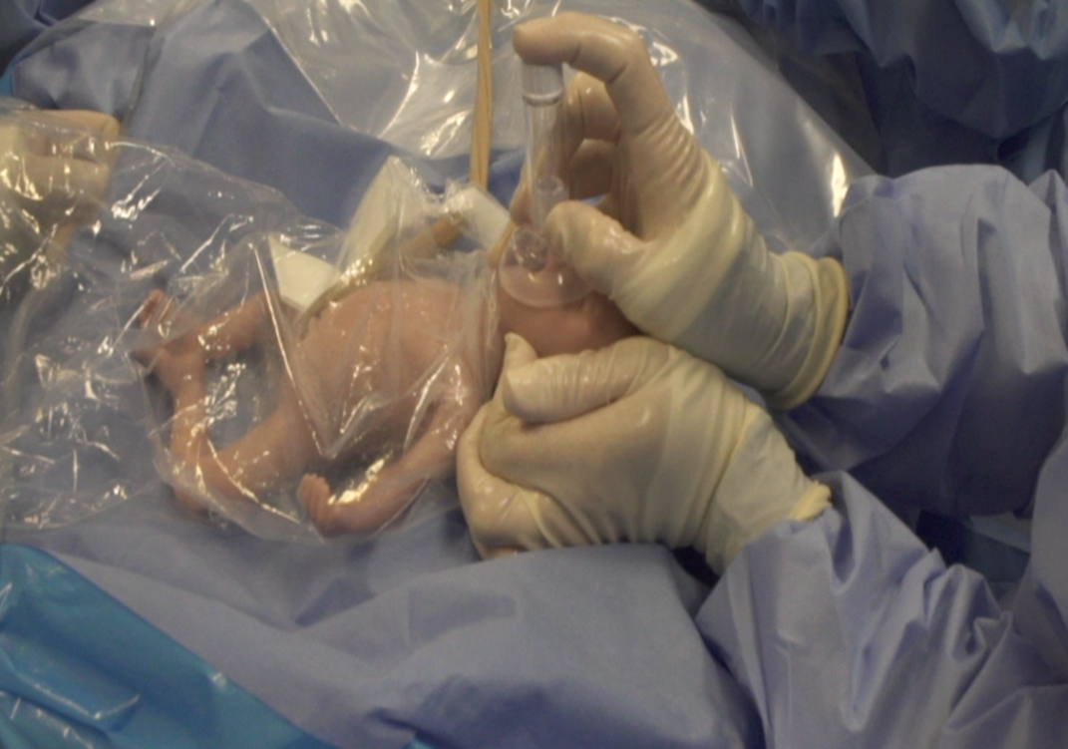
SIM Problem Solving
Optimising Cord Clamping

Slide 8
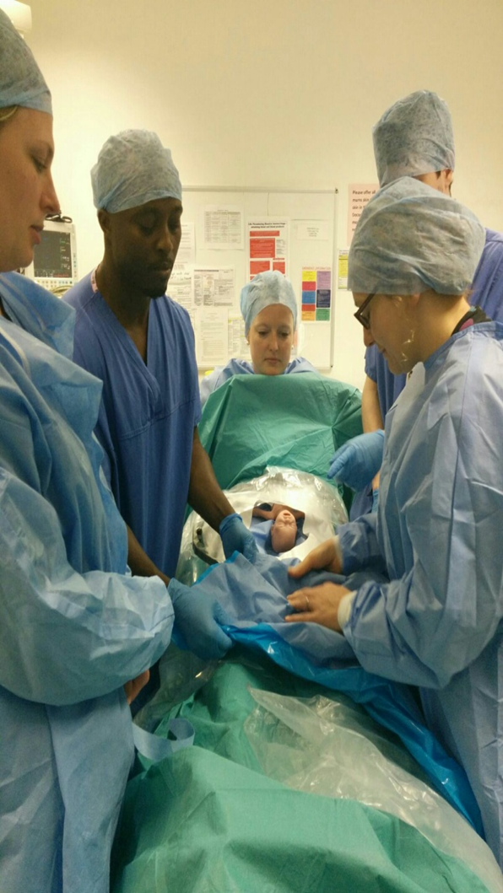

Slide 9
% infants <32 weeks receiving DCC
Notes:
And, over the last 2 and a half years, this is what we have achieved – a significant increase in the proportion of babies receiving DCC. Almost all that do get DCC receive simultaneous airway and breathing support and thermal care during this.

Slide 10
Deferred Cord Clamping with Thermal Care & Stabilisation
Notes:
Explain y axis = seconds, each dot is a baby

Slide 11
Next Steps:
Forming a learning community
Setting up a shared discussion space
Do we want another DCC Share and Learn Session?
Please complete evaluation survey that will be shared – we are learning how best to facilitate on line sessions

