Slide 1
CCG logo here
A common language across healthcare: using RESTORE2 & NEWS2 to identify the physically deteriorating person in care/nursing homes and beyond
Train the trainer slides
RESTORE2 uses NEWS2 reproduced from the Royal College of Physicians. National Early Warning Score (NEWS) 2: Standardising the assessment of acute illness severity in the NHS. Updated report of a working party. London: RCP, 2017. The NEWS2 charts must be reproduced in full colour and high resolution only.
RESTORE2 and its components must not be modified/amended in any way.
RESTORE2 is trademarked and copyrighted West Hampshire Clinical Commissioning Group 2019
Notes:
All homes and hospital do speak different languages. NEWS2 means that all professionals will have a common language across healthcare.

Slide 2
Introduction and Housekeeping
Guidelines for participating – please follow local guidance, e.g.:
Maintain 2m+ spacing
Wear facemasks
Well ventilated areas (windows open etc.)
Consider use of more devices
Consider use of projectors to for easier viewing

Slide 3
Aims and Objectives
Aim
To provide participants with an overview of RESTORE2 and the necessary skills and knowledge to enable them to train others on the tool.
Objectives
Provide awareness of the component of RESTORE2 tool (i.e. soft signs, recording observations, escalation and communication) and the advantages of applying the tool to recognise and respond to the deteriorating patient
Provide an overview of potential steps and processes to enable participants facilitate a training session in practice on the RESTORE2 tool
Enhance participant’s confidence in training others on the RESTORE2 tool
2019

Slide 4
Session outline
Start with why
What is RESTORE2
Why do your resident need RESTORE2
How to prepare for a session (Practicalities)
How to train on the RESTORE2 tool (content delivery)

Slide 5
Why are we here?
RESTORE2 recommended by NHSE, BGS, LeDeR, and has won several national awards
Originally developed in West Hampshire, other areas have recognised its value in keeping people safe
Begins by recognising the importance of carer instinct / intuition – fab!

Slide 6
During this session…
Feel free to critically evaluate the training
Take note of things you’d like to include in your sessions
Feel free to make your sessions your own. Think of examples from your own experience that you can bring into the training to bring it to life

Slide 7
What is
https://www.youtube.com/watch?v=Gxrr9QOergg 3mins 12sec
Notes:
RESTORE2TM –What is it? https://www.youtube.com/watch?v=Gxrr9QOergg (3mins 12 secs)

Slide 8
RESTORE2 is a physical deterioration and escalation tool for care/nursing homes.
It is designed to:
Recognise when a resident may be deteriorating or at risk of physical deterioration
Act appropriately according to the residents care plan
Obtain a complete set of physical observations to inform escalation and conversations with health professionals
Speak with the most appropriate health professional in a timely way
Provide a concise escalation history to health professionals to support their professional decision making
Get staff and residents the right support in the right timescale
2019
Notes:
RESTORE2TM –What is it? https://www.youtube.com/watch?v=Gxrr9QOergg (3mins 12 secs)

Slide 9
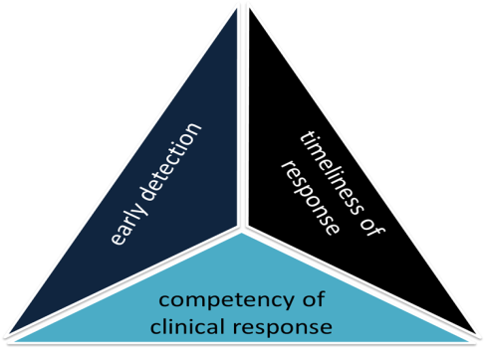
Getting the best outcome for residents
If any one of us was unwell, we would want the following things to be in place to give us the best chance of a good outcome:
Someone to recognise our deterioration early
Healthcare services to get to us as quickly as is required
A clinical response that meets our need
These 3 things are the triad of clinical outcomes.
Support carers to recognise physical deterioration early
Provide a standardised assessment tool and a common language across healthcare
early detection
Enable staff to communicate concisely with clinical decision makers to get an effective response
Notes:
RESTORE2 is not an admission avoidance tool- It is a right care, right time, right place tool, right outcome tool
They are critical in preventing worsening deterioration and giving residents the best chance of being treated successfully
Ideally this means managing them in the community in their own place of residence, but it could mean having the shortest possible admission to hospital or supporting a dignified and managed death.
Challenges facing homes;
The proportion of care that is provided by untrained carers
The lack of available standardised assessment tools
The difficulty in communicating effectively with multiple healthcare providers when escalating concerns
The complexity of recognising physical deterioration in residents with underlying health problems

Slide 10
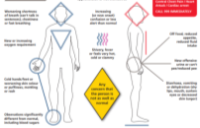
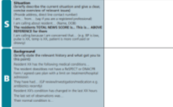
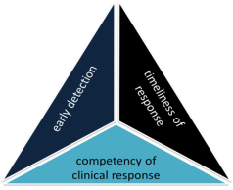
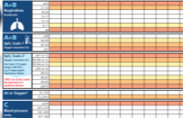
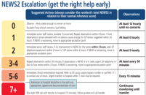
Components of RESTORE2TM
Recognise Soft Signs
Take observations
Calculate NEWS
Communicate using SBARD
Escalate using Escalation Tool
Recognise Soft Signs
RESTORE2 combines soft signs with NEWS2, a clear escalation pathway designed around care homes and an SBARD communication tool and Action Tracker.
Get your message across
Take Observations
Get the right help early
Calculate NEWS2
2019
Notes:
Recognition of Soft signs allows the early detection of acute illness or physical deterioration and leads into taking physical observations using NEWS2.
Carers are usually the first to recognise soft signs but found it difficult to communicate this concern.
NEWS2 allows the carer to escalate their concern to a GP or another professional.
Fancy way of saying ‘right help, right place, right time’

Slide 11
Why do your residents need
Notes:
Best if you can use an example from your own experience

Slide 12
Case Study Lost Opportunities
10am Resident Y developed ‘flu like symptoms - referred to the local GP practice who diagnosed a chest infection – prescribes antibiotics
Oxygen saturations 91% in air
Not engaging in rehab
NEWS
More lethargic than previously
NOT MEASURED
Chance to repeat observations and recognise potential for deterioration
3
NEWS
NEWS would have been 3 if measured
Nursing Home – GP

Slide 13
Case Study Lost Opportunities
5pm Antibiotics have not arrived
00.10am Resident developed a fever and elevated heart rate and the nursing home contacted the Out of Hours GP service who advised paracetamol and fluids
worsening clinical picture
OOH GP did not do a NEWS
NEWS
advised to wait until morning for antibiotics
NOT MEASURED
8
NEWS
NEWS would have been 8 if measured
Nursing Home – GP – Out of Hours GP

Slide 14
Case Study Lost Opportunities
03.30am Home contacted Out of Hours again because of concerns around falling blood pressure and oxygen levels in the blood
worsening clinical picture
Effects of paracetamol in reducing temperature not appreciated
NEWS
NOT MEASURED
7
NEWS
NEWS would have been 7 if measured
Nursing Home – GP – Out of Hours GP

Slide 15
Case Study Lost Opportunities
04.00am Home call 999 as so concerned about the resident.
The resident died in the emergency department at 09.30am due to sepsis
low mortality
NEWS Score | Mortality
0 | 0.5%
<5 | 5.5%
root causes
no-one recognised how sick the resident was
response from healthcare services was inadequate
high mortality
home were unable to effectively communicate their concerns to healthcare professionals
NEWS Score | Mortality
≥5 | 22%
≥7 | 27%
≥9 | 38%
Nursing Home – GP – Out of Hours GP – 999 - Hospital

Slide 16
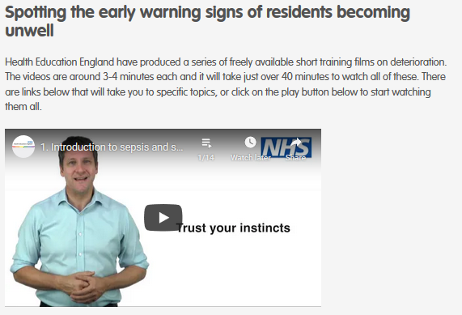
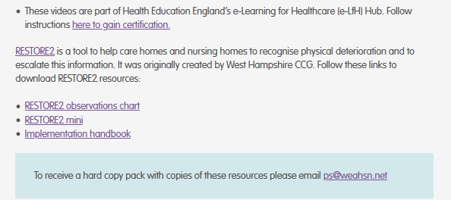
https://www.weahsn.net/
https://wessexahsn.org.uk/

Slide 17
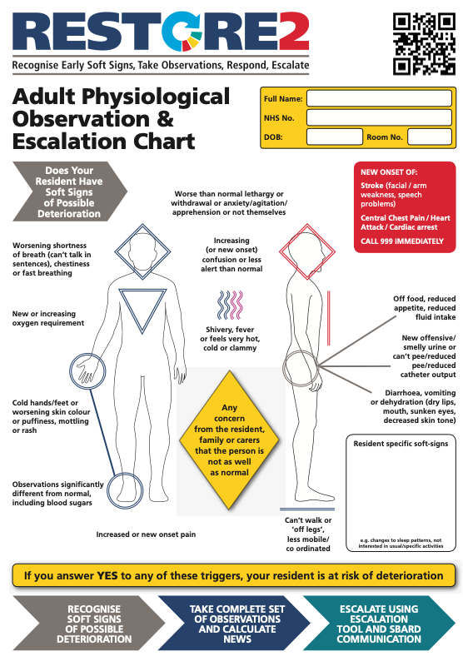
Identifying the soft signs of deterioration
Notes:
Does your resident have soft signs? If yes, they are at risk of deterioration.
Carers are usually the first to recognise soft signs but found it difficult to communicate this concern.
Soft signs are the early indicators that the resident may not be as well as they were previously.
Some soft signs are generic and apply to all residents, but you can also bespoke the RESTORE2 tool with the unique signs that indicate deterioration for a particular resident.
Soft signs provide an entry point into the National Early Warning Scores (NEWS).

Slide 18
Scenario: Charlie
Charlie is 67 yrs old gentleman admitted to care home as unable to cope. Charlie has full capacity but reduced mobility. Charlie has been with the home for 3 months and is generally fit and well. He is on medication for hypertension but no other medication and has not required medication review since joining the home.
One morning you notice that Charlie is reluctant to eat his breakfast and feels he needs to go back to bed for a rest. When you check on Charlie an hour later you feel his hands are colder than normal and he is beginning to shiver. Charlie has also informed you he does not feel very well.
What soft signs can you recognise in Charlie?

Slide 19
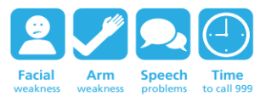
Medical emergencies
There may be some occasions when the early signs of deterioration may be a medical emergency. In these cases it is not appropriate to delay contacting the emergency services in order to record a NEWS2. It may be appropriate to monitor your resident’s vital signs once you have contacted the emergency services. Such situations include:
New onset of chest pain or suspected heart attack
Where the individual is displaying signs consistent with having a stroke
Prolonged seizure where the individual does not have a care plan in place to manage it
Where the resident has sustained a significant injury – e.g. a fracture head injury
Where the person is unable to breath
Remember to follow a person’s End of Life or Agreed Limit of Treatment of they have one

Slide 20
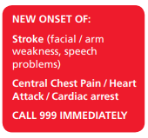
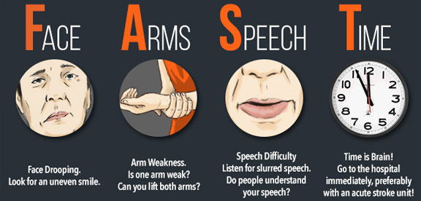
When to call 999
A stroke is a brain attack. It happens when the blood supply to part of the brain is cut off. Without blood brain cells can be damaged or die – do not use RESTORE2 but call 999
2019
Notes:
Please contact 999 if you think someone is having a stroke

Slide 21
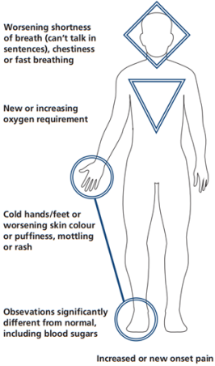
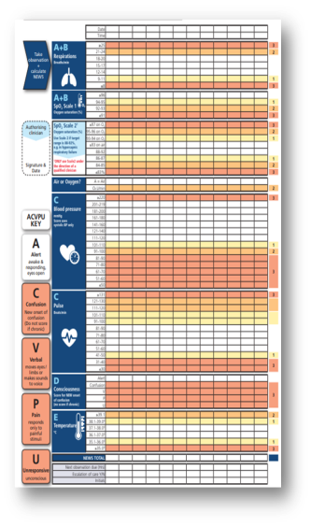
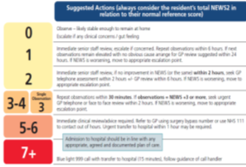
Making NEWS accessible
+
SBARD
Soft Signs
NEWS2
2019
Notes:
Soft Signs are not specific enough to be used alone
Soft Signs benefit from some sort of validation / quantification
Pre-requisite of NEWS is either regular observations or recognising concern
NEWS requires an entry point in community settings (don’t want to over-medicalise care homes, only take obs when really needed, as many people now do at home)

Slide 22
Understanding your resident
Homes are encouraged to understand what is normal for the resident and work with GPs or other teams (e.g. frailty teams) to define when another health professional would want to be informed of an event – this should include knowing what a normal set of physical observations looks like for the resident
Any escalation should be with reference to the residents wishes and advanced care plan – if a plan does not exist it should be created with the resident or the appropriate person with Power of Attorney (health and welfare)
Essential that there is evidence of a documented Capacity Assessment where Best Interests Decisions are being made and that decisions are made with others and are clearly articulated
2019
Notes:
You need to know what is normal for their resident. ReSPECT is currently being used at our local hospitals (e.g. BRI/Southmead), as well as some GPs. We hope it will be used by many more GPS in the future. DNACPR is included on the ReSPECT form.

Slide 23
Understanding your resident
Edward is normally fit and active but is often mildly confused in the mornings before breakfast. Normally NEWS score is 0 but in the morning Edward may trigger the AVPU scale – only call a GP if the confusion continues to lunchtime. Edward is for full treatment and admission to hospital if required. Edward becomes agitated when he is becoming unwell which is a good soft sign for him.
Dr. Davids 12/4/18 DDAVIDS
Notes:
It is important to know what is normal for the resident.
This can support the GP or other healthcare professionals with clinical decision making when their attention is requested.
Local hospitals and some GPs are already using ReSPECT. We hope many more GPS will join others in using it soon.
DNACPR is included on the ReSPECT form.

Slide 24
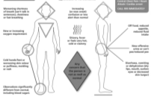
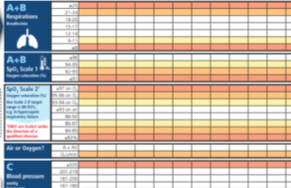
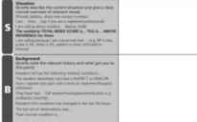
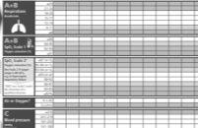
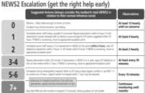
Take Observations
Recognise Soft Signs
Take observations
Calculate NEWS
Escalate using Escalation Tool
Communicate using SBARD
Recognise Soft Signs
Get your message across
Get your message across
Take Observations
Take Observations
Get the right help early
Calculate NEWS2
Get the right help early
Calculate NEWS2
2019

Slide 25
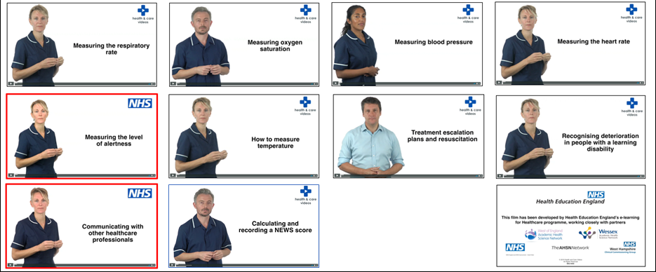
Take observations
Notes:
Do you want your students to watch these first?

Slide 26
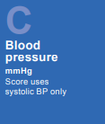
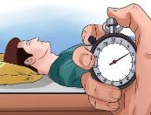
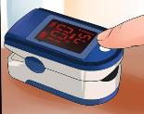
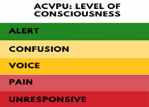
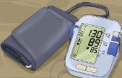
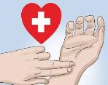
Taking physical Observations
Staff need to have had the appropriate training in taking physical observations
Homes need to invest in quality equipment for observations and ensure that this is serviced and calibrated regularly
Staff must take and document complete observations
Recording should be made in black pen, be clear, dated, timed and signed
The NEWS2 tool measures 6 vital signs or observations to determine level of illness via a overall score
Notes:
So that you are aware of what physical observations cover.
NEWS2 is a standardised assessment tool, which gives an indication of how unwell the patient is.
Together the measurements gives a score of between 0 and 20
This is a common language across healthcare
Depending on the NEWS scores, staff using RESTORE2TM can escalate the patient’s care appropriately in line with an escalation plan.
NEWS allows the carer to escalate their concern to a GP or another professional.
Omit slides 16-22 if there is evidence of knowledge and or experience of taking observations. Jump to calculating NEWS score.

Slide 27
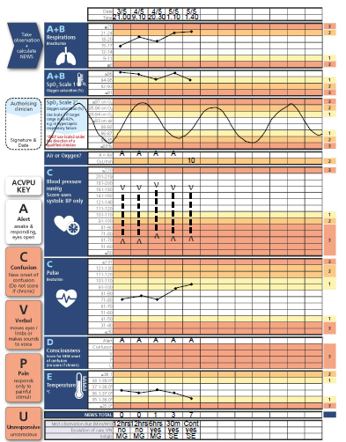
NEWS2 chart
A straight forward way of documenting a patient’s observations.
It allows you to quickly identify abnormalities and the severity- leading to quicker and more efficient treatment.
Plotting each set of observations also identifies trend and allows you to see if a patients health is deteriorating.
What’s wrong with this chart? How would you handover the latest set of obs?
Notes:
Because RESTORE2 uses NEWS which is a standardised across healthcare settings, there is a common language that can support healthcare professionals to assess residents and communicate.
NEWS2 makes you go back and review your resident and start a conversation with another professional.

Slide 28
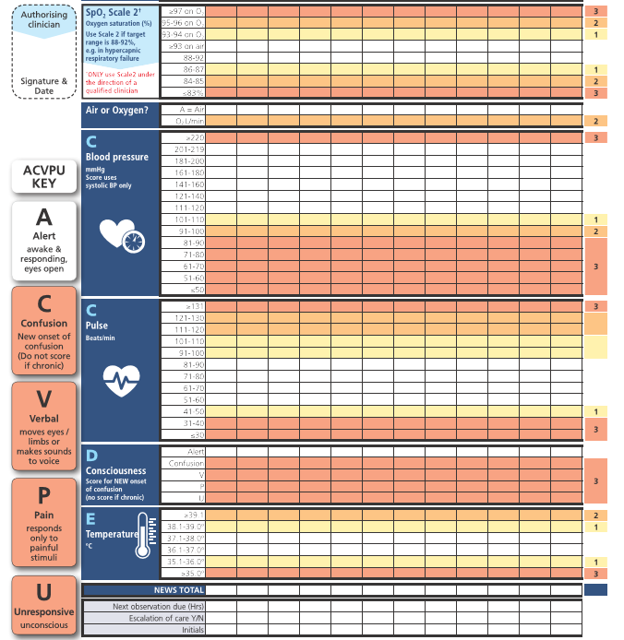
NEW
NEW

Slide 29
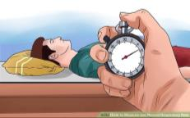
Respiratory rate
Is the number of breaths a person takes in a minute. Normal adult parameters: 12-20 breaths per minute. Always take RR over 60 seconds
Should be taken when a patient is at rest, and done by counting the number of times a person’s chest rises.
Thought to be the most sensitive indicator of a patient’s physiological well-being
Reflects not only respiratory function (hypoxia or hypercapnia), but cardiovascular status as is pulmonary oedema and metabolic imbalance i.e. DKA
Elevated RR is a powerful sign of acute illness and distress, in all patients
Generalised pain and distress
Sepsis remote from the lungs
CNS disturbance and metabolic disturbances such as metabolic acidosis
Reduced RR is an important indicator of CNS depression and narcosis
Notes:
Can omit these slides if there is evidence of knowledge and or experience of taking observation. Otherwise redirect to the HEE NEWS and taking observation videos

Slide 30
SpO₂ Scoring scales- Oxygen levels
Taken by placing a device called an Oximeter over a person’s finger.
The Oximeter reading gives indication of the percentage of oxygen in the person’s blood.
Cold hands, anaemia, poor circulation or a dirty probe can prevent an accurate reading.
NEWS2 has 2 scoring scales for SpO₂ : Use scale 1 unless scale 2 is authorised for specific residents by a competent qualified clinician/clinical decision maker, and the decision recorded in the resident’s clinical notes.
Residents requiring SpO₂ scale 2 will have a prescribed oxygen saturation requirement of 88–92% (e.g. in patients who normally retain Carbon Dioxide and need to do this to drive their respiratory effort (hypercapnic respiratory failure) confirmed on blood gas analysis on either a prior, or current hospital admission. This prescription should be documented in the residents notes.
To avoid doubt, clearly cross out the SpO2 scoring scale not being used
Normal Adult Parameters: 96-100% (excluding patients with underlying respiratory conditions)
Notes:
Can omit these slides if there is evidence of knowledge and or experience of taking observation. Otherwise redirect to the HEE NEWS and taking observation videos

Slide 31
Sp0₂ Scoring scales
2019
Notes:
Ref: Royal College of physicians National early warning score news 2 December 2017
Hypercapnia respiratory failure
hypercapnia (a high concentration of carbon dioxide in the blood) – main cause copd but are other causes

Slide 32
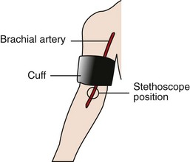
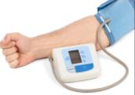
Blood pressure
Can be measured using two common methods:
Manually using a sphygmomanometer and stethoscope
Ensure the correct size cuff
Position the cuff around the upper arm ensuring the lower edge sits 1inch above the antecubital fossa (elbow crease)
Place the Stethoscope on the brachial artery (shown on diagram) and inflate to 180mmgHG
Slowly release the valve and listen to first sound (this is the Systolic, Second sound is the Diastolic )
Using an automatic inflation machine
Notes:
Can omit these slides if there is evidence of knowledge and or experience of taking observation. Otherwise redirect to the HEE NEWS and taking observation videos
Systolic blood pressure reading is used in calculating a NEWS score.

Slide 33
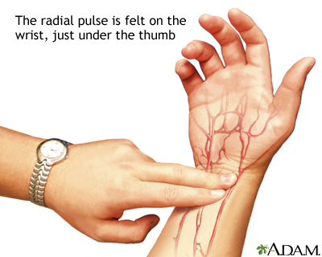
Heart rate
Measured in Beats Per Minute (BPM)
To measure a person’s Heart Rate you must first locate the Radial Pulse, located on the wrist under the thumb.
Once you have located the pulse count the beats for one whole minute
Normal Heart Rate/Pulse: 60-100 BPM
Notes:
Can omit these slides if there is evidence of knowledge and or experience of taking observation. Otherwise redirect to the HEE NEWS and taking observation videos

Slide 34
Level of Consciousness
Measured via ACVPU (alert, new confusion, voice, pain, unresponsive)
Alert – patient is active, responsive, interacting with people and surroundings, answers questions etc.
New onset or worsening confusion is now included which excludes residents with confusion as part of their normal disease process
Voice – responds to voice but not spontaneously interacting, may be drowsy, keeps eyes closed, may not speak coherently
Pain – not alert and does not respond to verbal stimuli, responds to painful stimulus
Unresponsive – unresponsive, unconscious
2019
Notes:
Can omit these slides if there is evidence of knowledge and or experience of taking observation. Otherwise redirect to the HEE NEWS and taking observation videos
Residents with acute illness may develop an acutely altered mental state, manifesting as new confusion, delirium or a Glasgow Coma Scale (GCS) <15
New confusion is an important sign of acute clinical deterioration requiring urgent clinical assessment
Acutely altered mental state may occur because of sepsis, hypoxia, hypotension or metabolic disturbances, either alone or in combination
If it is unclear whether the confusion is new or a normal state, it should be assumed to be new until confirmed to be otherwise
What challenge this may pose in residents with dementia?

Slide 35
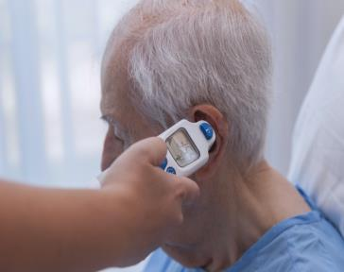
Temperature
Typically using a thermometer (e.g.“tympanic”) can help determine a person’s temperature.
Extremes of temperature are sensitive markers of acute illness severity and physiological disturbance.
Pyrexia > 38º C may indicate infection
Hypothermia can also indicate illness which is why it scores on NEWS2
Average adult body temperature: 36.1°C-37.2°C
(or 97°F-99°F)
Notes:
Can omit these slides if there is evidence of knowledge and or experience of taking observation. Otherwise redirect to the HEE NEWS and taking observation videos
Normal body temperature is different for everyone and changes during the day.
A high temperature is usually considered to be 38C or above. This is sometimes called a fever.
Many things can cause a high temperature, but it's usually caused by the body fighting an infection.
Note: If you feel hot or shivery, you may have a high temperature even if a thermometer says your temperature is below 38C.

Slide 36
Calculating a NEWS2 score
Notes:
Best way to see how it works is to practice
NEWS score:
1. Can indicate how unwell the resident may be- the higher the NEWS score, the sicker the patient
2. Is a common language of deterioration across healthcare settings
3. Performs a track-and-trigger function especially when used earlier in pre-hospital settings before arrival in hospital

Slide 37
Take observation and calculate NEWS2 scores You take Charlie’s observations twice one hour apart and record the following readings:
1st set of observations
Reps: 20
Sats: 95% (scale 1)
On air
Bp: 128/80
P: 95
Alert
T: 37.5°C
NEWS2 score=
2nd set of observations
Reps: 22
Sats: 94%
On air
Bp: 133/76
P: 91
Alert
T: 38°C
NEWS2 score=
What the NEWS score for both sets of observations? What would you do next?
Notes:
1st set NEWS2 score =2
2nd set NEWS2 score = 4
Charlie’s condition is deteriorating (0-2-4)
HEE videos- What is NEWS: https://youtu.be/S-KWnrsOw8M (3 mins 34 sec)
Measuring Oxygen Saturation: https://youtu.be/QabKghrtXps (2mins 41sec)

Slide 38
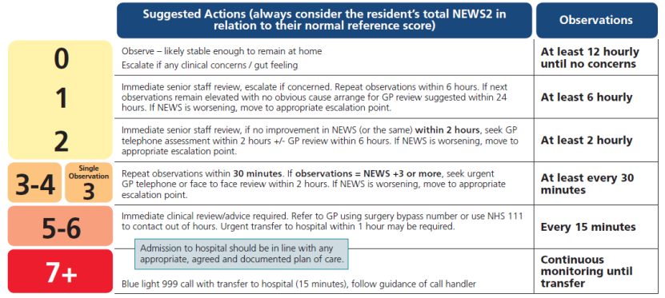
Escalation – get the right help
Removes the element of personal interpretation
2019
Notes:
Carers are usually the first to recognise soft signs but found it difficult to communicate this concern.
NEWS2 allows the carer to escalate their concern to a GP or another professional.
Escalation does not replace clinical judgement.
It has been noted that in care homes, sometimes observations are not recorded regularly.
NEWS2 makes you go back and review your resident and start a conversation with another professional.

Slide 39
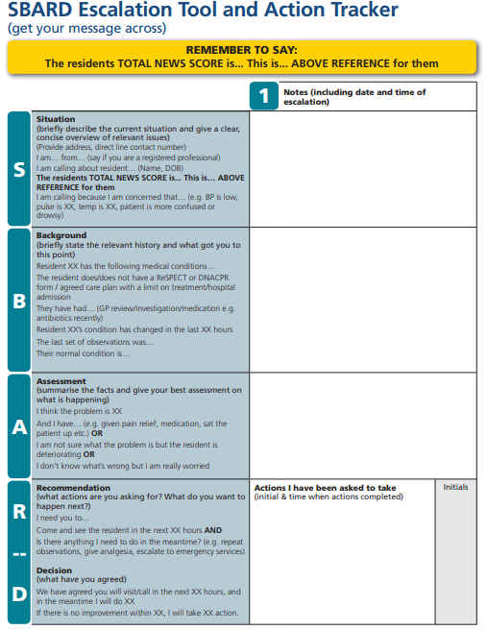
Get your message across
SBARD is a structured method for communicating critical information that requires immediate attention and action effectively with medical professionals.
Five steps:
S Situation
B Background
A Assessment
R Recommendation
D Decision
Notes:
Participants may be familiar with using SBAR or are confident talking to another professional without the need of SBARD.
SBARD is used in hospitals to ensure that there is a standard approach in giving info ensuring no information may be misinterpreted by another professional.

Slide 40
S: Briefly describe the current situation and give a clear concise overview of relevant issues
B: Briefly state the relevant history and what got you to this point
A: Summarise the facts and give your best assessment on what is happening
R: What actions are you asking for? What do you want to happen next?
D: What have you agreed?

