Slide 1
RESTORE2 mini training
Soft signs of deterioration

Slide 2
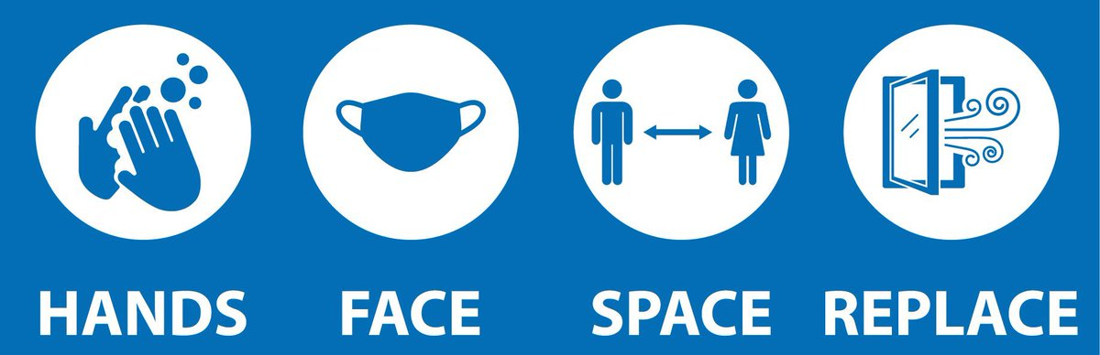
Introduction and Housekeeping
Guidelines for participating – please follow local guidance, e.g.:
Maintain 2m+ spacing
Wear facemasks
Well ventilated areas (windows open etc.)
Consider use of more devices
Consider use of projectors to for easier viewing

Slide 3
Training objectives
To ensure that care staff can:
spot any illness or cause of deterioration quickly
respond to and escalate concern effectively so as to “get their message across” every time in order to “get the right help”

Slide 4
Session outline
Introduction to Soft Signs
Structured communication using SBARD
ReSPECT
Q&A
Close
RESTORE2mini

Slide 5
What is
https://www.youtube.com/watch?v=Gxrr9QOergg 3mins 12sec
Notes:
RESTORE2TM –What is it? https://www.youtube.com/watch?v=Gxrr9QOergg (3mins 12 secs)

Slide 6
RESTORE2 is a physical deterioration and escalation tool designed care/nursing homes, increasingly used in other areas.
It is designed to help carers:
Recognise when a resident may be deteriorating or at risk of physical deterioration
Act appropriately according to the residents care plan
Obtain a complete set of physical observations to inform escalation and conversations with health professionals
Speak with the most appropriate health professional in a timely way
Provide a concise escalation history to health professionals to support their professional decision making
Get staff and residents the right support in the right timescale
2019
Notes:
RESTORE2TM –What is it? https://www.youtube.com/watch?v=Gxrr9QOergg (3mins 12 secs)

Slide 7
The mini version of the tool is designed for those not yet using the National Early Warning Score (NEWS2), so that they can still benefit from other aspects of the tool. It is used:
In care homes not yet using NEWS2
To support family carers
To support non-care staff, such as admin staff and reception staff
2019
Notes:
RESTORE2TM –What is it? https://www.youtube.com/watch?v=Gxrr9QOergg (3mins 12 secs)

Slide 8
Notes:
The RESTORE2 mini form.

Slide 9
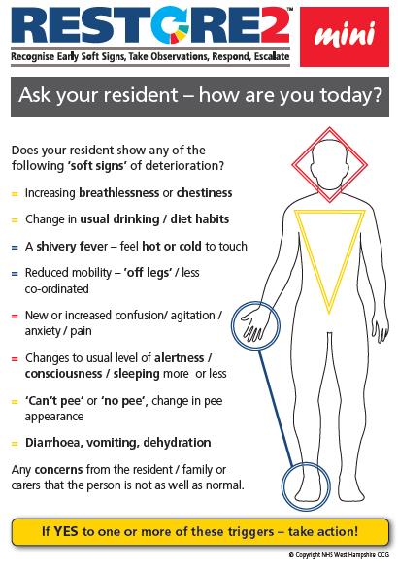
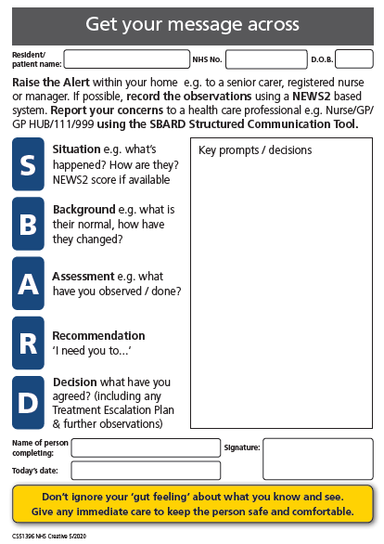
Notes:
Updated RESTORE2 mini tool

Slide 10
Early “Soft Signs” of deterioration
Soft signs of deterioration

Slide 11
Raise your hand if…
You have heard of the “soft signs” of deterioration

Slide 12
Activity 1: sharing experience
Think of a time when you (or someone you know) became unwell.
How did you first know you/they were unwell?
What did you see, hear, feel etc.?
Unmute and share your experience
Notes:
5 mins - Whole group activity. After invite anyone who hasn’t had the chance to share to post in the chat, so all involved

Slide 13
Activity 2: sharing experience
Think of a time when someone in your care became unwell.
How did you first know they were unwell?
Unmute and share your experience
Notes:
5 mins - Whole group activity. After invite anyone who hasn’t had the chance to share to post in the chat, so all involved.

Slide 14
Notes:
If resident show any of the soft signs, they are at risk of deterioration.
Recognition of Soft signs allows the early detection of acute illness or physical deterioration
Carers are usually the first to recognise soft signs but may find it difficult to communicate this concern
Soft signs are the early indicators that the resident may not be as well as they were previously.
Some soft signs are generic and apply to all residents, but you can also bespoke the RESTORE2 tool with the unique signs that indicate deterioration for a particular resident.
Soft signs provide an entry point into the National Early Warning Scores (NEWS).

Slide 15
https://www.youtube.com/watch?v=A6sg0mkcJIY&list=PLrVQaAxyJE3cJ1fB9K2poc9pXn7b9WcQg&index=2&t=0s
Notes:
Depending on the participant group use this video or Recognising deterioration in people with a learning disability video
Host/Tech help to play video

Slide 16
https://www.youtube.com/watch?v=vSWCPza8dCU
Notes:
Depending on the participant group use this video or Introduction to Sepsis and serious illness video.
Host/Tech help to play video

Slide 17
Medical emergencies
There may be some occasions when the early signs of deterioration may be a medical emergency. In these cases it is not appropriate to delay contacting the emergency services in order to record a NEWS2. It may be appropriate to monitor your resident’s vital signs once you have contacted the emergency services. Such situations include:
New onset of chest pain or suspected heart attack
Where the individual is displaying signs consistent with having a stroke
Prolonged seizure where the individual does not have a care plan in place to manage it
Where the resident has sustained a significant injury – e.g. a fracture head injury
Where the person is unable to breath
Remember to follow a person’s End of Life or Agreed Limit of Treatment of they have one

Slide 18
Can you identify the early softs signs the residents below may show if they were becoming unwell?
Molly is a fun and outgoing 83 year old. She mobilises with a Zimmer frame and loves to socialise with other residents and staff in the lounge. When she’s not talking she is an avid reader of romantic novels, you can often find her with her head in a book in the conservatory. Molly often jokes that she is too busy to sleep; she goes to bed late and tends to get up early, often having a cup of tea with the night staff before they go off duty.
David is 70. He lives in your home, primarily because of his poorly controlled diabetes. He has both legs amputated and sometimes uses a wheelchair to mobilise. Often David stays in his room, his blood sugars are high he gets headaches. He becomes increasingly tired and feels very thirsty and when his blood sugars are high he gets very grumpy.
Notes:
Group exercise to round up soft signs section

Slide 19
How to use a pulse oximeter (YouTube videos)
HEE video: https://youtu.be/QabKghrtXps (2:41sec)
English :https://www.youtube.com/watch?v=nx27Ck7xOgo
Hindi: https://www.youtube.com/watch?v=e1ipiJY-zwk
Punjabi: https://www.youtube.com/watch?v=wU5V6wVEHoM
Urdu: https://www.youtube.com/watch?v=rkGRRLlumW4
Polish: https://www.youtube.com/watch?v=Lkd-BNeMvLs

Slide 20
Communicating and escalating concerns (SBARD)
Getting your message across

Slide 21
How confident do you feel?
How confident do you feel communicating your concerns about a resident both within your care home and to external healthcare professionals?

Slide 22
https://www.youtube.com/watch?v=Ki0BX61xhdw&list=PLrVQaAxyJE3cJ1fB9K2poc9pXn7b9WcQg&index=12

Slide 23
SBARD: A structured method for communicating critical information that requires immediate attention and action effectively with medical professionals.
Situation
Background
Assessment
Recommendation
Decision

Slide 24
https://westhampshireccg.nhs.uk/restore2/
Notes:
Two new versions of RESTORE2 mini have been published.
They were created for homes who want to use the mini as a legal record or as an extension sheet to the full RESTORE2TM document.
The A5 version prints on one sheet of A4 and contains a short SBARD with the resident’s name, NHS number and date of birth, plus the completing person’s name, signature and date of completion.
The A4 version prints double sided and contains a full SBARD (the same as in the full RESTORE2TM version) with the resident’s name, NHS number and date of birth, plus the completing person’s name, signature and date of completion.

Slide 25
Scenario to practice communicating concerns
One morning you notice that 76yr old resident Charlie is reluctant to eat his breakfast and feels he needs to go back to bed for a rest. When you check on Charlie an hour later you feel his hands are colder than normal and he is beginning to shiver.
Charlie has been with the home for 3 months and is generally fit and well. He is on medication for hypertension but no other medication and has not required medication review since joining the home. Charlie has informed you he does not feel very well.
Using the SBARD framework, how would you communicate your concerns about Charlie to other healthcare professionals?
Situation
Background
Assessment
Recommendation
Decision
Notes:
Can be done as a group exercise. Ask participants to identify (shout out or write in chat) information that should be given under each letter of SBARD

Slide 26
Summary of what we have covered so far
Introduction to Soft Signs
Structured communication using SBARD
ReSPECT
Q&A
Close
RESTORE2 mini
Notes:
Summarise what has been covered to end the RESTORE2 mini section of the training.

Slide 27
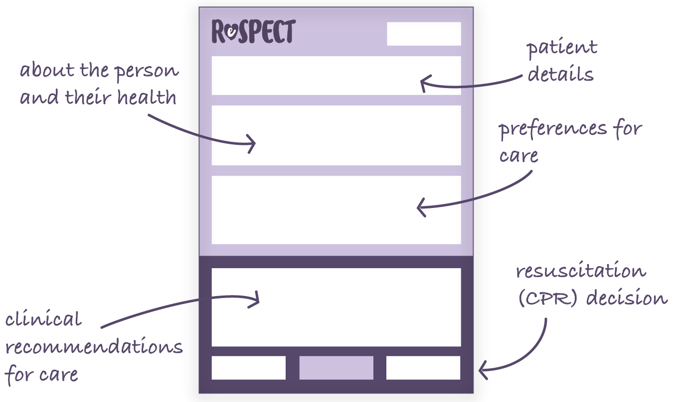
Recommended
Summary
Plan for
Emergency
Care and
Treatment
Notes:
Treatment Escalation Plans (such as ReSPECT, Advance Care Plan, Do Not Attempt Cardiopulmonary Resuscitation (DNACPR) etc.) are processes to support people to have a say in what they would like when they become unwell, or when they cannot express their wishes.
ReSPECT is a personalised recommendation for someone’s clinical care in emergency situations where they are not able to make decisions or express their wishes.
RESTORE2 is closely linked to anticipatory care planning and deterioration in the community.
It’s important that residents have a clear end of life plan and this is not just about DNACPR.

Slide 28
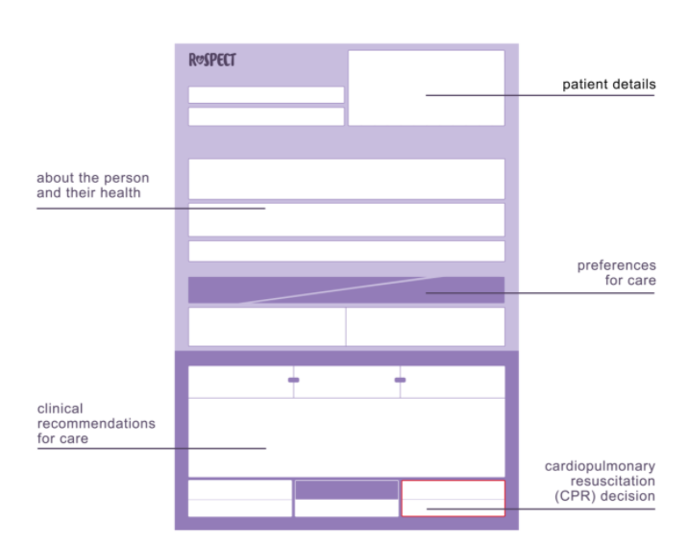
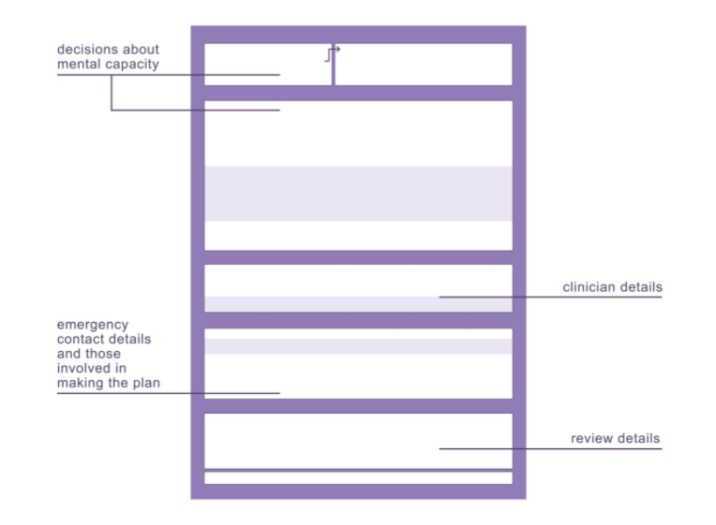
How to recognise the form
Notes:
ReSPECT is a process with the conversations recorded on the ReSPECT form.
GPs can support the process to ensure that the resident is treated at the right place, at the right time, in the best way.

Slide 29
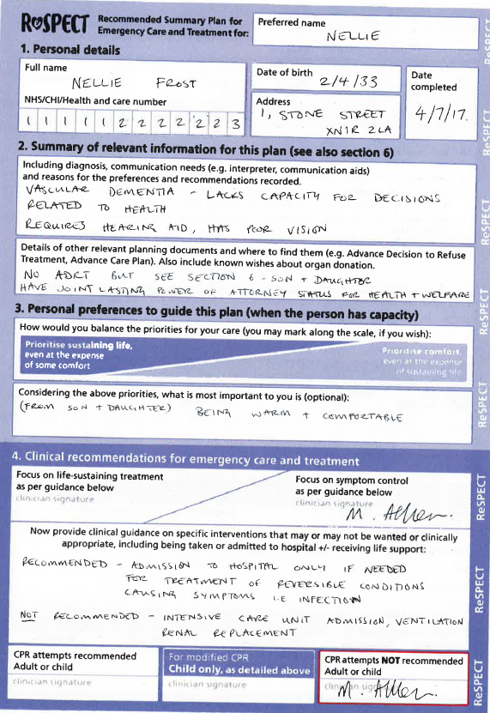
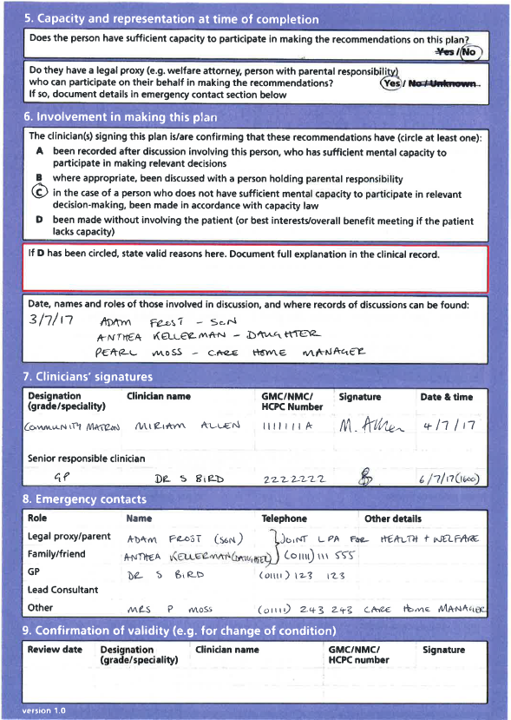
Example of completed ReSPECT form
Notes:
ReSPECT is a process that encourages and enables a series of conversations (preferably earlier) with people on their end of life health and treatment preferences.
ReSPECT can be for anybody, but is particularly relevant for the elderly, frail and people with deteriorating conditions.
These decisions made by the person and their doctor and health professionals are recorded on a ReSPECT form that can be used in emergency situations to assist when decisions need to be made on what is best for the person.

Slide 30
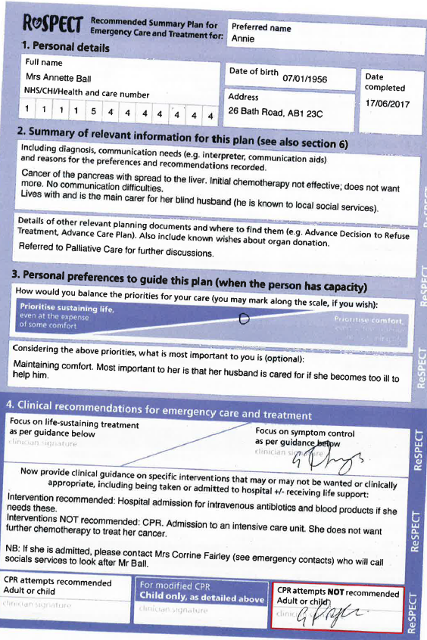
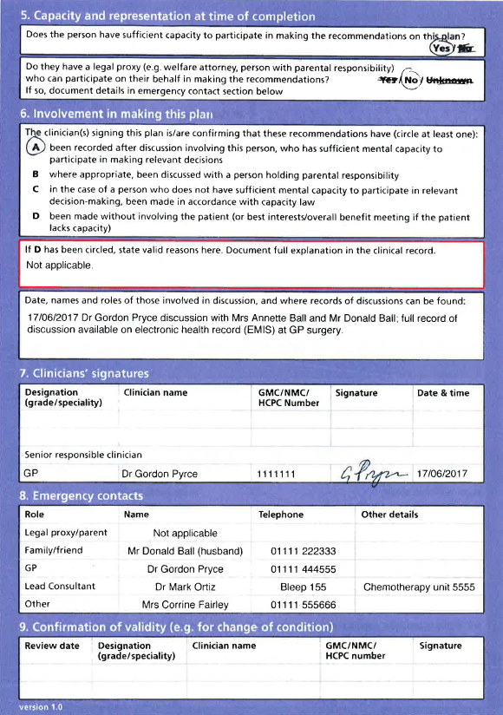
Example of completed ReSPECT form
Notes:
ReSPECT is a process that encourages and enables a series of conversations (preferably earlier) with people on their end of life health and treatment preferences.
ReSPECT can be for anybody, but is particularly relevant for the elderly, frail and people with deteriorating conditions.
These decisions made by the person and their doctor and health professionals are recorded on a ReSPECT form that can be used in emergency situations to assist when decisions need to be made on what is best for the person.

Slide 31
How to care for someone with a ReSPECT form
ReSPECT is not legally binding. It is a guide to immediate decision-making. You should be prepared to justify valid reasons for overriding the recommendations on a ReSPECT form.
If a person opens up to you about their future preferences and these are not documented, offer to help set up an appointment with their GP so that they can have a ReSPECT conversation.
If a situation arises that is not addressed on the form, or staff are unsure what to do, they should ask for help from their seniors, or members of the clinical team.
Notes:
Why is ReSPECT not legally binding? This is an FAQ. Imagine a situation where someone with only a couple of weeks to live has a ReSPECT form which says ‘do not take me to hospital under any circumstances’. Perhaps they’ve had the ReSPECT form for years but recently updated it due to a change in prognosis. They then find themselves in extreme agony, and ask their carer to call an ambulance to take them to hospital to get on top of the pain. The paramedic will of course need to override the ReSPECT form (which they can do because it’s not legally binding), as this is an unforeseen circumstance.

Slide 32
Action in a life threatening situation
CONFIRM the identity of the person (section 1) and that this is the latest version of the form.
READ the form to understand which recommendations may relate to your role in their care.
Read section 4 “Clinical care and Resuscitation Decision” including escalation plan to inform immediate actions.
Read section 3 for ”Patient’s preferences for care.”
Read section 7 ”Involvement in Plan” to ensure the recommendations have been endorsed by a responsible clinician.
ACT. If the recommendations apply to the current emergency and the person cannot decide for themselves then act on the recommendations relevant to your role when caring for that person.

Slide 33
Other key points to note about a ReSPECT:
ReSPECT is not legally binding. It is a guide to immediate decision-making. You should be prepared to justify valid reasons for overriding the recommendations on a ReSPECT form.
If a situation arises that is not addressed on the form, or staff are unsure what to do, they should ask for help from their seniors, or members of the clinical team.
Notes:
Why is ReSPECT not legally binding? This is an FAQ. Imagine a situation where someone with only a couple of weeks to live has a ReSPECT form which says ‘do not take me to hospital under any circumstances’. Perhaps they’ve had the ReSPECT form for years but recently updated it due to a change in prognosis. They then find themselves in extreme agony, and ask their carer to call an ambulance to take them to hospital to get on top of the pain. The paramedic will of course need to override the ReSPECT form (which they can do because it’s not legally binding), as this is an unforeseen circumstance.

Slide 34
Thank you… now it’s over to you!
How will you use this training to contribute to
your delivery of care going forwards?
Let us know in the chat!
We will stay on the call for 30 minutes after the session if you would like to talk though any questions further.
Please complete our post-training survey with feedback on the session and let us know how you get on with using the training in practice.

Slide 35
Additional resources

Slide 36
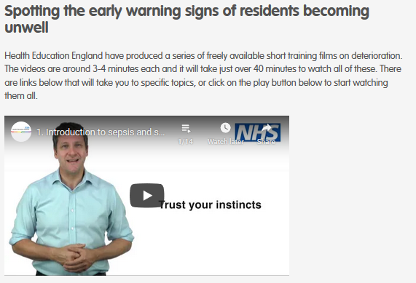
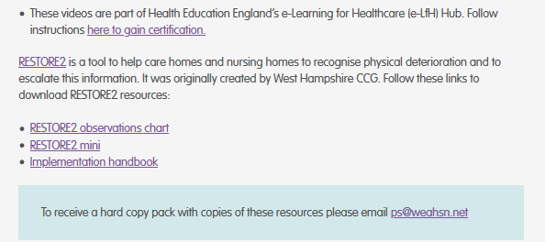
https://www.weahsn.net/
https://wessexahsn.org.uk/

Slide 37
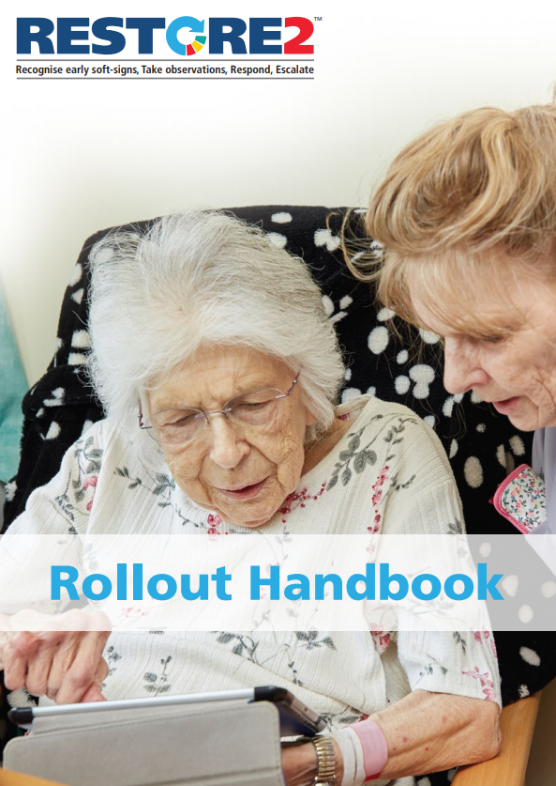
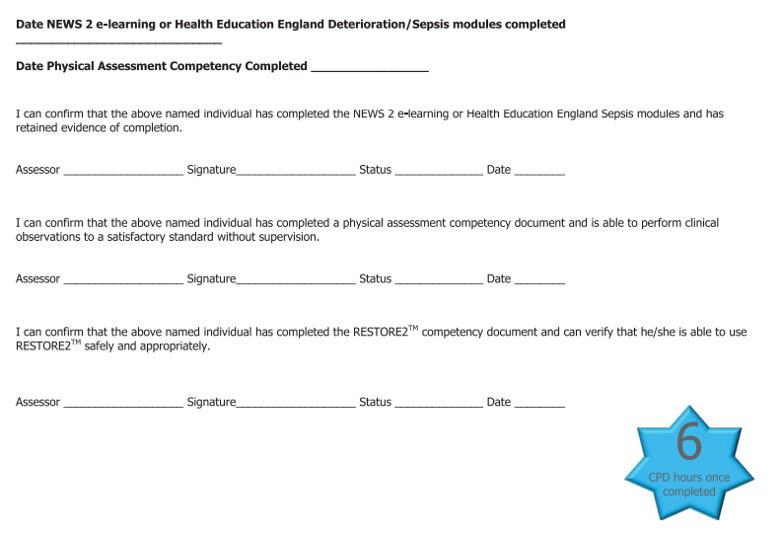
Rollout handbook
These slides can be used in conjunction with the RESTORE2 Rollout Handbook (April 2020) which gives more detail and training scenarios and optional competency assessments.

Slide 38
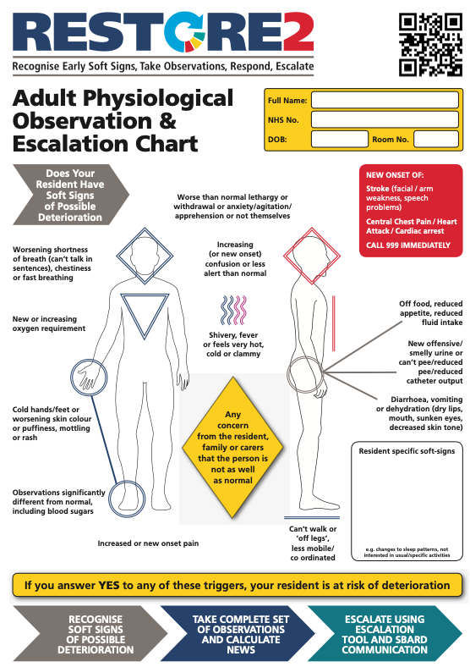
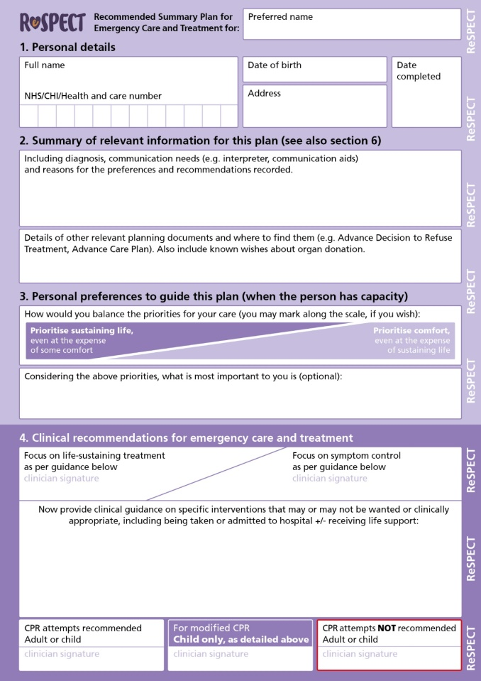
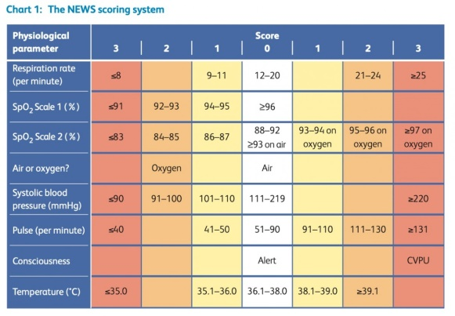
Additional training available
Further sessions on RESTORE2 (including taking physical observations and calculating NEWS2) and using ReSPECT are available.
Visit https://www.weahsn.net/covid-19-support

Slide 39
Free short training videos available on:
https://www.youtube.com/playlist?list=PLrVQaAxyJE3cJ1fB9K2poc9pXn7b9WcQg

Slide 40
You can also access the films as part of the full training on Health Education England’s e-Learning for Healthcare (e-LfH) Hub (www.e-lfh.org.uk), an educational web-based platform that provides quality assured online training content for the UK’s health and care workforce, from this link.

Slide 41
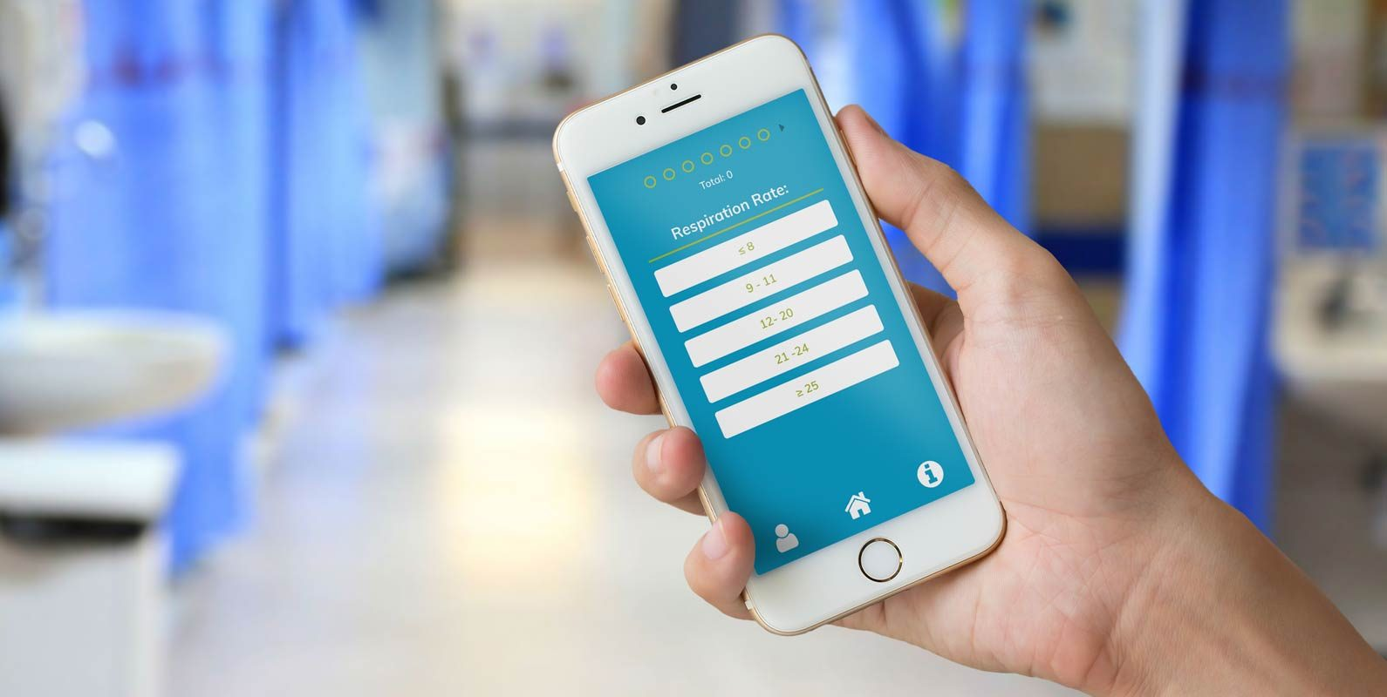
Free NEWS2 e-learning
This accredited e-learning is usually £5 per registered user but we have funded a number of licenses as our gift to you: https://woe.newslms.ocbmedia.com/
Sign up by clicking on the ‘Sign up now’ button on the page linked above.
You can also download the official NEWS2 Calculation App for free:
iOS – visit the Apple App Store and search for ‘NEWS2′. The app is called NEWS calculator produced by OCB Media.
Android – visit the Google Play store and search for ‘NEWS2’ or use the following link here
Notes:
Advise to do full RESTORE2 training first / alongside

Slide 42
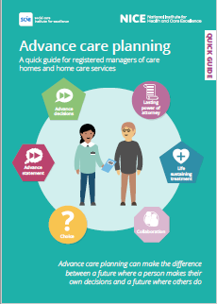
Advance Care planning- Quick guide
https://www.nice.org.uk/Media/Default/About/ NICE-Communities/Social-care/quick-guides/ advance-care -planning-quick-guide.pdf

Slide 43
A programme which aims to standardise training and knowledge of frailty as a complex multi-system, long-term condition
Strives to promote a common language in frailty care and is designed to support enhanced clinical skills and competencies to be embedded within the existing workforce
Will support health and social care staff to meet the needs of individuals living with varying degrees of frailty and to deliver improved health outcomes
Ensures that there is equity in the understanding and knowledge of frailty across workforce to enable delivery of consistent best practice outcomes and person experience
Align consistently with national and regional Ageing Well strategies for improvement
Explores the multi-system complexity of frailty via the Geriatric 5Ms (framework which comprises Mind, Mobility, Medications, Multi-complexity and Matters most) which encompasses all the elements important when considering holistic care of older adults, whatever setting you are in or profession you come from.
https://www.e-lfh.org.uk/wp-content/uploads/2021/03/MicrosoftTeams-image-1.png

Slide 44
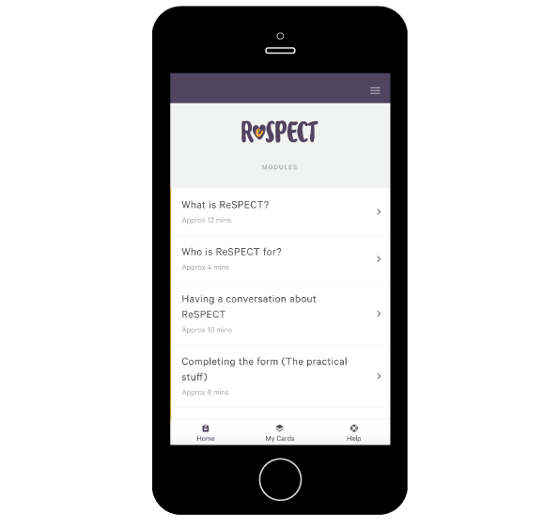
Short e-learning available at https://learning.respectprocess.org.uk
What is ReSPECT? (12 minutes)
Who is ReSPECT for? (4 minutes)
How to care for someone with a ReSPECT form (10 minutes)
Visit https://www.weahsn.net/our-work/improving-patient-safety/respect/implementing-respect/ for more information and resources
Contact respect@weahsn.net

Slide 45
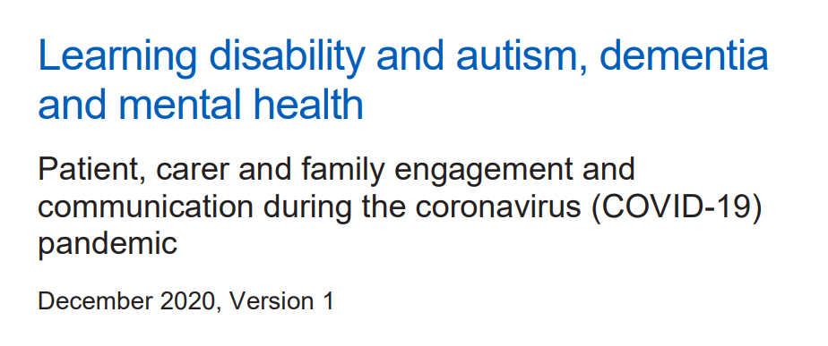
www.england.nhs.uk/coronavirus/wp-content/uploads/sites/52/2020/03/C0590-Patient-carer-and-family-engagement-and-communication-during-the-coronavirus-COVID-19-pandemic.pdf

