Slide 1
Calculating a NEWS Score

Slide 2
Calculating a NEWS2 score
Notes:
NEWS score:
1. Can indicate how unwell the resident may b e- the higher the NEWS score, the sicker they’re likely to be
2. Is a common language of deterioration across healthcare settings
3. Performs a track-and-trigger function especially when used earlier in pre-hospital settings before arrival in hospital

Slide 3
Take observation and calculate NEWS2 scores You take Charlie’s observations twice one hour apart and record the following readings:
1st set of observations
RR: 20
Sats: 95% (scale 1)
On air
Bp: 128/80
P: 95
Alert
T: 37.5°C
NEWS2 score=
2nd set of observations
RR: 22
Sats: 94%
On air
Bp: 133/76
P: 91
Alert
T: 38°C
NEWS2 score=
What the NEWS score for both sets of observations? What would you do next?
Notes:
Practice together.
1st set NEWS2 score = 2
2nd set NEWS2 score = 4
Charlie’s condition is deteriorating (0-2-4)
HEE videos- What is NEWS: https://youtu.be/S-KWnrsOw8M (3 mins 34 sec)
Measuring Oxygen Saturation: https://youtu.be/QabKghrtXps (2mins 41sec)

Slide 4
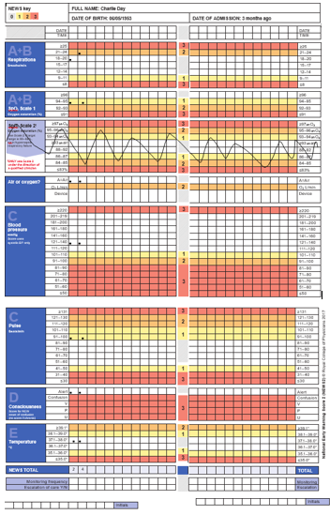
Notes:
Note – best to write in the value as just a ‘dot’ or ‘x’ can make handover difficult, and mean subtle changes can be missed.

Slide 5
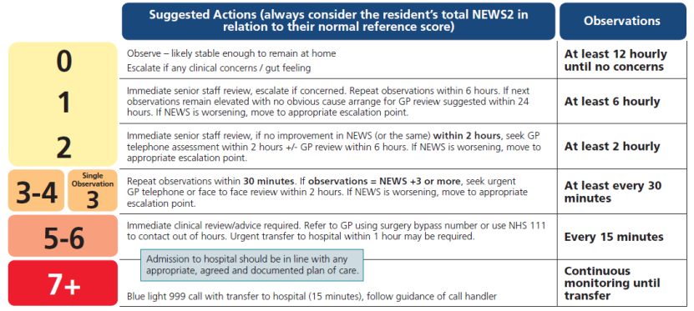
Escalation – get the right help
Removes the element of personal interpretation
2019
Notes:
Copied from the RESTORE2 tool.
Carers are usually the first to recognise soft signs but report finding it difficult to communicate this concern.
NEWS2 allows the carer to escalate their concern to a GP or another professional, in a common language, in a way that helps that person triage alongside other patients.
Whilst very prescriptive for care home staff, this NEWS2 Escalation does not replace clinical judgement of the receiving clinician (e.g. GP), who may opt not to follow this, based on clinical judgement / available information / other priorities. However, care home staff should always follow this unless advised otherwise by a clinical decision maker (e.g. GP, ACP) - either in a resident’s notes, TEP etc., or as part of their SBARD escalation discussion (at which point this should be documented in the ‘D’ for ‘Decision’).

Slide 6
Understanding your resident
Edward is normally fit and active but is often mildly confused in the mornings before breakfast. Normally NEWS score is 0 but in the morning Edward may trigger the AVPU scale – only call a GP if the confusion continues to lunchtime. Edward is for full treatment and admission to hospital if required. Edward becomes agitated when he is becoming unwell which is a good soft sign for him.
Dr. Davids 12/4/18 DDAVIDS
Notes:
It is important to know what is normal for the resident.
This can support the GP or other healthcare professionals with clinical decision making when their attention is requested.
If caring for someone with a high baseline NEWS2 (data shows us this is rare), their GP may wish to create a personalised NEWS2 Escalation plan. Details of this can be written in – or referred to in – this box.
….
Essential to always factor in end of life or agreed limits treatment documentation, such as TEPS, ReSPECT, ACPs, etc.
Many local hospitals and GPs are already using ReSPECT. We hope many more GPS will join others in using it soon.
DNACPR is included on the ReSPECT form. If you find someone with both, always go with the most recent and flag this to the person’s GP surgery for action.

Slide 7
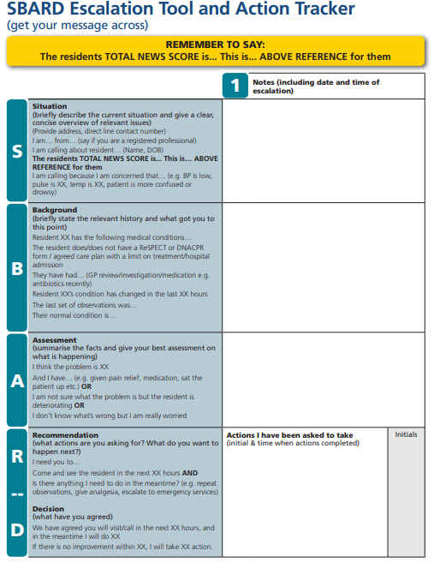
Get your message across
SBARD is a structured method for communicating critical information that requires immediate attention and action effectively with medical professionals.
Five steps:
S Situation
B Background
A Assessment
R Recommendation
D Decision
Notes:
Everyone does SBARD slightly differently – that’s okay. E.g. some put the NEWS2 in the S, as it’s the reason they are calling, others in the A, as it’s their assessment! Use it as a checklist to ensure essential information has been given.
SBARD is used in hospitals and the ambulance service to ensure that there is a standard approach in giving info ensuring no information may be misinterpreted by another professional.
Great in pressured situations where it’s easy to forget key information.
Different ways of going about it (e.g. some people might chose to put NEWS2 in the ‘S’, others in the ‘A’. Both right. Important thing is getting this essential information across in a structured way. SBARD acts as a ‘prompt’ for this and at each step ask yourself ‘have I communicated all relevant information here?’

Slide 8
S: Briefly describe the current situation and give a clear concise overview of relevant issues
B: Briefly state the relevant history and what got you to this point (inc. TEP/ReSPECT/etc.)
A: Summarise the facts and give your best assessment on what is happening
R: What actions are you asking for? What do you want to happen next?
D: What have you agreed?
Notes:
‘R’: How can this best land? Two-way recommendation. Big difference between ‘You should come within two hours’ vs. ‘The RESTORE2 tool advises a review within 2 hours, what do you think Dr. Sarah? Is there anything you recommend I do to help too?’

Slide 9
Scenario to practice using the RESTORE2 tool

Slide 10
Scenario: Charlie
Charlie is 67 yrs old gentleman admitted to care home as unable to cope. Charlie has full capacity but reduced mobility. Charlie has been with the home for 3 months and is generally fit and well. He is on medication for hypertension but no other medication and has not required medication review since joining the home.
One morning you notice that Charlie is reluctant to eat his breakfast and feels he needs to go back to bed for a rest. When you check on Charlie an hour later you feel his hands are colder than normal and he is beginning to shiver. Charlie has also informed you he does not feel very well.
Soft signs: What soft signs can you recognise in Charlie?
What would you do next?
Notes:
Recap

Slide 11
What is normal for Charlie
Monthly observations stable so far for the 3 months in the home
Charlie has an advanced care plan in place
Baseline observations
RR: 16 per minute
Oxygen Sats (scale 1): 96% on air
BP: 125/90
Pulse: 88
ACVPU: A
Temp: 37°C
Charlie’s baseline NEWS2 =0
Notes:
Baseline NEWS2 score = 0

Slide 12
Take observation and calculate NEWS2 scores You take Charlie’s observations twice one hour apart and record the following readings:
1st set of observations
RR: 20
Sats: 95% (scale 1)
On air
Bp: 128/80
P: 95
Alert
T: 37.5°C
NEWS2 score=
2nd set of observations
RR: 22
Sats: 94%
On air
Bp: 133/76
P: 95
Alert
T: 38°C
NEWS2 score=
What the NEWS score for both sets of observations? What would you do next?
Notes:
1st set NEWS2 score = 2
2nd set NEWS2 score = 4
Charlie’s condition is deteriorating (0-2-4)

Slide 13
Escalation
Refer to Escalation
Request immediate senior staff review (2 hrly obs)
No improvement in NEWS within 2 hrs and NEWS score worsening. seek urgent GP advice/telephone or face to face review within 2 hrs
Repeat observation at least every 30 mins
How would you give the information to the GP?

Slide 14
Escalate concerns to the GP using SBARD to structure your communication.
Situation
Background
Assessment
Recommendation
Decision
Notes:
Can be done as a group exercise. Ask participants to identify (shout out or write in chat) information that should be given under each letter of SBARD

Slide 15
SBARD
Situation
I am ringing because I am concerned about one of my residents. I became concerned as he is off his food, unusually lethargic, his hands are cold and he’s shivering.
We have been monitoring his observations over the day using the RESTORE2 tool and his NEWS2 Score has risen to 4.
Background
Charlie is 67yrs old and alert with full capacity.
Charlie has been with the home for 3 months and is generally fit and well. His reference/normal NEWS2 score is 0.
He is on medication for hypertension but no other medication.
He has not required medical review since joining the home.
His last set of observations are : RR 22, Sats 95%, Bp 115/70, P 95, Alert, T 38.0
Notes:
Good to get participants doing this themselves. Point out different approaches okay provided there is structure (e.g. breakdown of NEWS2 could just as easily go in assessment – both correct).

Slide 16
SBARD
Assessment
I am not sure what the problem is but he is deteriorating.
Recommendation
Please could you review Charlie?
The RESTORE2 tool recommends a review within 2 hours for a NEWS2 of 3-4. What do you think?
Is there anything I can do whilst I am waiting for you?
GP- Advice please give 1g of paracetamol and continue with observations.
Decision
GP – will visit after surgery; hopes within 2 hours but advised may be slightly longer.
Agreed to continue with observations as per RESTORE2 guidance and call back / escalate if Charlie’s condition changes before the GP arrives.
Document .Document .Document

Slide 17
Outcome
Charlie is reviewed by GP
Antibiotics prescribed (UTI )
To continue observations in line with the escalation tool until returned to Charlies “Normal”
Reflection
What did you do?
Notes:
What did you do?
Recognised soft signs
Used SBAR to communicate your concerns
Achieved a GP review in a timely manner

Slide 18
Reflection
What did you do ?
Recognised soft signs
Used SBAR to communicate your concerns
Achieved a GP review in a timely manner

Slide 19
Recent use of RESTORE2 in a home in Bristol
Gloria (name changed for confidentiality) had a slightly crackly chest, was very sleepy and the night before had been unsettled. Staff checked her temperature and oxygen saturations and when they contacted the GP, they gave her this information. They were able to receive intervention immediately. The GP prescribed antibiotics for Gloria, which meant she was able to be supported from home with staff who know her well, instead of going to hospital. A week on, Gloria has made a full recovery and is grateful to have been allowed to be at home, especially during these difficult times.
The Senior at the supported living placement informed me that following the NEWS2 training, they purchased the equipment recommended, which was how they were able to record Gloria’s oxygen levels.
The training has really had a huge impact on how staff support service users in identifying health decline and seeking relevant medical help.

Slide 20
Case Study RESTORE2 in a Nursing Home
Resident has a normal NEWS2 score of 0
Completing monthly observations means the staff recognise what is “normal” for the resident
NEWS
0
Use of the Reference box (what’s normal for the resident) makes staff aware of needs specific for the resident
Nursing Home
20

Slide 21
Case Study RESTORE2 in a Nursing Home
Staff noticed a change in the residents general condition “soft signs” which prompted observations and highlighted the need for review
low temperature
off food
NEWS
increased lethargy
4
not taking fluid and medications
Clear story to tell GP with physiology using SBARD
Nursing Home – Recognising change and escalating concerns
21

Slide 22
Case Study RESTORE2 in a Nursing Home
GP reviewed and regular monitoring maintained, with the addition of blood sugar readings due to residents medical history
ReSPECT form in place to help formulate plan of care
clear, objective evidence of condition and deterioration
NEWS
4
Family kept informed and included in discussions
Good visual representation of residents condition
Nursing Home – GP Review
22

Slide 23
Case Study RESTORE2 in a Nursing Home
The resident was reviewed, considered for end of life care and anticipatory medications put in place
Resident able to stay in home and be cared for by a familiar team
‘the home staff felt the RESTORE2 tool complimented their clinical judgement resulting in timely review and avoidance of hospital admission’
‘the incident has highlighted the importance of recognising soft signs and how a fully informed and followed process can populate an appropriate plan of care
Right place, right time, right care
Nursing Home – GP – No hospital admission needed

Slide 24
Awareness of ReSPECT
Recommended Summary Plan for Emergency Care and Treatment

Slide 25
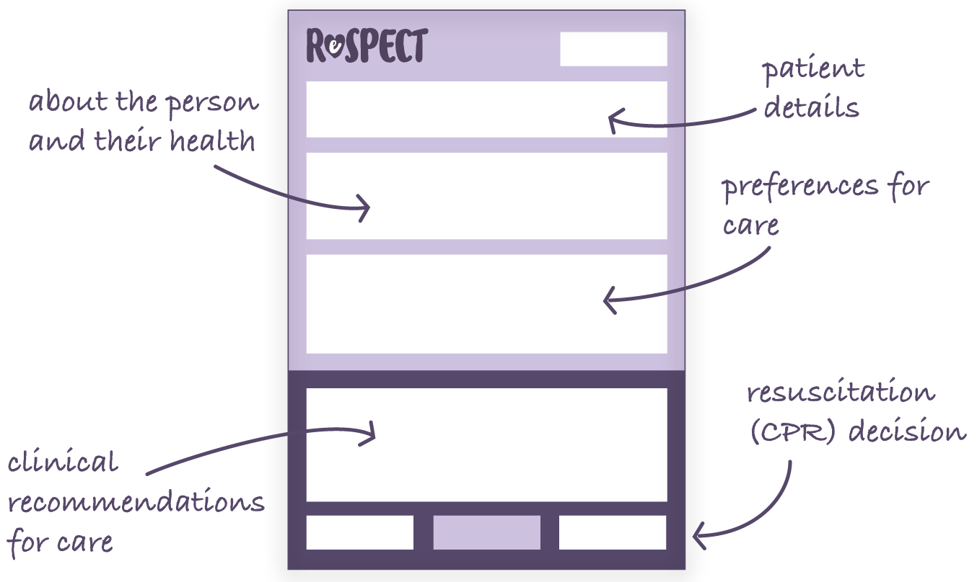
Recommended
Summary
Plan for
Emergency
Care and
Treatment
Notes:
RESTORE2 refers to End of Life and Agreed Limits of Treatment.
It’s important that residents have a clear plan, not just for the very end of their life but in the period beforehand.
ReSPECT is not just about DNACPR but about their wishes, how and where they would like to be treated if they have an episode of acute physical deterioration, where they may be too unwell to express their wishes.

Slide 26
What is a ReSPECT conversation?
ReSPECT conversations follow the ReSPECT process by:
Discussing and reaching a shared understanding of the person’s current state of health and how it may change in the foreseeable future,
Identifying the person’s preferences for and goals of care in the event of a future emergency,
using that to record an agreed focus of care (either more towards life-sustaining treatments or more towards prioritising comfort over efforts to sustain life),
Making and recording shared decisions about specific types of care and realistic treatment that they would want considered, or that they would not want, and explaining sensitively advance decisions about treatments that clearly would not work in their situation,
Making and recording a shared decision about whether or not CPR is recommended.

Slide 27
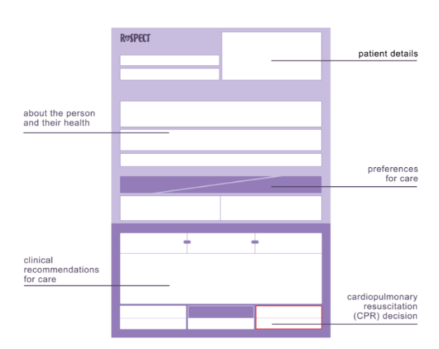
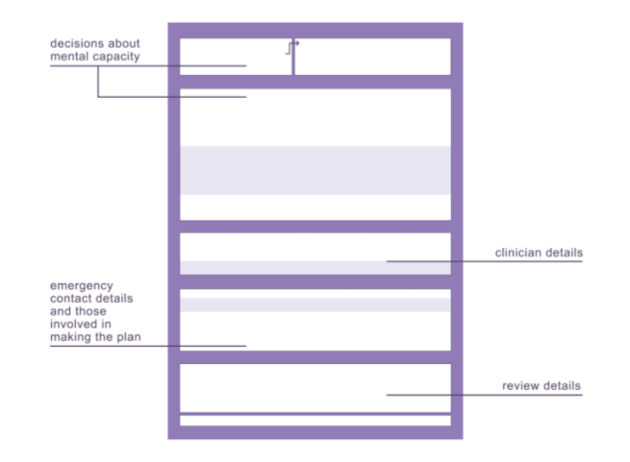
How to recognise the form
Notes:
ReSPECT is a process with the conversations recorded on the ReSPECT form.
GPs can support the process to ensure that the resident is treated at the right place, at the right time, in the best way.

Slide 28
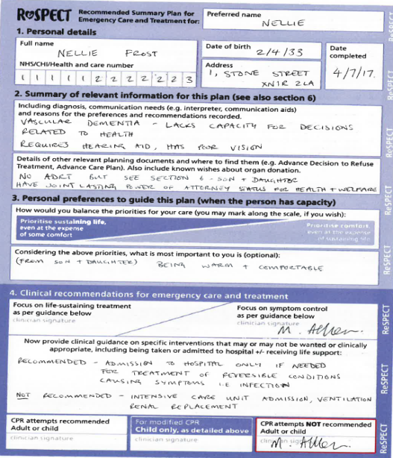
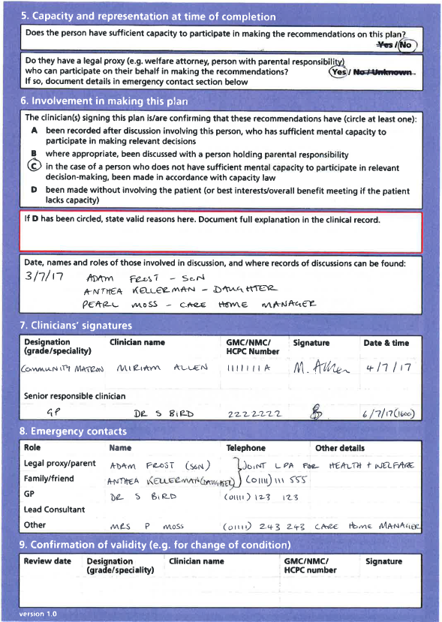
Example of completed ReSPECT form

Slide 29
How to care for someone with a ReSPECT form
ReSPECT is not legally binding. It is a guide to immediate decision-making. You should be prepared to justify valid reasons for overriding the recommendations on a ReSPECT form.
If a person opens up to you about their future preferences and these are not documented, offer to help set up an appointment with their GP so that they can have a ReSPECT conversation.
If a situation arises that is not addressed on the form, or staff are unsure what to do, they should ask for help from their seniors, or members of the clinical team.
Notes:
Why is ReSPECT not legally binding? This is an FAQ. Imagine a situation where someone with only a couple of weeks to live has a ReSPECT form which says ‘do not take me to hospital under any circumstances’. Perhaps they’ve had the ReSPECT form for years but recently updated it due to a change in prognosis. They then find themselves in extreme agony, and ask their carer to call an ambulance to take them to hospital to get on top of the pain. The paramedic will of course need to override the ReSPECT form (which they can do because it’s not legally binding), as this is an unforeseen circumstance.

Slide 30
Action in a life threatening situation
CONFIRM the identity of the person (section 1) and that this is the latest version of the form.
READ the form to understand which recommendations may relate to your role in their care.
Read section 4 “Clinical care and Resuscitation Decision” including escalation plan to inform immediate actions.
Read section 3 for ”Patient’s preferences for care.”
Read section 7 ”Involvement in Plan” to ensure the recommendations have been endorsed by a responsible clinician.
ACT If the recommendations apply to the current emergency and the person cannot decide for themselves then act on the recommendations relevant to your role when caring for that person.

Slide 31
Thank you… now it’s over to you!
How will you use this training to contribute to
your delivery of care going forwards?
Let us know in the chat!
We will stay on the call for 30 minutes after the session if you would like to talk though any questions further.
Please complete our post-training survey with feedback on the session and let us know how you get on with using the training in practice.

Slide 32
The end…….what we have covered so far
RESTORE2TM
Taking physical observations
Calculating NEWS2
ReSPECT
Q&A
Close
Notes:
Total (bar additional resources) =51 slides

Slide 33
Additional resources
Notes:
Reminder: offline at this point

Slide 34
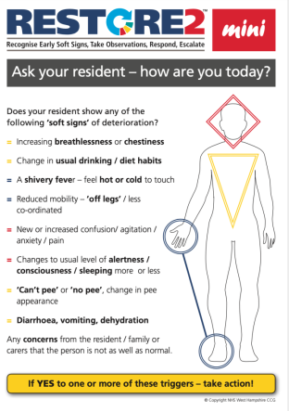
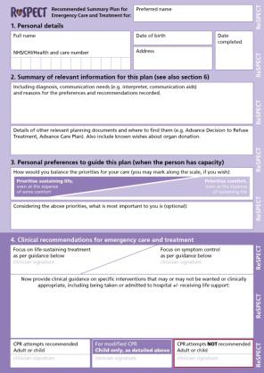
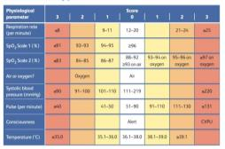
Additional training available
Further sessions on RESTORE2-mini and using ReSPECT are available.
Visit https://www.weahsn.net/covid-19-support

Slide 35
Additional training available
Free short videos
https://www.youtube.com/playlist?list=PLrVQaAxyJE3cJ1fB9K2poc9pXn7b9WcQg

Slide 36
You can also access the films as part of the full training on Health Education England’s e-Learning for Healthcare (e-LfH) Hub (www.e-lfh.org.uk), an educational web-based platform that provides quality assured online training content for the UK’s health and care workforce, from this link.
Notes:
2mins: Additional resources. Highlight information on NEWS2 accessible via videos on YouTube and HEE platform

Slide 37
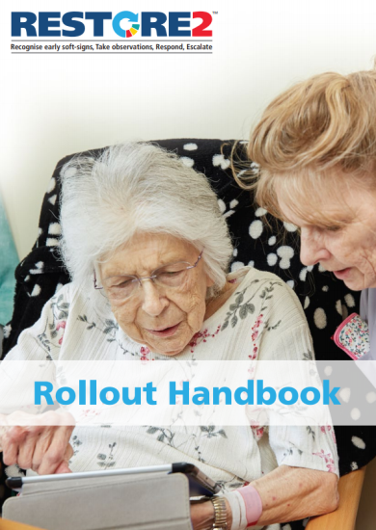
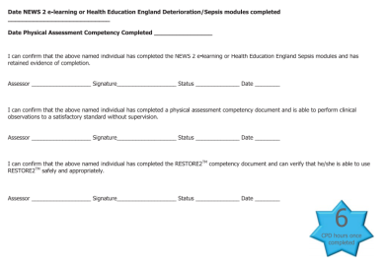
Rollout handbook
These slides can be used in conjunction with the RESTORE2 Rollout Handbook (April 2020) which gives more detail and training scenarios and optional competency assessments.
Notes:
30secs

Slide 38
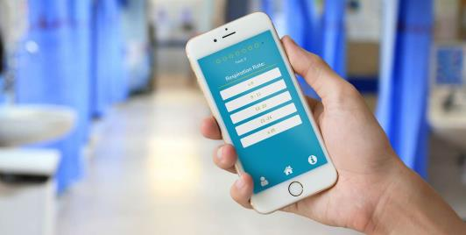
Free NEWS2 e-learning
This accredited e-learning is usually £5 per registered user but we have funded a number of licenses as our gift to you: https://woe.newslms.ocbmedia.com/
Sign up by clicking on the ‘Sign up now’ button on the page linked above.
You can also download the official NEWS2 Calculation App for free:
iOS – visit the Apple App Store and search for ‘NEWS2′. The app is called NEWS calculator produced by OCB Media.
Android – visit the Google Play store and search for ‘NEWS2’ or use the following link here

Slide 39
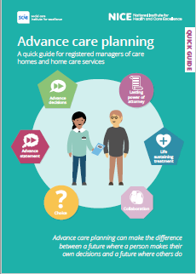
Advance Care planning- Quick guide
https://www.nice.org.uk/Media/Default/About/ NICE-Communities/Social-care/quick-guides/ advance-care -planning-quick-guide.pdf

Slide 40
A programme which aims to standardise training and knowledge of frailty as a complex multi-system, long-term condition
Strives to promote a common language in frailty care and is designed to support enhanced clinical skills and competencies to be embedded within the existing workforce
Will support health and social care staff to meet the needs of individuals living with varying degrees of frailty and to deliver improved health outcomes
Ensures that there is equity in the understanding and knowledge of frailty across workforce to enable delivery of consistent best practice outcomes and person experience
Align consistently with national and regional Ageing Well strategies for improvement
Explores the multi-system complexity of frailty via the Geriatric 5Ms (framework which comprises Mind, Mobility, Medications, Multi-complexity and Matters most) which encompasses all the elements important when considering holistic care of older adults, whatever setting you are in or profession you come from.
https://www.e-lfh.org.uk/wp-content/uploads/2021/03/MicrosoftTeams-image-1.png

Slide 41
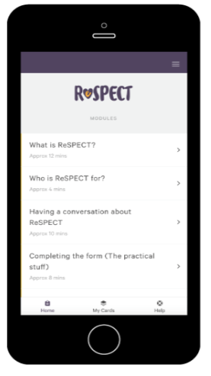
Short e-learning available at
https://learning.respectprocess.org.uk
What is ReSPECT? (12 minutes)
Who is ReSPECT for? (4 minutes)
How to care for someone with a ReSPECT form (10 minutes)
Visit https://www.weahsn.net/our-work/improving-patient-safety/respect/implementing-respect/ for more information and resources
Contact respect@weahsn.net

Slide 42
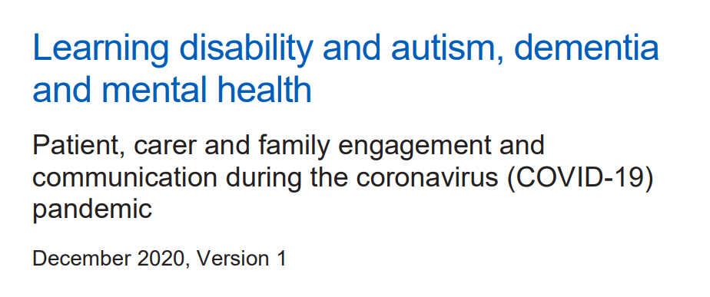
www.england.nhs.uk/coronavirus/wp-content/uploads/sites/52/2020/03/C0590-Patient-carer-and-family-engagement-and-communication-during-the-coronavirus-COVID-19-pandemic.pdf

Slide 43
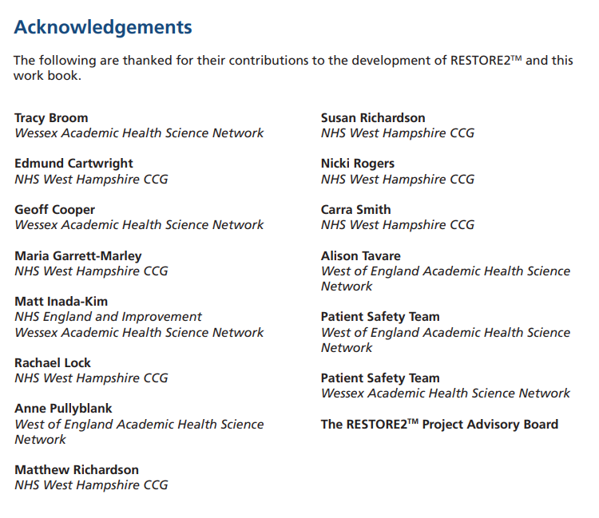
Acknowledgements
Images from HOSTING TROLL-FREE/PLAYFUL/INTERACTIVE VIRTUAL EVENTS WITH ZOOM by Alexandra Kutler Based on a work at https://docs.google.com/document/d/1KLRrnm6g5YvD8QRSPwwNWq6NPk9FYvMpZPy_XEyOmMM/edit#.

