Slide 1
RESTORE2 full training
Taking physical observations and calculating NEWS2

Slide 2
Introduction and Housekeeping
Guidelines for participating – please follow local guidance, e.g.:
Maintain 2m+ spacing
Wear facemasks
Well ventilated areas (windows open etc.)
Consider use of more devices
Consider use of projectors to for easier viewing

Slide 3
Aim and objectives
Aim
To provide participants with an overview of the RESTORE2 tool and the necessary skills and knowledge to apply it in practice, in order to ensure early and appropriate intervention.
Objectives
Discuss the key components of the RESTORE2 tool (i.e. soft signs, taking observations using NEWS2, end of life and agreed limit of treatment, escalating and communicating concerns using SBARD).
Provide an understanding of the advantages of applying the RESTORE2 tool to recognise and respond to physical deterioration.
Practice with scenarios to ensure that participants are comfortable with using the tool.
2019

Slide 4
Session outline
RESTORE2TM
Taking physical observations
Calculating NEWS2
ReSPECT
Q&A
Close

Slide 5
What is
https://www.youtube.com/watch?v=Gxrr9QOergg 3mins 12sec
Notes:
RESTORE2TM –What is it? https://www.youtube.com/watch?v=Gxrr9QOergg (3mins 12 secs)

Slide 6
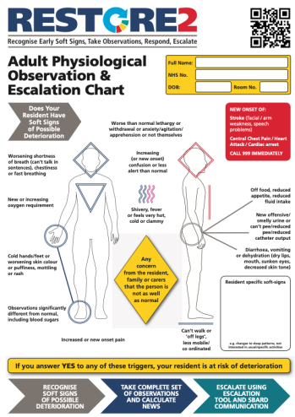
The RESTORE2 tool is designed to support homes and health professionals to:
Recognise when a resident may be deteriorating or at risk of physical deterioration
8
Act appropriately according to the resident’s care plan, taking into account end of life or agreed limits of treatment
Obtain a complete set of physical observations to inform escalation and conversations with health professionals
Speak with the most appropriate health professional in a timely way to get the right support
Provide a concise escalation history to health professionals to support their professional decision making.
https://wessexahsn.org.uk/img/projects/CS49286-RESTORE2-full-version%20(WHCCG).pdf
Notes:
To familiarise with the tool. Note the Reference NEWS2 (what is normal for this resident) box, End of life/advanced care plans/Treatment escalation plans that may already or should be in place for residents.

Slide 7
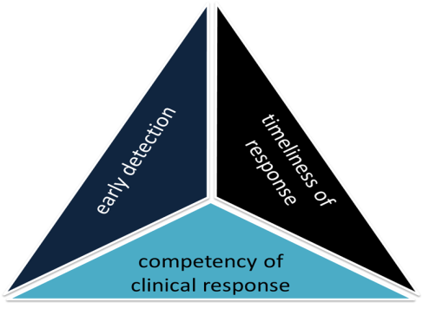
Getting the best outcome for residents
If any one of us was unwell, we would want the following things to be in place to give us the best chance of a good outcome:
Someone to recognise our deterioration early
Healthcare services to get to us as quickly as is required
A clinical response that meets our need
These 3 things are the ‘triad of clinical outcomes’
Support carers to recognise physical deterioration early
Provide a standardised assessment tool and a common language across healthcare
early detection
Enable staff to communicate concisely with clinical decision makers to get an effective response
Notes:
RESTORE2 is not an admission avoidance tool- It is a ‘right care, right time, right place tool’, a ‘right outcome tool’
Tools can be critical in preventing worsening deterioration and giving residents the best chance of being treated successfully
Now more than ever, this ideally means managing a person in the community in their own place of residence, but it could also mean having the shortest possible admission to hospital or supporting a dignified and person-centred death.

Slide 8
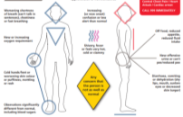
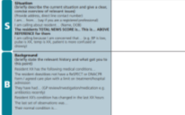
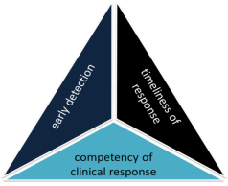
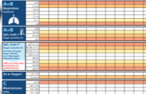
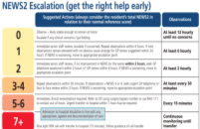
Components of RESTORE2TM
Recognise Soft Signs
Take observations
Calculate NEWS
Communicate using SBARD
Escalate using Escalation Tool
Recognise Soft Signs
RESTORE2 combines soft signs with NEWS2, a clear escalation pathway designed around care homes, taking into account any end of life or agreed limits of treatment, and an SBARD communication tool and action tracker.
Get your message across
Take Observations
Get the right help early
Calculate NEWS2
2019
Notes:
Recognition of soft signs allows the early detection of acute illness or physical deterioration and leads into taking physical observations using the National Early Warning Score (NEWS2).

Slide 9
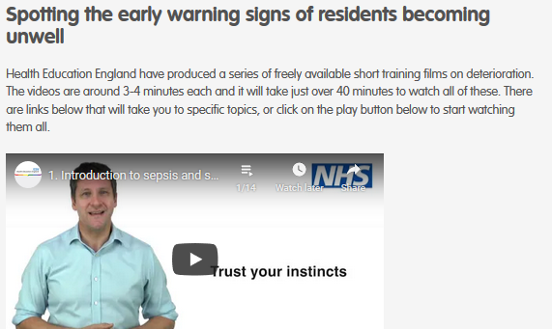
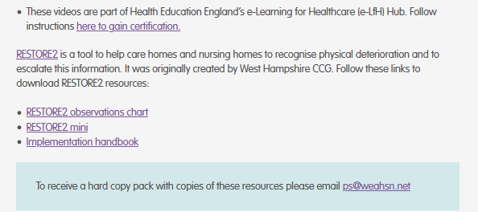
https://www.weahsn.net/
https://wessexahsn.org.uk/

Slide 10
Activity 1: sharing experience
Think of a time when you (or someone you know) became unwell.
How did you first know you/they were unwell?
What did you see, hear, feel etc.?
Unmute and share your experience
Notes:
5 mins - Whole group activity. After invite anyone who hasn’t had the chance to share to post in the chat, so all involved

Slide 11
Activity 2: sharing experience
Think of a time when someone in your care became unwell.
How did you first know they were unwell?
Unmute and share your experience
Notes:
5 mins - Whole group activity. After invite anyone who hasn’t had the chance to share to post in the chat, so all involved.

Slide 12
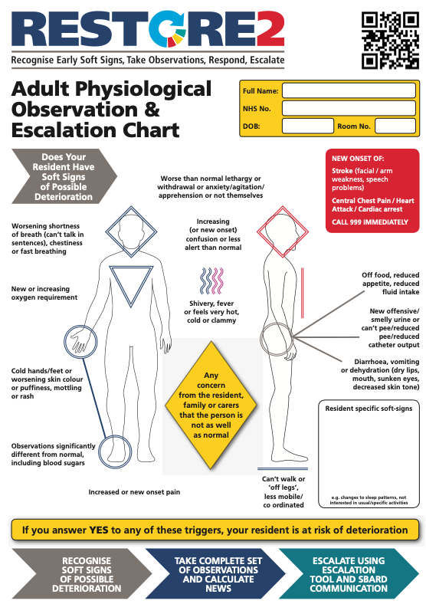
Identifying the soft signs of deterioration
Notes:
Does your resident have soft signs? If yes, they are at risk of deterioration.
Carers are usually the first to recognise soft signs but can find it difficult to communicate this concern / or feel heard.
Soft signs are the early indicators that the resident may not be as well as they were previously.
Some soft signs are generic and may apply to all residents, but you can also bespoke the RESTORE2 tool with the unique signs that indicate deterioration for a particular resident.
Soft signs provide an entry point into the National Early Warning Scores (NEWS2).

Slide 13
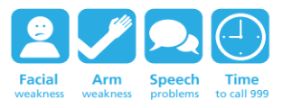
Medical emergencies
There may be some occasions when the early signs of deterioration may be a medical emergency. In these cases it is not appropriate to delay contacting the emergency services in order to record a NEWS2. It may be appropriate to monitor your resident’s vital signs once you have contacted the emergency services. Such situations include:
New onset of chest pain or suspected heart attack
Where the individual is displaying signs consistent with having a stroke
Prolonged seizure where the individual does not have a care plan in place to manage it
Where the resident has sustained a significant injury – e.g. a fracture head injury
Where the person is unable to breath
Remember to follow a person’s End of Life or Agreed Limit of Treatment of they have one

Slide 14
Why do your residents need
Notes:
Best if you can use an example from your own experience

Slide 15
Case Study Lost Opportunities
10am Resident Y developed ‘flu like symptoms - referred to the local GP practice who diagnosed a chest infection – prescribes antibiotics
Oxygen saturations 91% in air
Not engaging in rehab
NEWS
More lethargic than previously
NOT MEASURED
Chance to repeat observations and recognise potential for deterioration
3
NEWS
NEWS would have been 3 if measured
Nursing Home – GP

Slide 16
Case Study Lost Opportunities
5pm Antibiotics have not arrived
00.10am Resident developed a fever and elevated heart rate and the nursing home contacted the Out of Hours GP service who advised paracetamol and fluids
worsening clinical picture
OOH GP did not do a NEWS
NEWS
advised to wait until morning for antibiotics
NOT MEASURED
8
NEWS
NEWS would have been 8 if measured
Nursing Home – GP – Out of Hours GP

Slide 17
Case Study Lost Opportunities
03.30am Home contacted Out of Hours again because of concerns around falling blood pressure and oxygen levels in the blood
worsening clinical picture
Effects of paracetamol in reducing temperature not appreciated
NEWS
NOT MEASURED
7
NEWS
NEWS would have been 7 if measured
Nursing Home – GP – Out of Hours GP

Slide 18
Case Study Lost Opportunities
04.00am Home call 999 as so concerned about the resident.
The resident died in the emergency department at 09.30am due to sepsis
low mortality
NEWS Score | Mortality
0 | 0.5%
<5 | 5.5%
root causes
no-one recognised how sick the resident was
response from healthcare services was inadequate
high mortality
home were unable to effectively communicate their concerns to healthcare professionals
NEWS Score | Mortality
≥5 | 22%
≥7 | 27%
≥9 | 38%
Nursing Home – GP – Out of Hours GP – 999 – Hospital
Notes:
Can early warning scores identify deteriorating patients in pre-hospital settings? A systematic review - ScienceDirect

Slide 19
Scenario: Charlie
Charlie is 67 yrs old gentleman admitted to care home as unable to cope. Charlie has full capacity but reduced mobility. Charlie has been with the home for 3 months and is generally fit and well. He is on medication for hypertension but no other medication and has not required medication review since joining the home.
One morning you notice that Charlie is reluctant to eat his breakfast and feels he needs to go back to bed for a rest. When you check on Charlie an hour later you feel his hands are colder than normal and he is beginning to shiver. Charlie has also informed you he does not feel very well.
Soft signs: What soft signs can you recognise in Charlie?
What would you do next?

Slide 20
Taking physiological observations (NEWS2)
Notes:
Sometimes now just referred to as ‘NEWS’ - more later on about updates from NEWS to NEWS2

Slide 21
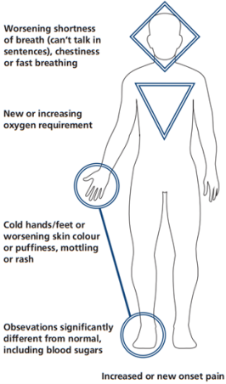
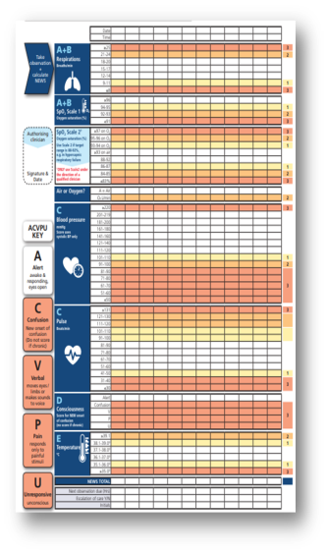
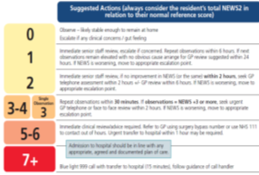
Making NEWS accessible
+
SBARD
Soft Signs
NEWS2
2019
Notes:
Soft Signs are not specific enough to be used alone
Soft Signs benefit from some sort of validation / quantification
Pre-requisite of NEWS is either regular observations or recognising concern
NEWS requires an entry point in community settings – no one wants to ‘medicalise’ people’s homes with routine observations every few hours like in hospital.
By recording a regular baseline and following the RESTORE2 NEWS2 escalation when someone is unwell, observations are done where they can add most value, and you might just save someone’s life.
Many people now do observations at home, but only when appropriate, not at regular intervals throughout the day, like in hospital.

Slide 22
When should we take physiological observations?
If your resident is displaying any unusual signs it is ALWAYS best to take a set of observations and repeat until you feel this issue has resolved. This way you can identify if a resident is becoming or is medically unwell.
Any exception to this should be outlined by a senior clinical decision maker, e.g. in end of life, agreed limit of treatment, treatment escalation plan or ReSPECT documentation
Raise your hands if you have heard of NEWS2 (National Early Warning Score 2). What is it?
Notes:
Check to know if participants have watched the HEE observations and NEWS videos.
Ask to know if they have experience of taking observation and using NEWS.
NEWS2 allows the carer to escalate their concern to a GP or another professional

Slide 23
COVID-19 pandemic in care homes
Recommendations from the British Geriatrics Society:
https://www.bgs.org.uk/resources/covid-19-managing-the-covid-19-pandemic-in-care-homes

Slide 24
The NEWS2 tool measures 6 vital signs or observations to determine level of illness via a overall score
Respiration rate
SpO₂ – Oxygen levels
Blood pressure
Pulse
Consciousness
Temperature
Notes:
NEWS2 is a standardised assessment tool, which gives an indication of how unwell the patient is.
Together the measurements gives a score of between 0 and 20
This is a common language across healthcare
Depending on the NEWS scores, staff using RESTORE2TM can escalate the patient’s care appropriately in line with an escalation plan.
NEWS allows the carer to escalate their concern to a GP or another professional.
Omit slides 16-22 if there is evidence of knowledge and or experience of taking observations. Jump to calculating NEWS score.

Slide 25
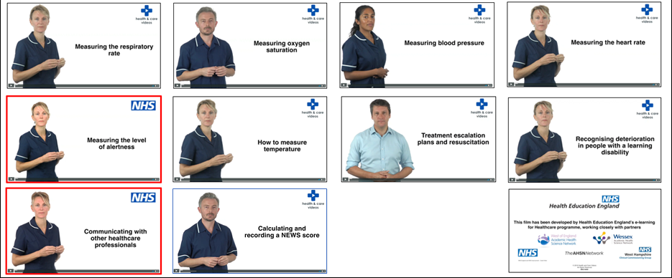
Take observations

Slide 26
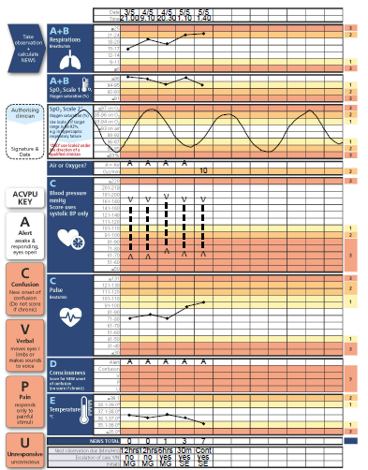
NEWS2 chart
A straight forward way of documenting an individual’s observations.
It allows you to quickly identify abnormalities and severity - leading to quicker and more efficient treatment.
Plotting each set of observations also identifies trend and allows you to see if an individual’s health is deteriorating.
What’s wrong with this chart? How would you handover the latest set of obs?
Notes:
Because RESTORE2 uses NEWS which is a standardised across healthcare settings, there is a common language that can support healthcare professionals to assess residents and communicate.
NEWS2 makes you go back and review your resident and start a conversation with another professional.
Video- NEWS: What is it? https://youtu.be/S-KWnrsOw8M (3:34sec)

Slide 27
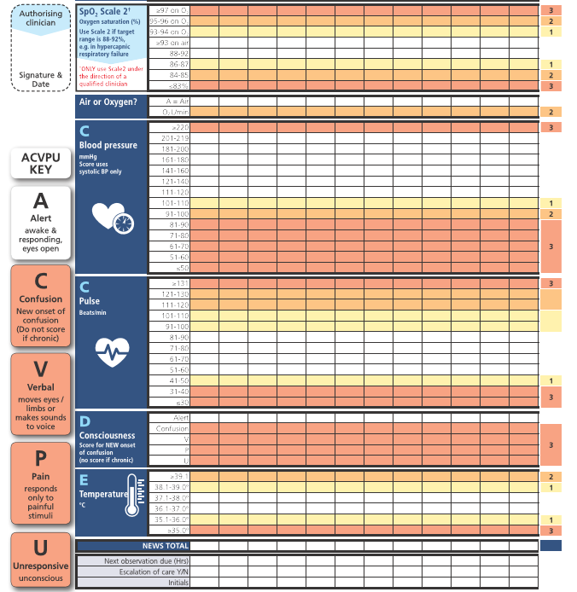
Added to NEWS2
Added to NEWS2
Notes:
SpO2 scale 2 and new onset of confusion. These are additions to the previous NEWS tool, hence the current tool is called NEWS2.
Additional guidance:
Confusion: If it is unclear whether the confusion is new or a normal state, it should be assumed to be new until confirmed to be otherwise
SpO2 scale 2: Only use for residents who have a prescribed oxygen saturation requirement of 88–92% (e.g. in patients who normally retain Carbon Dioxide and need to do this to drive their respiratory effort (hypercapnic respiratory failure) confirmed on blood gas analysis on either a prior, or current hospital admission. Decision for Scale 2 would have been made by a competent qualified clinician/clinical decision maker, and the decision recorded in the resident’s clinical notes.

Slide 28
SpO₂ Scoring scales- Oxygen levels
Taken by placing a device called an Oximeter over a person’s finger.
The Oximeter reading gives indication of the percentage of oxygen in the person’s blood.
Cold hands, anaemia, poor circulation, nail varnish or a dirty probe can prevent an accurate reading.
Use SpO₂ Scale 1 unless SpO₂ Scale 2 is authorised for specific residents by a competent qualified clinician/clinical decision maker, and the decision recorded in the resident’s clinical notes.
Residents requiring SpO₂ scale 2 will have a prescribed oxygen saturation requirement of 88–92% (e.g. in people who normally retain carbon dioxide and need to do this to drive their respiratory effort (hypercapnic respiratory failure) confirmed on blood gas analysis on either a prior, or current hospital admission.
To avoid doubt, clearly cross out the SpO2 scoring scale not being used
Normal adult parameters: 96-100%
Notes:
Measuring oxygen saturation https://youtu.be/QabKghrtXps (2:41sec)

Slide 29
Sp0₂ Scoring scales
2019
Notes:
Ref: Royal College of physicians National early warning score news 2 December 2017
Hypercapnia respiratory failure
hypercapnia (a high concentration of carbon dioxide in the blood) – main cause copd but are other causes

Slide 30
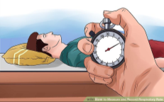
Respiratory rate
Is the number of breaths a person takes in a minute. Normal adult parameters: 12-20 breaths per minute. Always take RR over 60 seconds.
Should be taken when a patient is at rest, and done by counting the number of times a person’s chest rises.
Thought to be the most sensitive indicator of a patient’s physiological well-being
Elevated RR is a powerful sign of acute illness and distress
Reduced RR is an important indicator of central nervous system depression and narcosis
Notes:
Can omit if there is evidence of knowledge and/or experience of taking observation. Otherwise redirect to the HEE NEWS and taking observation videos

Slide 31
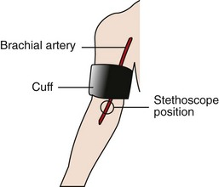
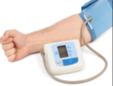
Blood pressure
Can be measured using two common methods:
Manually using a sphygmomanometer and stethoscope
Ensure the correct size cuff
Position the cuff around the upper arm ensuring the lower edge sits 1inch above the antecubital fossa (elbow crease)
Place the Stethoscope on the brachial artery (shown on diagram) and inflate to 180mmgHG
Slowly release the valve and listen to first sound (this is the Systolic, Second sound is the Diastolic )
Using an automatic inflation machine
Notes:
Can omit if there is evidence of knowledge and/or experience of taking observation. Otherwise redirect to the HEE NEWS and taking observation videos
Systolic blood pressure reading is used in calculating a NEWS2 score.
Picture normally available on cuff to remind about correct positioning.
Tip from colleague caring for people with learning disabilities: If caring for someone who is anxious about having their blood pressure taken, why not let them take yours first, or let them help (e.g. by pressing ‘go’ in their own time)

Slide 32
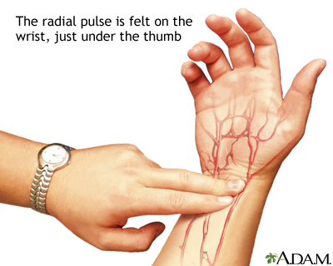
Heart rate
Measured in Beats Per Minute (BPM)
To measure a person’s heart rate you must first locate the radial pulse, located on the wrist under the thumb.
Once you have located the pulse count the beats for one whole minute
Normal resting heart rate / pulse: 60-90 BPM
Notes:
Can omit if there is evidence of knowledge and/or experience of taking observation. Otherwise redirect to the HEE NEWS and taking observation videos

Slide 33
Level of Consciousness
Measured via ACVPU (Alert, new Confusion, Voice, Pain, Unresponsive)
Alert – awake and responding, eyes open
Confusion (new) – new onset of confusion, including additional new confusion on top of chronic confusion
Voice – responds to voice but not spontaneously interacting, may be drowsy, keeps eyes closed, may not speak coherently
Pain – not alert and does not respond to verbal stimuli, responds to painful stimulus
Unresponsive – unresponsive, unconscious
2019
Notes:
Can omit if there is evidence of knowledge and or experience of taking observation. Otherwise redirect to the HEE NEWS and taking observation videos
Residents with acute illness may develop an acutely altered mental state, manifesting as new confusion, delirium or a Glasgow Coma Scale (GCS) <15
New confusion is an important sign of acute clinical deterioration requiring urgent clinical assessment
Acutely altered mental state may occur because of sepsis, hypoxia, hypotension or metabolic disturbances, either alone or in combination
If it is unclear whether the confusion is new or a normal state, it should be assumed to be new until confirmed to be otherwise
What challenge this may pose in residents with dementia?

Slide 34
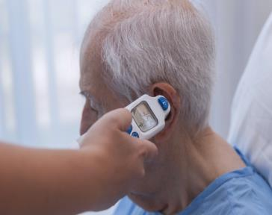
Temperature
Typically using a thermometer (e.g.“tympanic”) can help determine a person’s temperature
Both high and low temperature can indicate illness which is why both score with NEWS2
Useful in conjunction with other observations,
less useful on its own
>Drugs such as paracetamol can impact temperature
NEWS2: normal adult body temperature: 36.1°C-38.0°C
Notes:
Can omit if there is evidence of knowledge and or experience of taking observation. Otherwise redirect to the HEE NEWS and taking observation videos
Normal body temperature is different for everyone and changes during the day.
A high temperature is usually considered to be 38C or above. This is sometimes called a fever.
Many things can cause a high temperature, but it's usually caused by the body fighting an infection.
Note: If you feel hot or shivery, you may have a high temperature even if a thermometer says your temperature is below 38C.

Slide 35
Screen/ comfort break
Notes:
3-5mins screen or comfort break.

